Slide 1
Faculty Activity Reporting with Faculty 180
Faculty Candidate
Required Actions – A Step by Step Guide
Purdue University Northwest

Slide 2
Please make sure you use Google Chrome
Get to the PNW Home web page and
Select the ”Search” icon.
Type “Interfolio” and click on enter key.

Slide 3
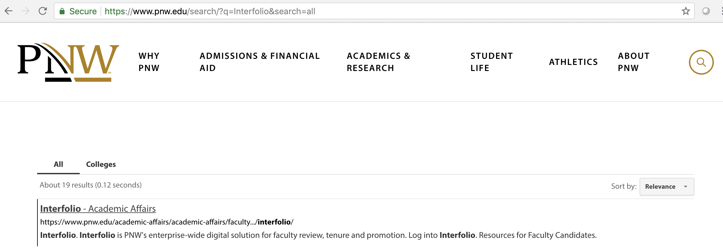
Select “Interfolio – Academic Affairs”

Slide 4
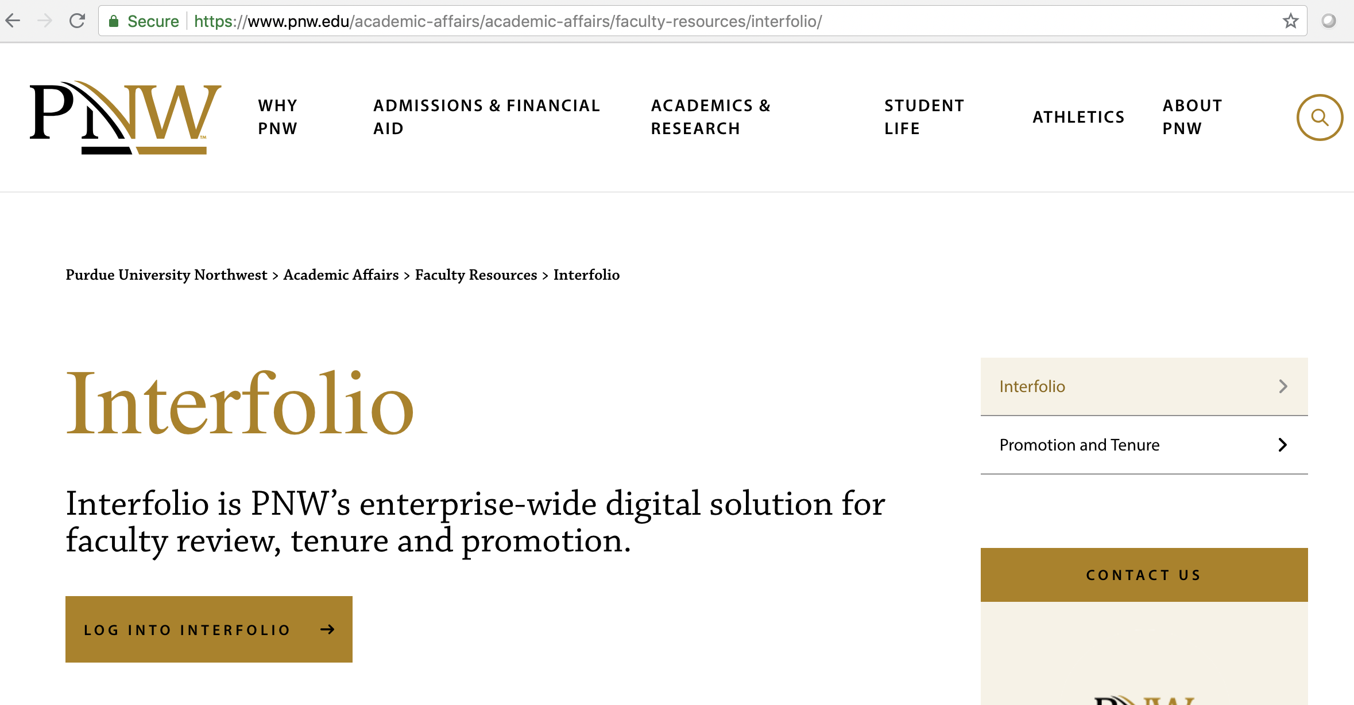
Select “Log Into Interfolio”

Slide 5
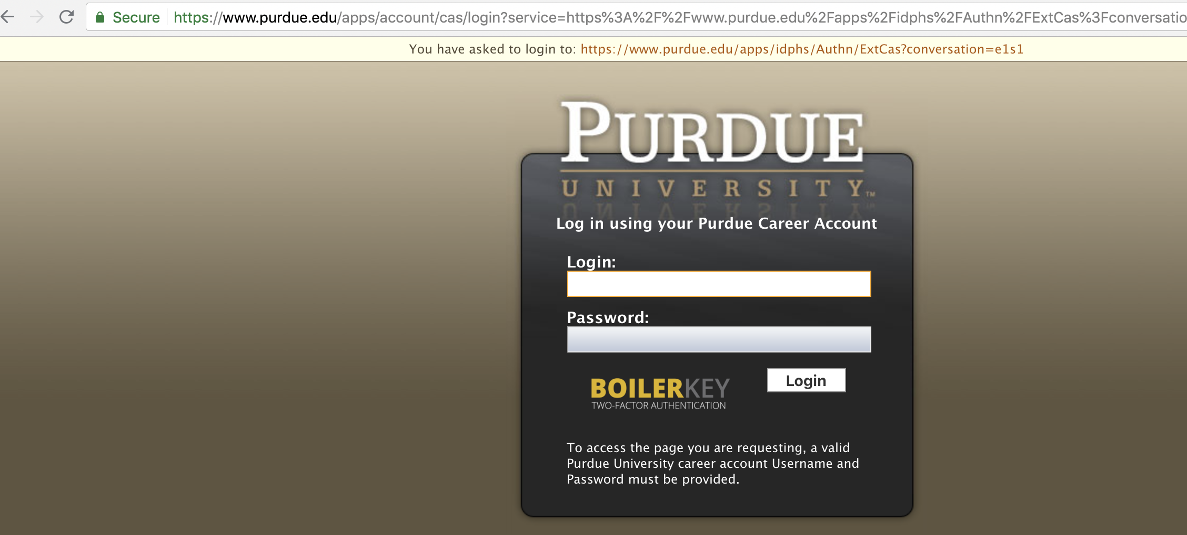
Log in with your PNW Career Account and Boiler Key

Slide 6
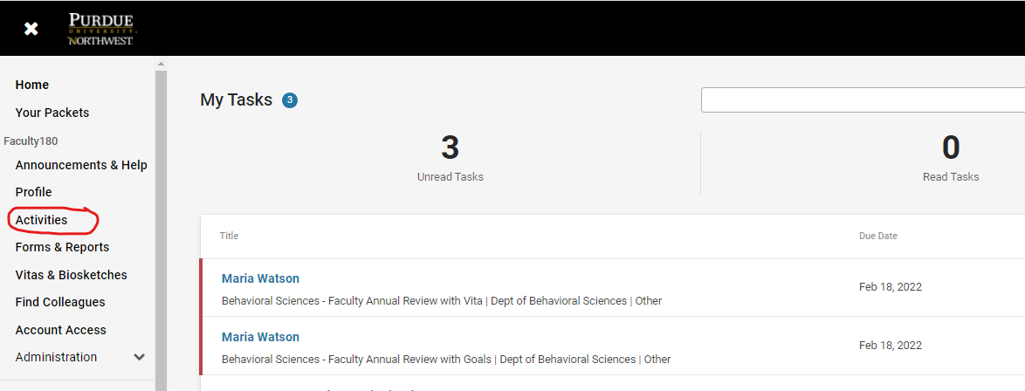
To add documentation throughout the year, please select “Activities”

Slide 7
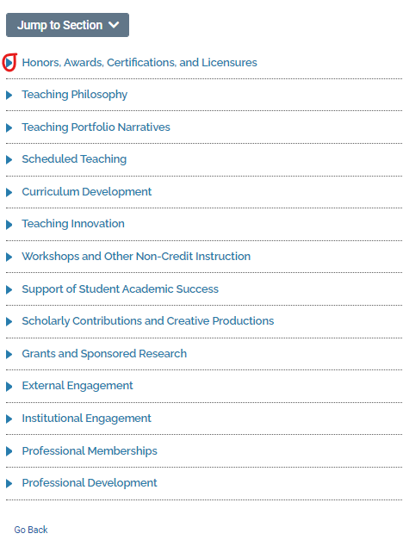
To add your activities, please click on the arrow to the appropriate section

Slide 8
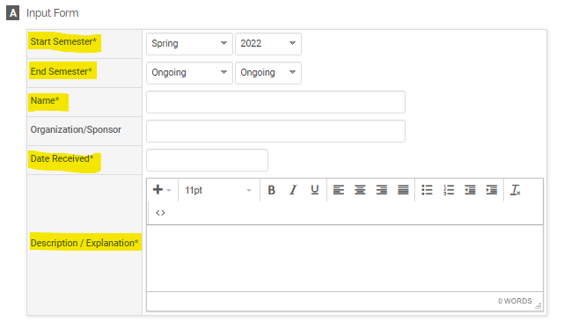
Select “Add”
Follow the prompts making sure you complete all the sections with an asterisk * as these are required fields.

Slide 9
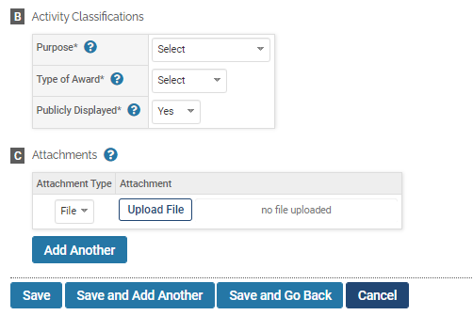
If you need to add more than one, select “Save and Add Another”
If not, then select “Save and Go Back” to complete adding the rest of your activities to each section
ALWAYS CLICK “SAVE”

Slide 10
Here is where you will start to upload or add your scholarly contributions and creative productions via a manual upload or importing them in the system.
Please click on the blue arrow head to open the criteria box.

Slide 11
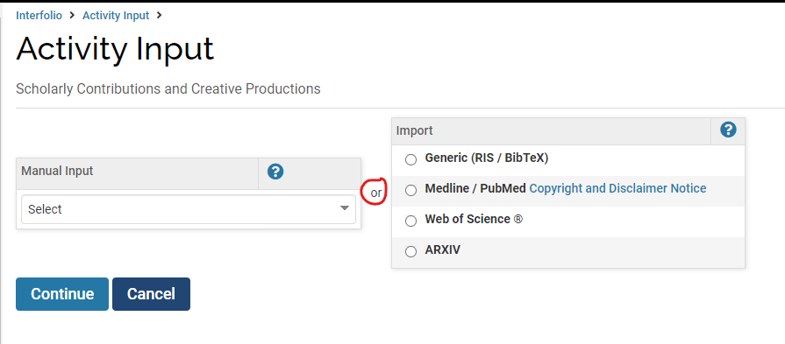
Please select the “Add” button
Here is where you can import your scholarly contributions.
If you are entering a manual input, select the appropriate category from the dropdown arrow and select “Continue”
Here is where you can manually input your scholarly contributions.

Slide 12
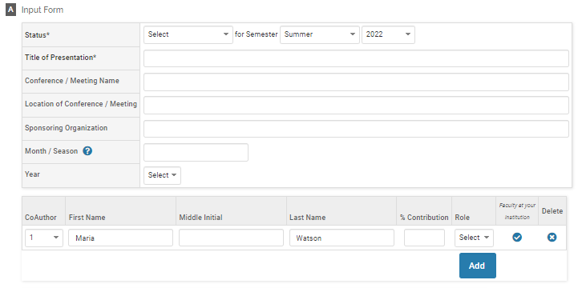
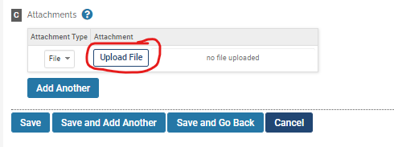
Please complete the sections that are marked with a * as these are required fields
Please note that each activity section may have more than one required field and they are all not depicted in this help guide.
Any attachments can be uploaded
When you are done, please either “Save and Add Another” if you are entering more manual entries or “Save and Go Back” to get back to the Activities list

Slide 13
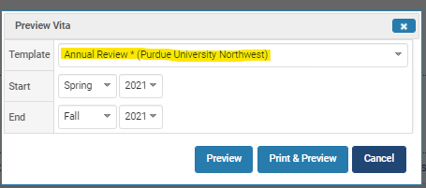
When you’re done adding all your information, you can preview your Annual Review Vita.
This is the point where you can still make edits and changes to your information before you submit.

Slide 14
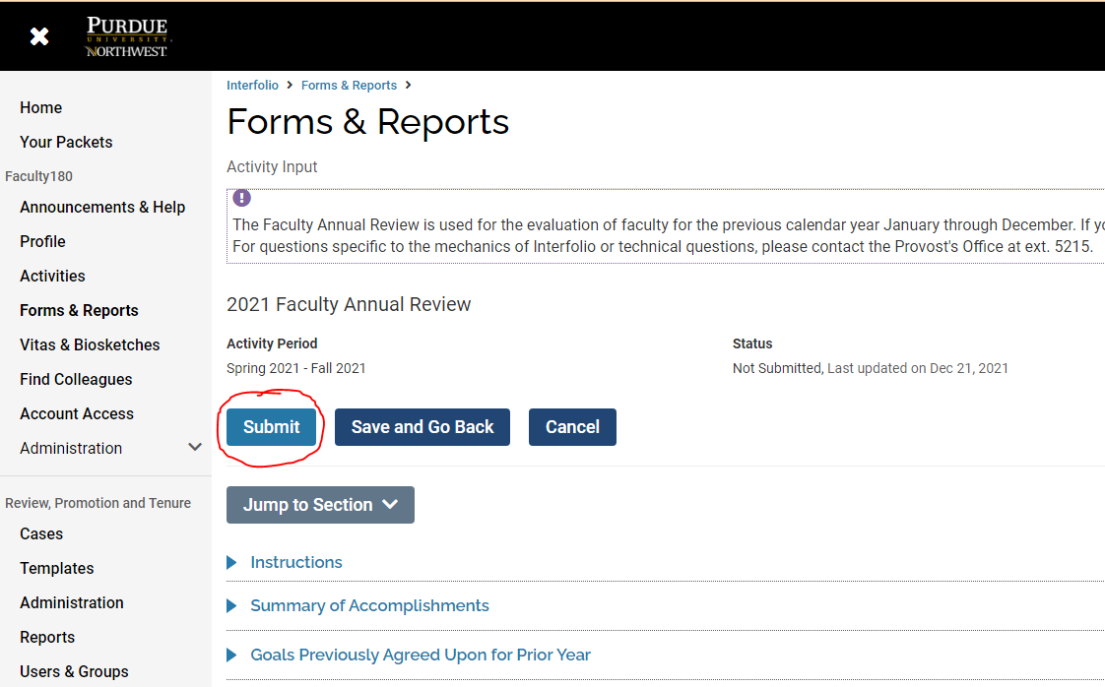
If you are satisfied with your entries and wish to make no further changes or edits, please click on “Submit.”
This concludes Part 1 (Faculty Input) of the Faculty Annual Review process.

Slide 15
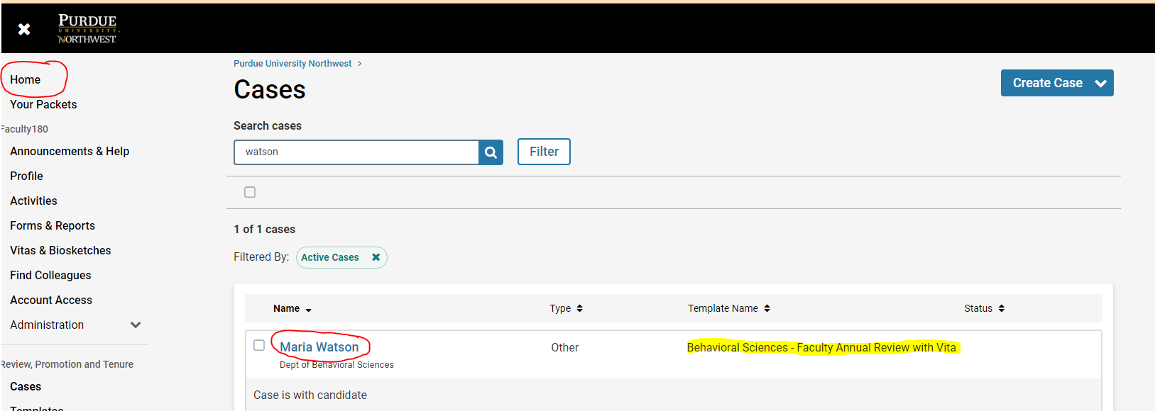
Part 2 of the Faculty Annual Review Process (Work Flow for Review by Department Chair):
After you “Submit” your Faculty Annual Review through the FAR module, please click on “Home.” You will see a case that has been created through the RPT module. You will see your department name highlighted. Click on “Faculty Annual Review with Vita.”

Slide 16
Please click “Packet”
To upload your Vita, please click on “Regenerate”. Your Vita will upload from the Faculty Annual Review Module with the current date.
Please click “Submit” so your department chair can view your submission.
You have completed your Faculty Annual Review

Slide 17
How to find support:
For assistance with these tasks, please contact the VCAA’s office at x5215.
Interfolio’s Scholar Services team is available to help provide one-on-one support if you have trouble with anything technical with the software.
Email them at help@interfolio.com
They can also be reached by phone at (877) 997-8807 between 9am and 6pm ET, Monday - Friday

