Slide 1
WELCOME TO accounts payable TRAINING
*Please silence your microphones
*Please make sure your audio is set appropriately to accommodate headphone or speaker accordingly.
1

Slide 2
Mission, Goal & Vision
Our Mission is to provide guidance, support, training, and resources to assist Purdue Northwest staff with processing invoices.
Our Goal is to perform our due diligence in providing timely responses to inquiries, keying invoices as provided to us, and setting up/changing vendors.
Our Vision is to maintain data integrity, compliance, and financial stewardship for Purdue Northwest

Slide 3
Agenda
New & Review – Let’s Get Started!
Pg. 1 – WELCOME!
Pg. 2 – Mission, Goal & Vision
Pg. 3– AGENDA
Pg. 4 - SECTION ONE – EXPECTATIONS & RESPONSIBILITIES
Pg. 5 – Programs and Procedures
Pg. 6– Return address for VOIDED checks
Pg. 7.8 – Department Responsibilities when placing an order
Pg. 9,10,11– INVOICE – Due Diligence
Pg. 12,13,14– Importance of Processes
Pg. 15,16– Cyber Threats
Pg. 17 – Important Key Factors When Updating Vendors!
Pg. 18 - SECTION TWO – FORMS
Pg. 19 – Electronic Signature
Pg. 20- DIV
Pg. 21– HELD Check
Pg. 22– Credit Memo
Pg. 23, 28– Payee Certification Form (Power Form)
Pg. 29 – Outside Entity Exception Form
Pg. 30 –Substitute W-9
Pg. 31– ACH Form
Pg. 32 –Wire Transfer Form
Pg. 33– SECTION THREE – ONE-TIME VENDOR
Pg. 34– Prospective Employee Reimbursement
Pg. 35 –One-Time Vendor Spreadsheet – Excel Format
Pg. 36,37,38 - One-Time Vendor Request Types
Pg. 39 – SECTION FOUR – OTHER PAYMENTS TYPES
Pg. 40 –Nonresident Alien Payments
Pg. 41 –Glacier Form
Pg. 42– “Other” Payments Training
Pg. 43 - Prizes and Awards
Pg. 44– Non-Employee/Employee Reimbursement
Pg. 45 – CASH ADVANCE
Pg. 46 - SECTION FIVE - CHARTS
Pgs. 47 through 57 – Accounts Payable Payment Processing Charts
Pgs. 58,59,60 – Accounts Payable Website
Pg. 61 – Things to Remember/Special Thanks/ Web Site / Email Address

Slide 4
Section One-Expectations & Responsibilities
Programs and Procedures
Return Checks/VOIDED
Provide Standard Expectations
Identify Potential Errors
Minimize Fraud
Payment Responsibilities
Changes Ahead – Stay Tuned!

Slide 5
Familiarize yourself with the following programs and procedures:
DocuSign – Docusign has many features for payment processes and necessary forms and functions. Please familiarize yourself with navigating Docusign, especially the area of DIV entry, removal, etc.
Filelocker – Email is not an encrypted secure method of sharing a vendor’s personal information. Tax Documents containing names accompanied by addresses, social security numbers (considered RESTRICTED data), bank account numbers, etc. should NOT be sent through your PNW email account to anyone including Accounts Payable.
Purdue IT Services –This link will provide you with useful information for all of Purdue’s popular services.
Microsoft Teams – This is AP’s most efficient and effective tool of choice for training. You should familiarize yourself with this program to enable future training and assistance.
Payee Certification Power Form– This form is done through our website and is not trackable until it appears back in your queue. Please familiarize yourself with this process. Please note the process:
Initiator (Department Rep. ) Consultant (Vendor) Supervisor (Department Head ) Initiator (Department Rep. )
Notes:
In order to perform your responsibilities efficiently and effectively, please familiarize yourself with the following:

Slide 6
RETURN/VOIDED/CREDITS
SEND CHECKS TO: The address listed on the left of the screen.
Make sure that the account and GL number are indicated on a post-it note when sending, so that the check can be returned to the correct account.
___________________________________________________
*Question: What should I do if my vendor says they didn’t receive a check?
*Answer: – Check the Due Date on the invoice to see if the payment is overdue. Then, send an email to PNWpayables@pnw.edu with the VENDOR’S NAME,INVOICE NUMBER and AMOUNT. We will then let you know if your vendor should have received the check by now or if they should be expecting it soon. If we determine the check to be overdue, we will initiate a stop/payment/rewrite process on the vendor’s behalf.
Purdue University
Accounts Payable
2550 Northwestern Avenue Facility 2550 Northwestern Avenue, Suite 1100 West Lafayette, IN 47906 United States

Slide 7
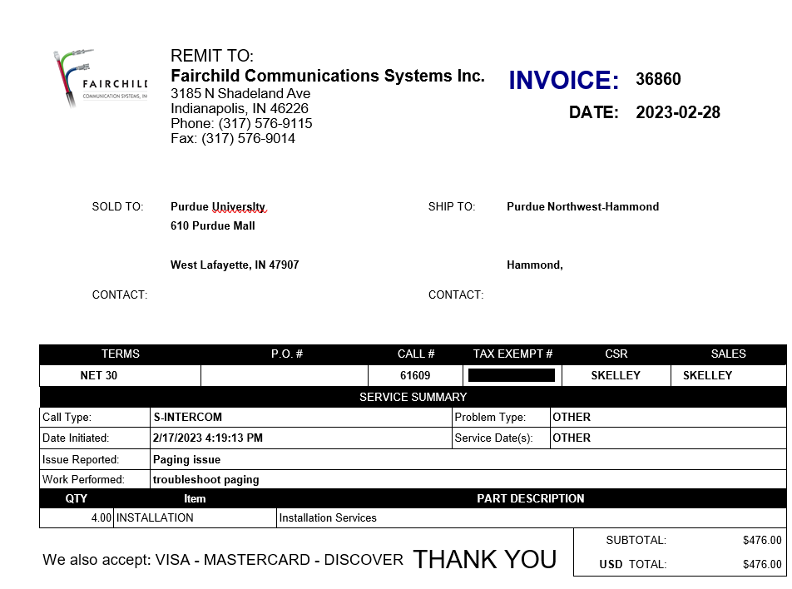
Accountability – Ensure Vendor Knows Where to Send Non-PO Invoices
How departments can help avoid delays in
processing invoices:
Provide the vendor with the following important information when placing your order:
Your Department Name
Contact Person Name (Who placed the order?, Who should receive the invoice?)
Contact Address (PNW address, Your Building/Room location)
Contact Phone Number (Your Phone Number, not the number for AP)
If you have placed your order through ARIBA and it has an ARIBA PO # 45XXXXXXXX on the invoice and Procurement has informed you to pay it through AP instead, the reason for the exception must be indicated on the DIV prior to sending it through the approval process. This allows AP to know it is not a double payment.

Slide 8
Payment Responsibilities
Due Diligence – Invoice/Contract: Ensure Documentation will Support the Payment
Supporting Documentation must be sufficient to answer the following questions:
Who is the payment for? Vendor Name?
What is the payment for? Brief explanation of expense?
When is the payment due? Actual Due Date? Terms of Payment?
Where is the payment going? Remittance Address?
Why/How is Purdue responsible for this payment?
MUST SUBSTANTIATE FOR AUDIT REVIEW – Purdue Does Not Make Payments to Third-Party Vendors.
The invoice must be addressed to Purdue and have Purdue as the entity responsible for payment.
Examples of supporting documentation:
Agreements
Approvals
Contracts
Emails
Invoices
PC Form
Notes:
When you call and ask will this get through the system, think about it like this, if internal audit randomly pulls your Docusign in 9 months to review, will the information included allow them to understand and substantiate without questioning anything? They won’t be speaking to you in person like I am right now. Will you remember in 9 months without perfect documentation?

Slide 9
Payment Responsibilities
Due Diligence – is it an actual Invoice?
Examine documents closely and look for key words:
Quote, Estimate, Pro-forma Invoice - Projection of Costs for Ordering Purposes
Order Detail, Summary, Acknowledgement - Confirmation of Order/Service
May not reflect accurate total
May not include correct payment terms or remittance instructions
Statements - Observation of Outstanding Invoices (example on next slide)
May not reflect recent payments *
May not include details of purchase/service
May not include correct payment terms or remittance instructions

Slide 10
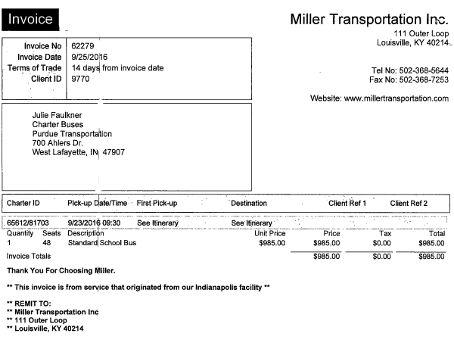
Payment Responsibilities
Due Diligence - Is it an Invoice? Did the company charge tax?

Slide 11
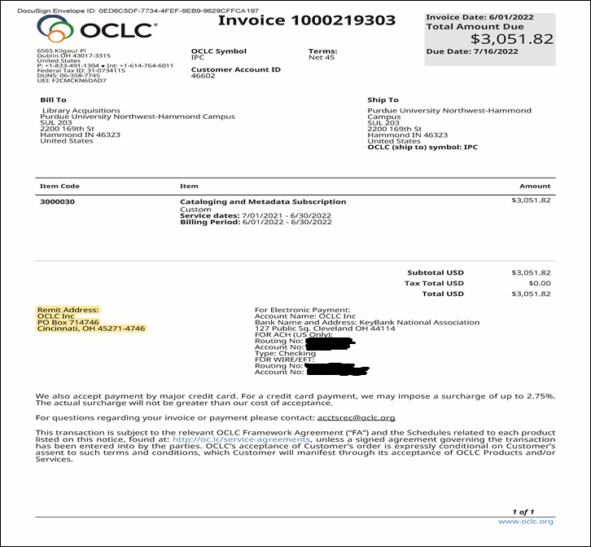
Please make sure you are using the correct remittance address on your DIV. This is important for AP to process your payment. Even if it is a direct deposit, the remittance address must match what is in our system. *When you are checking on payment status, please refer to the TERMS on the invoice prior to contacting AP. The invoice may not be due. *Also, when requesting payment status, please include the name of the vendor and the invoice number and always send your request to pnwpayables@pnw.edu.

Slide 12
Importance of Processes
Provide Standard Expectations - Requirements for Keying a Payment
Invoice Number – AP always must key the invoice number exactly as it appears on the invoice. If it goes over the *15-character maximum, we will have to determine at that time how to reduce it.
Allows Purdue Northwest staff to retrieve or research information
Assists Vendors in applying payments correctly per state/unit/etc.
Prevents duplicate payments
(If missing, use standard & unique value to identify the payment)
Invoice Date - Always key the date the invoice was created by the vendor
It is used by Vendors to apply payments correctly
Missing Date: Use Date of Order/Service
Accuracy of invoice date prevents early/late payments
Using correct invoice date can prevent duplicate payments

Slide 13
Importance of Processes
Identify Potential Errors & Understand Effort Required to Correct
More Effort and Time | Less Effort and Time
Duplicate Payments Incorrect Vendor Number Not An Invoice *Sent to Incorrect Bank Account ARIBA Invoice Multiple Invoices Paid Fraud Incorrect Amount Sent to Incorrect Address *Incorrect Payment Method Used Missed Discount | Immigration Typo No Invoice Attached Attached Incorrectly Insufficient Documentation Incorrect Invoice Date Incorrect Invoice Number Late Payment Incorrect Baseline Date Attachment is Illegible Incorrect Document Type Used Extra Invoices/Documentation

Slide 14
Importance of Processes
MINIMIZING FRAUD
Tax form - Individual
No white-outs or cross-outs are allowed on tax documents
If completed in two or more ways (I.E., partially typed and partially handwritten) use the outside entity exception form as to why this occurred.
Individuals must complete their own Sub W-9 to ensure up-to-date and accurate information.
Ensure dashes are in the correct place for the TIN (Tax ID number).
EIN, Employer Identification Number (XX-XXXXXXX) Please ensure this is a 9-digit number.
SSN, Social Security Number, is being used. (XXX-XX-XXXX) Please ensure this is a 9-digit number.
Tax form - Corporation
No white-out or cross-outs
If completed in two or more ways (I.E., partially typed and partially handwritten) use the outside entity exception form as to why this occurred.
Corporations must complete their own W-9 and ACH to ensure the information is up-to-date and accurate.
Ensure dashes are in the correct place for the TIN (Tax ID number) Please ensure this is a 9-digit number.
EIN, Employer Identification Number (XX-XXXXXXX) Please ensure this is a 9-digit number.

Slide 15
Be Aware of Common Cyber Threats
Phishing
Pretends to be a trustworthy source to acquire sensitive information
Victims may be subject to malware or identify theft
Defense:
Hover over questionable links to reveal the true destination;
Beware of cloned websites (watch for https);
Report suspicious email to abuse@purdue.edu
Spoofing an Email Account or Website
Making the source look like a reputable source
Cybercriminal uses tools that mask the source/sender; relies on our lack of attention!
Defense: carefully read incoming emails for the proper email address; hover over sender's name to see underlying address; contact sender directly if email or phone number is questionable.

Slide 16
Data Security
Why Should I Care About How Data Is Handled?
Often, we become desensitized to the data that we handle in our everyday job. However, somewhere someone is handling your information, where it be your SSN (Social Security number), your bank account information or other private information. Handle someone else’s data how you’d like your data handled.
Why are we doing this?
Reinforce our procedures
Protect Purdue resources
Protect Purdue’s reputation
Protect Purdue and YOU!
Others?

Slide 17
Important Key Factors For Updating Vendors
Banking Verification Form Process:
To prevent fraud attacks, the Banking Verification Form and the associated email confirmation that a verbal conversation took place with the vendor is completed by the PNW Payables Team.
Address Change – Vendor Verbal Confirmation Process: The Verbal Verification Process with the vendor regarding an address change is executed by the PNW Accounts Payable Team.
ZEMP Org Records – EMPLOYEE – Changes made in Success Factors DO NOT update in SAP. These records are for Concur payments. When an employee changes their banking in SuccessFactors, it does not change in SAP for reimbursement purposes when being paid through the DIV process. It does update in CONCUR. Therefore, when a reimbursement is made through the DIV process to an employee and they have made a banking change, PNW Accounts Payable does not have access to this information and the reimbursement will continue to go to the old bank account unless PNW AP is informed of this change prior to the reimbursement and makes a banking change request to the employee vendor record in SAP. However, if the employee chooses to be reimbursed through CONCUR, the updated banking information should automatically carry over from SuccessFactors to the CONCUR system. An email from the employee, including contact information, should be sent to: pnwpayables@pnw.edu instructing them that a banking change has taken place along with the date of the change and their name as it appears in SuccessFactors. This will allow us to verify the PUID and request this change be made in SAP.
BLOCKED VENDOR: AP will ask the Department to request a W9. Please ask the vendor for the current email and phone number. We are required to have that information as well as the W9 when submitting the request to unblock.
We ask that Departments please inform vendors that PNW Payables Staff will be requesting this information, as this step is required prior to processing payments to the vendors. Your assistance in informing the vendor prior to us contacting them regarding their sensitive data is essential to making this process an effective one.

Slide 18
Section Two – Forms
Electronic Signature
DIV
Held Check
Credit Memo
Payee Certification Form
Outside Entity Exception Form
Substitute W-9
ACH
Wire Transfer Form

Slide 19
Electronic Signatures
Obtaining an original signature from vendors has become more difficult, with several vendors being unable to provide an original signature due to their remote working environment.
Effective October 1, 2023 authenticated electronic signatures were acceptable on W-9s, Purdue's Sub W-9, and Purdue's EFT/ACH form. An authenticated signature is created through electronic software that includes a security procedure designed to verify the signature is for the specific individual signing the document.
It is imperative to remember that restricted data cannot be sent via email. We should not initiate a Purdue DocuSign to collect this restricted information. All staff must remain compliant with Purdue's data handling requirements ensuring restricted data is safely shared among peers utilizing Filelocker.
Example: Carol J Wright
This is NOT an authenticated electronic signature !!!!!

Slide 20
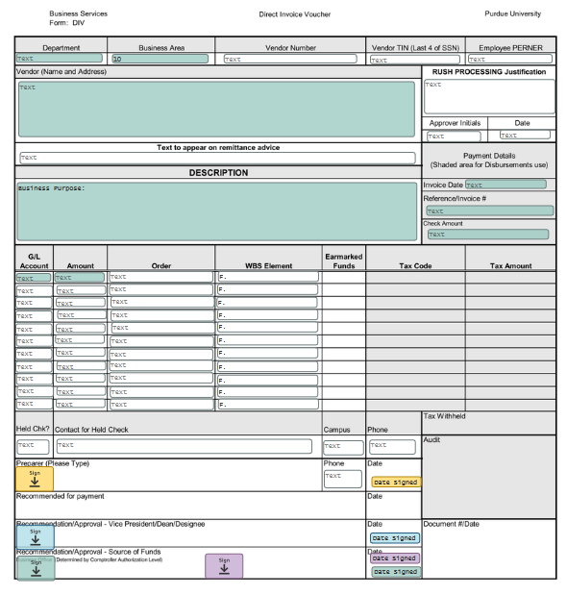
Instructions for DIV
*Vendor- Type the name of the company and the remit address per the invoice
*Your department and the business area should auto-populate.
*Text to appear on remittance is optional- This is where you would include any account number or invoice number that you wish to be written in the note section of the check.
*Invoice date- Date listed on the Invoice or date of purchase if it is a receipt
Reference/Invoice #- The invoice number listed on the invoice when applicable, or your own identifier accompanied with the following: REIMB09282020JD(reimbursement) SRVC09282020JD(Service), STIP092820JD (Stipend) 15-character space maximum ONLY
Check Amount- The current total amount to be paid
Description- Write a brief description of what services were provided or what items were purchased
GL- Business Office ( Account Coordinator ) will assign the appropriate GL number
Amount- the amount of the charge. If the charges need to be paid by different accounts, then you will need to enter separate lines.
Order- This is where you include the account number(s) you wish to use. Example: 320000XXXX
WBS Element- This is used when your desired account number begins with F.XXXXXXXX.XX.XXX
Employee PERNER: This is the user ID number listed in SuccessFactors.
Docusign link for further instructions :
DocuSign Template Training

Slide 21
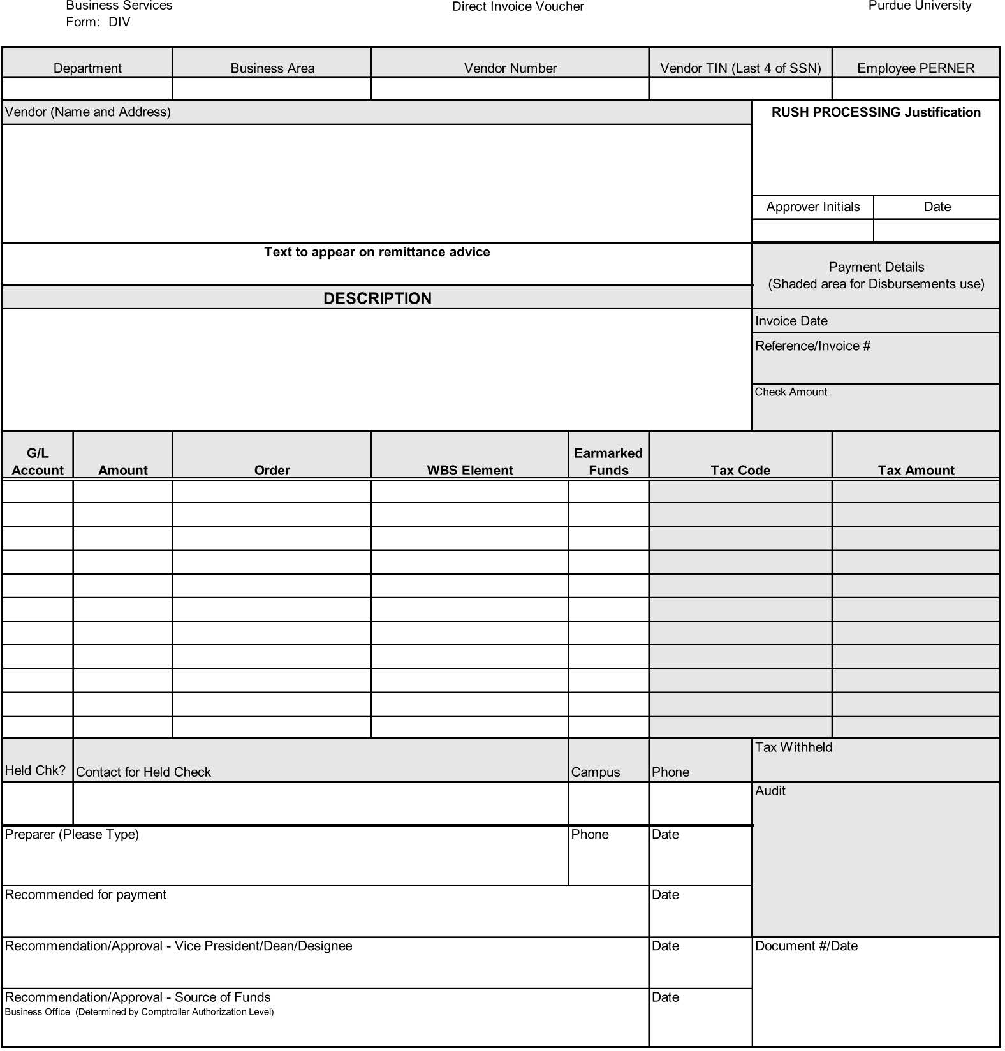
Held Check
EXAMPLE: Held Check Information
This information is necessary for West Lafayette to contact you to obtain information regarding your “send to” location preference. Please DO NOT include your location information in this space.
YES
Carol Wright cwrigh@pnw.edu 219-785-5238 PNW

Slide 22
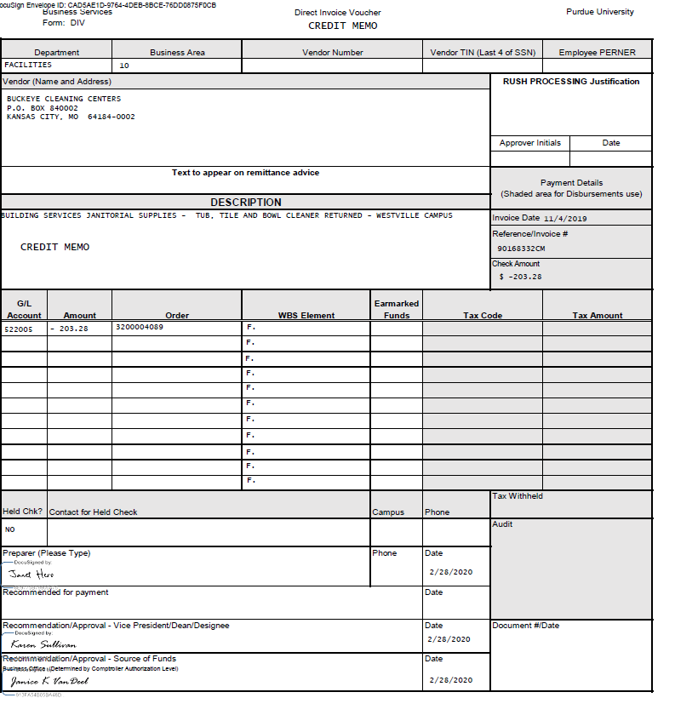
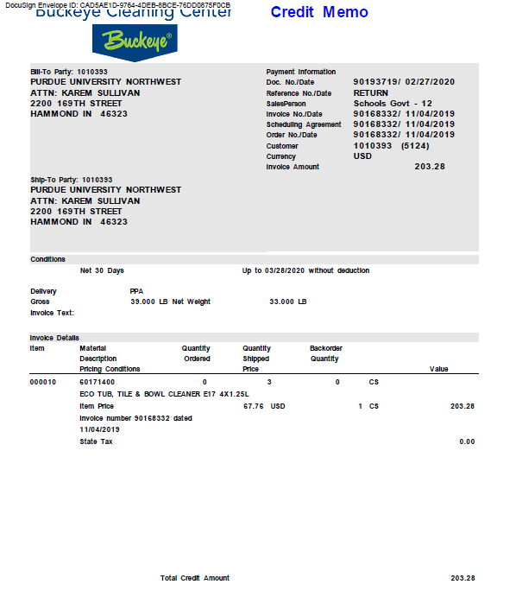
Example of a Credit Memo DIV
Example of a Credit Memo DIV
Notice the added text box at the top of the page. Please also add Credit Memo in the description area. Everything else is entered as a regular DIV.
This must be attached in your DocuSign for processing. Notice that it states at the top that it is a Credit Memo, and the credit amount is listed at the bottom.
*Please indicate the credit in the amount section as ($203.28)

Slide 23
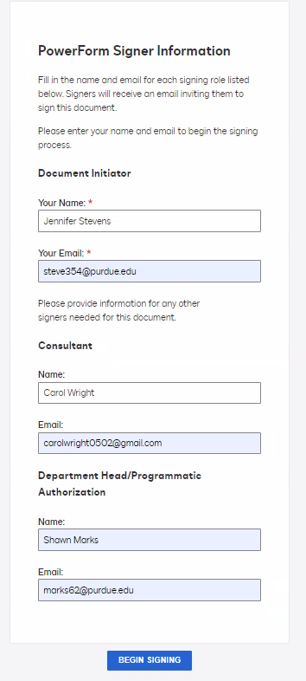
PowerForm Format
PowerForm Process
The document begins with you@purdue.edu. It advances to your vendor aka consultant. It then advances to the approver usually a supervisor departmenthead@purdue.edu. It then comes back to you@purdue.edu. Everyone must be aware of their role in the process for it to be successful.

Slide 24
Initiator Form Flow ( Department Representative )

Slide 25
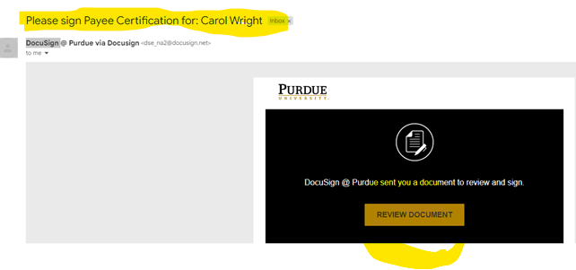
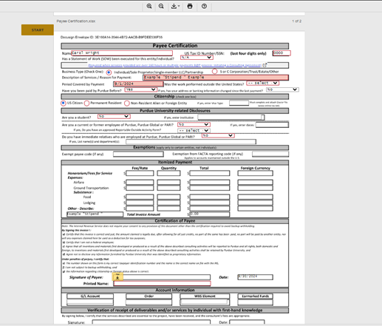
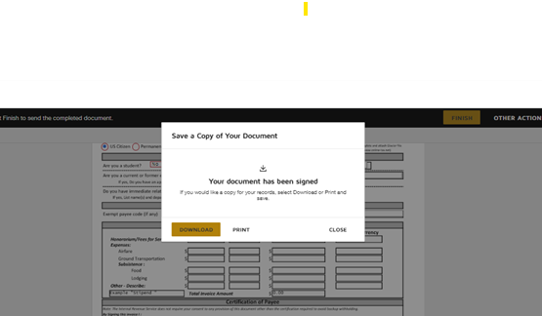
The Consultant / Vendor view This is what the consultant/ vendor would receive, they would then complete their areas on the payee cert. form. The consultant/ vendor clicks finish and then it is complete.

Slide 26
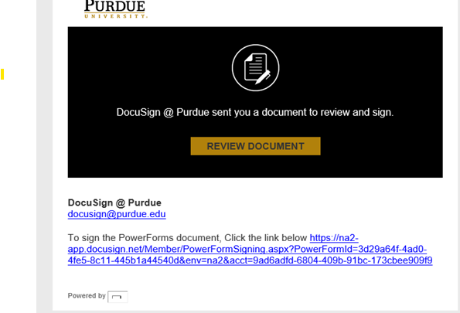
The Final Approver (Department Head/ Supervisor ) Your department head will receive this email to review the document, they sign the payee certificate, and it then is rerouted back to you.

Slide 27
Final view of the Power form You will receive the email below stating to view the completed document.

Slide 28
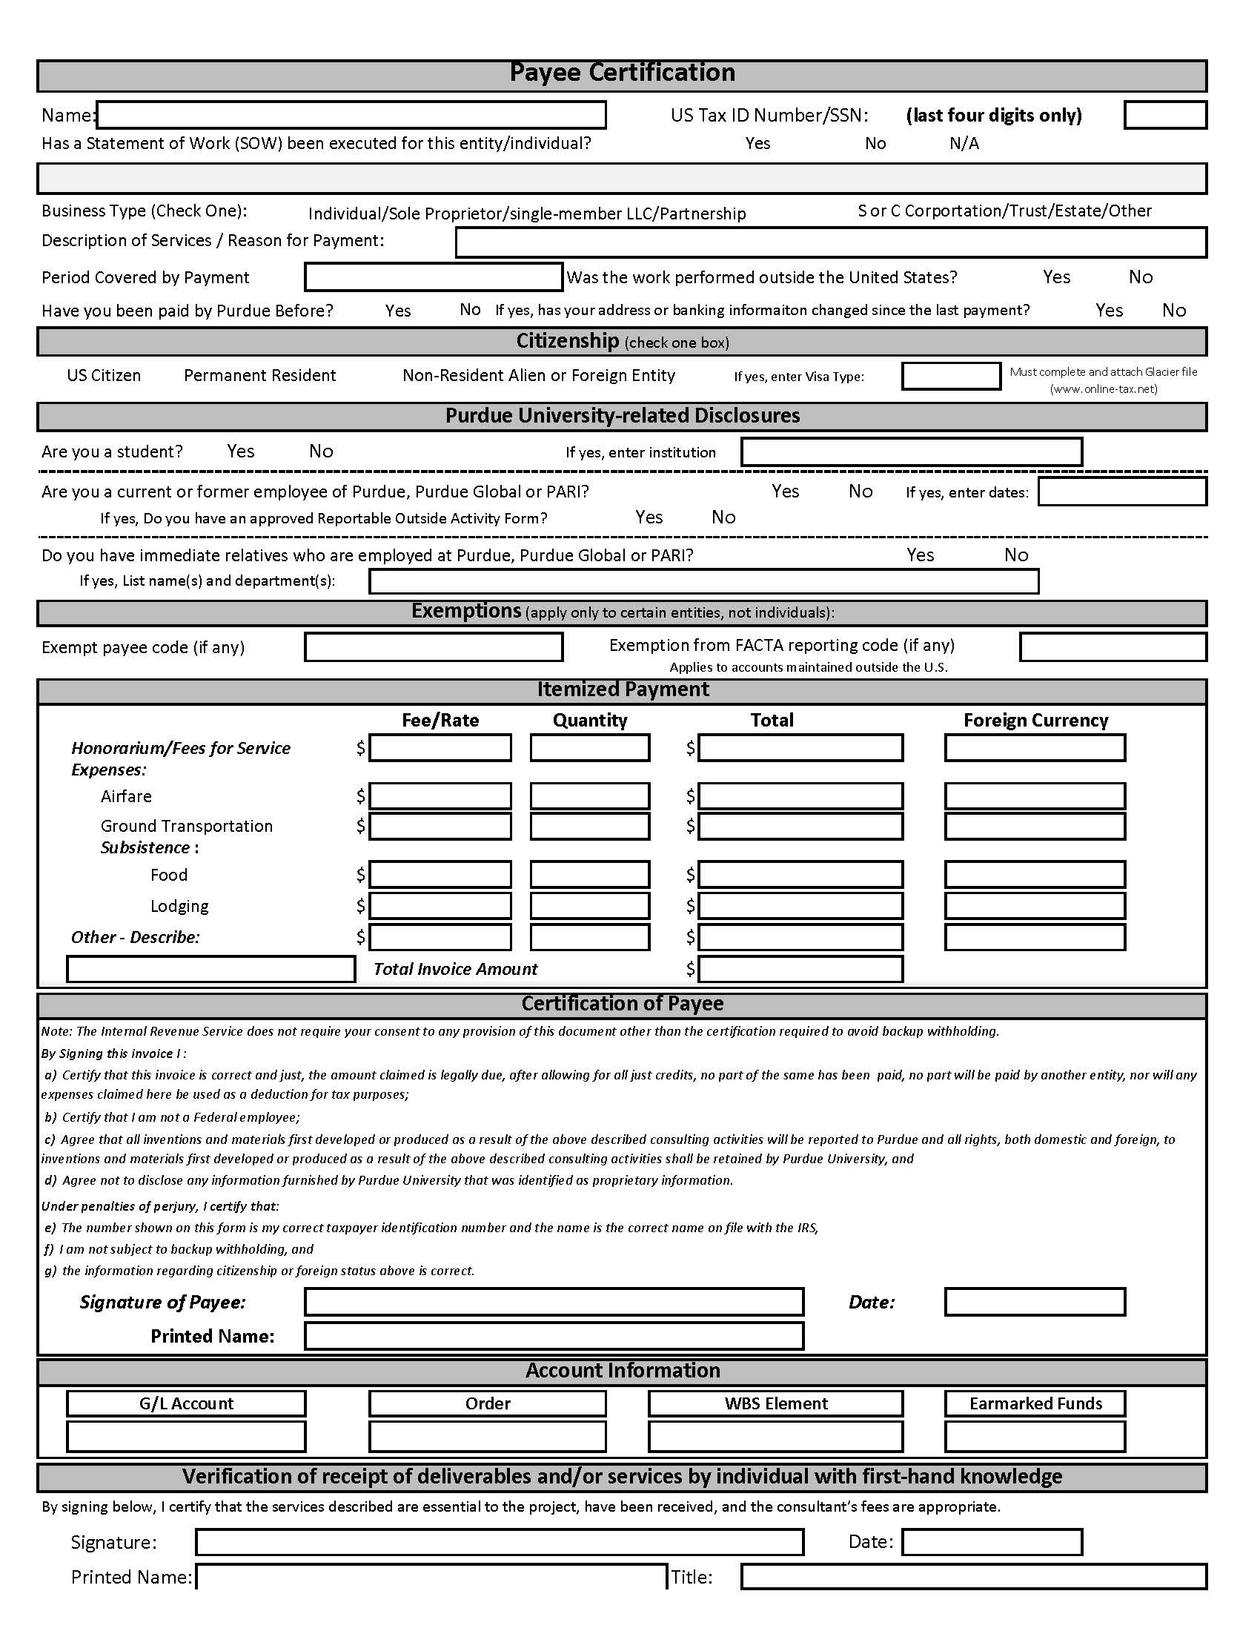
PAYEE CERTIFICATION POWER FORM
This form needs to be completed for sole proprietors, single-member LLCs, and individuals who are NOT Employees/Grad Assistants and have not been identified as one-time vendors by the AP Department.
A copy of the Professional Services Agreement needs to be attached to the DIV being processed through DocuSign if the Statement of Work has been executed for the entity/individual.
If VISA Type is F1, a Glacier packet should be included.
The information provided by the Payee is used to confirm all information is updated in the Tax Department in the SAP accounting system prior to processing payment.
When putting in the email addresses of employees, it is best to use: …..@purdue.edu
*The Docusign will appear in the email of the approver as: Docusign@purdue.edu
The GL will be placed on the Payee Certification Form by the Account Coordinator – DO NOT complete this area! Consult your Account Coordinator on how to add a text box for them to complete this information.
https://PowerForm Payee Certification.docusign.net
When NOT using the Power Form Process, the Payee Certification Form is to either be handwritten or all typed.

Slide 29
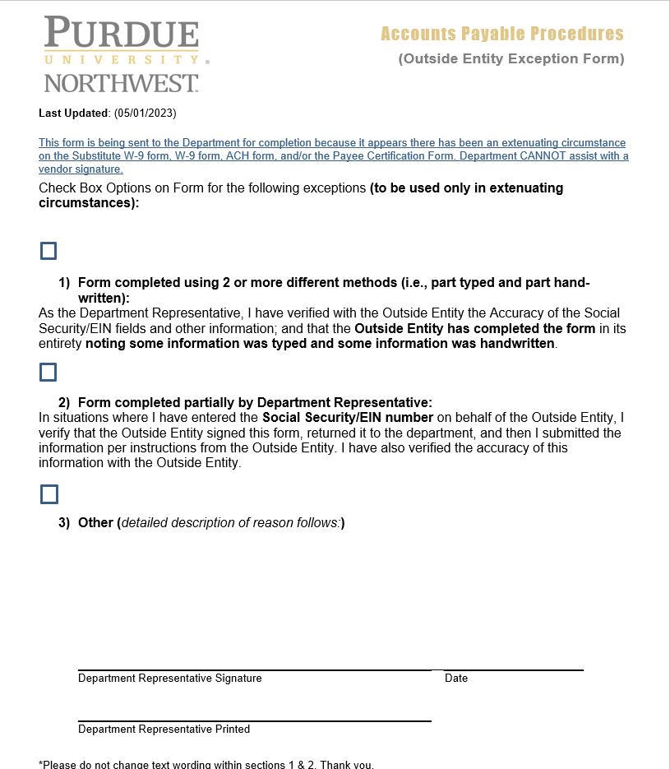
If for some reason the student and/or individual cannot or is not capable of completing parts of the Sub-W9 on their own, they may give you the information and you may do it for them under one of the listed extenuating circumstances. HOWEVER, YOU MAY NOT SIGN THE SUB-9 ON THEIR BEHALF. Please remember, by utilizing this form, you are taking responsibility that the information contained herein is correct as given to you by the vendor.

Slide 30
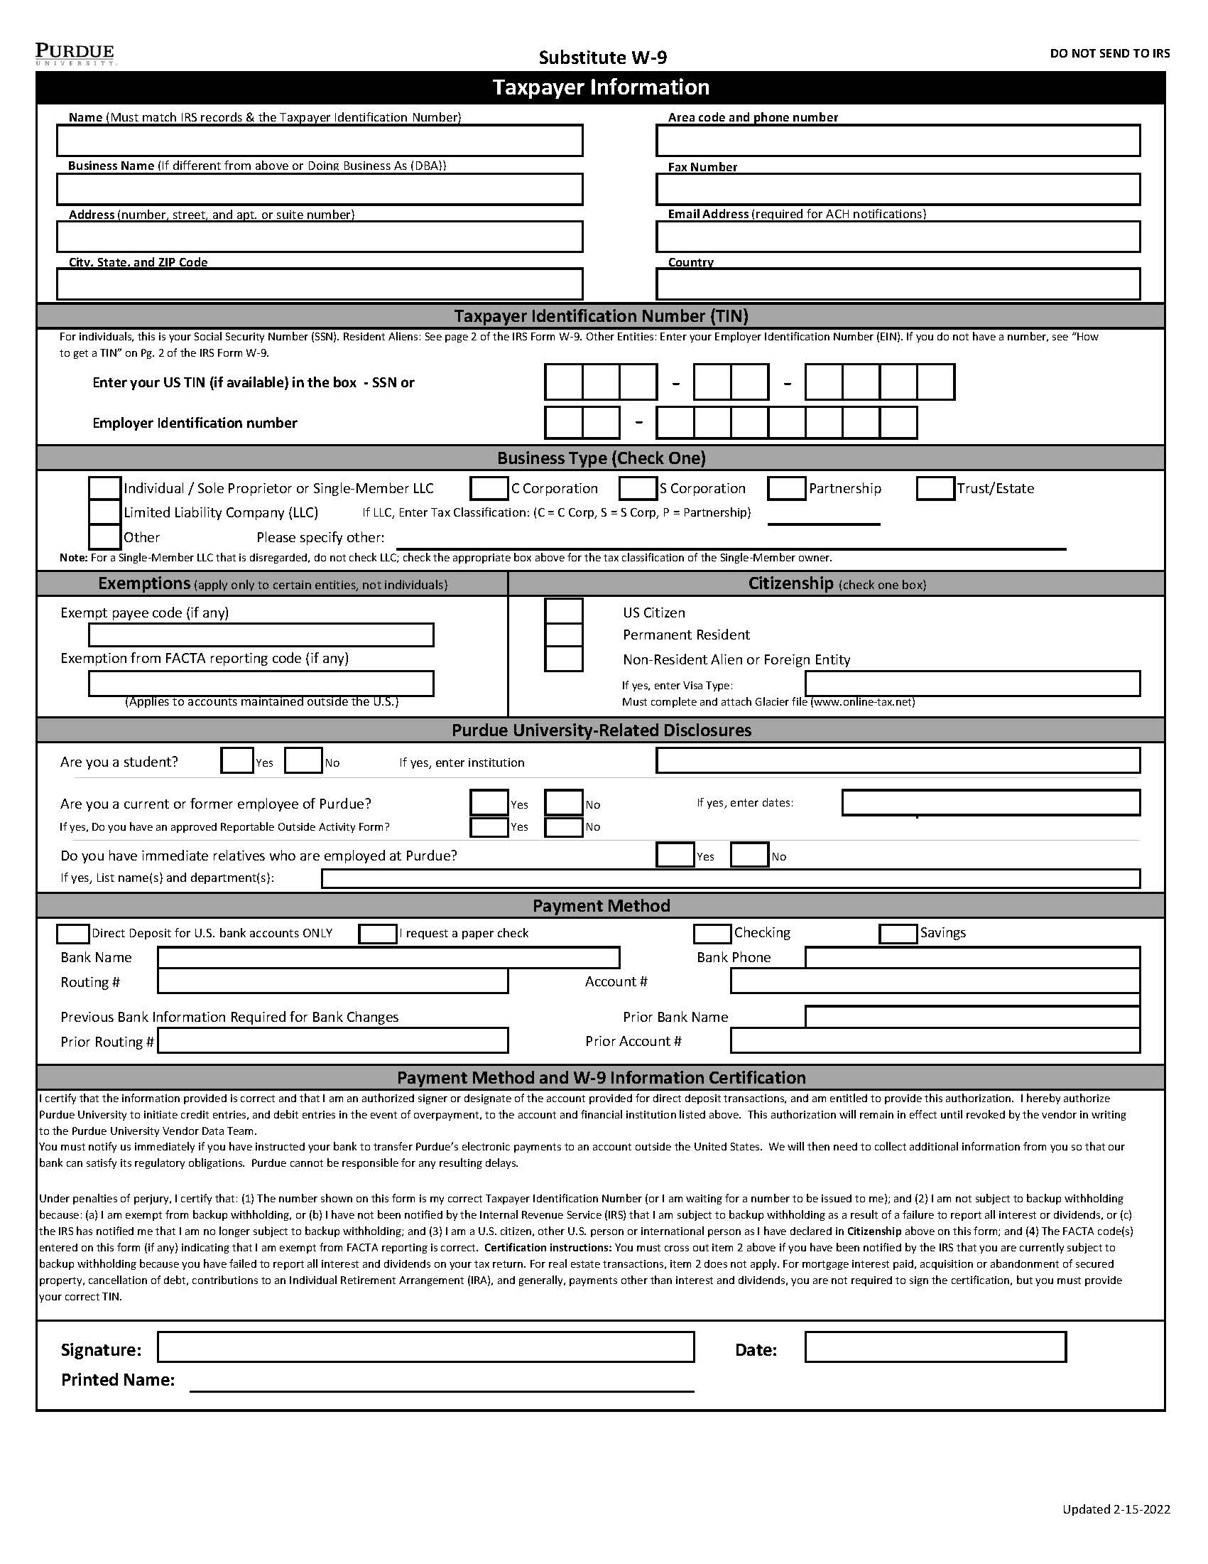
Substitute W-9
This form is necessary for all new or changes to, a current individual or sole proprietor, or single-member LLC. This form is to be completed exclusively by the vendor.
We NEED to have a Banking Phone Number from the Vendor! This area may not be omitted.
The Vendor needs to complete the following :
Taxpayer Information
Taxpayer Identification Number
Business Type
Citizenship
Purdue University –Related Disclosures
Payment method
The information on this form is used to set up the vendor in the SAP accounting system. This form would be needed for current vendors if there is a change in their Citizenship, Name, Address, TIN#, Banking Number, or Business Type.
Also, please be sure to work with your staff to advise that we can not RUSH payments to vendors.
Substitute W-9
**No areas may be left blank on the form. This form may not be altered.

Slide 31
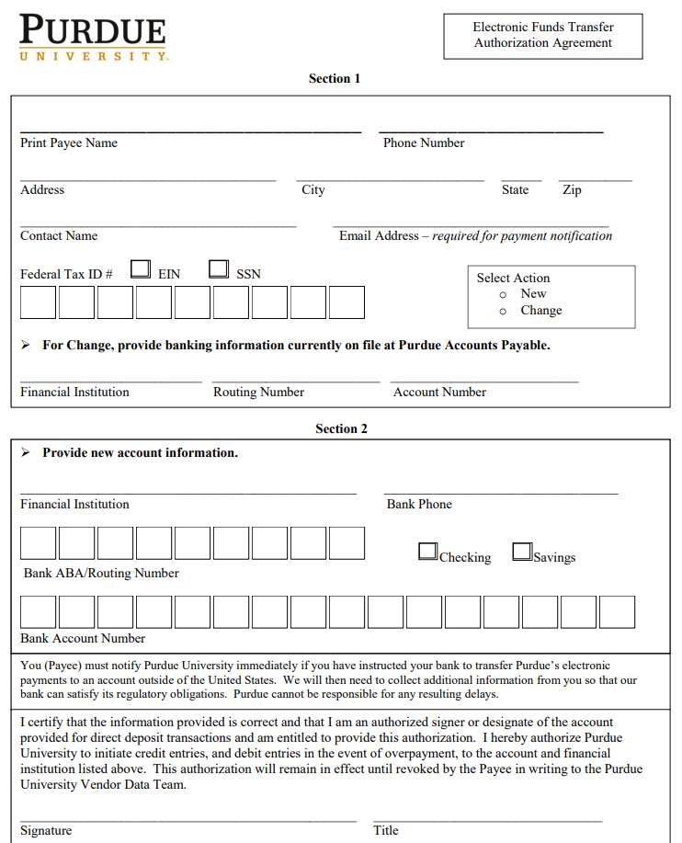
ACH Form
This form is necessary for Electronic Funds Payments. Accounts Payable can’t
accept the information written on an invoice as official banking information.
This form is used in conjunction with a W-9 Form for non-personal payment vendors/payees.
An ACH is an electronic funds transfer. This method is less costly and safer than other methods of payment.
Instruction for ACH
The form is required for Direct Deposit payment.
This form is required if the vendor is a new vendor, or their banking or ACH has changed.
Check the box to indicate NEW or CHANGE
Complete all of section one. Name, address, phone and email contact for remittance notification.
If a Change, the vendor must provide banking information that is on file at Purdue.
Section Two: ALL the information needs to be completed with the new account information.
REMINDER:
We NEED to have an EMAIL ADDRESS to perform the following: NEW/CHANGE vendor set up for BOTH corporation and individual.
Even if the NEW/Change Vendor DOES NOT CHOOSE ACH/Direct Deposit Banking – An EMAIL ADDRESS & VENDOR PHONE NUMBER ARE still REQUIRED to establish the vendor.
IRS W-9 Form ACH Form

Slide 32
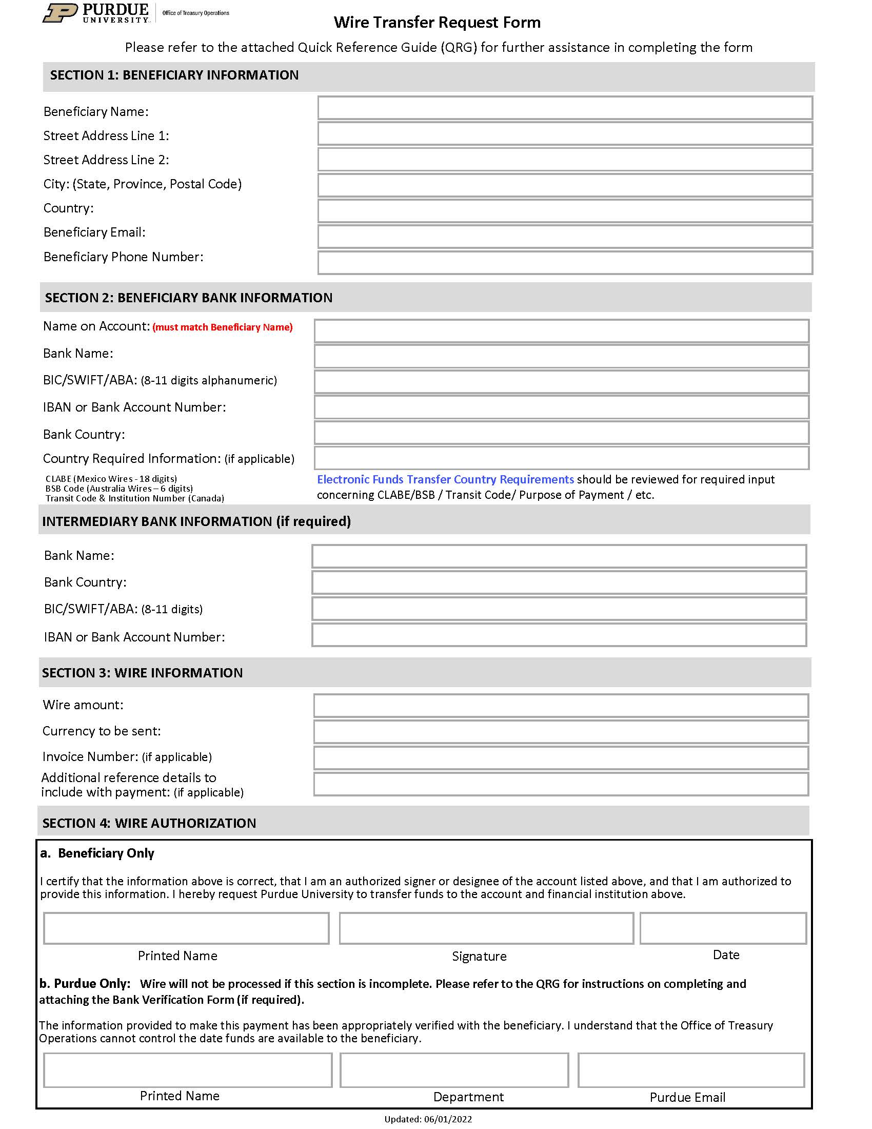
Wire Transfer Form
This form is used when funds are being sent from one account to the other with the bank being the “liaison” instead of the ACH.
A Wire Transfer Request Form and supporting documentation need to be attached with each payment request.
All International payments must be made via wire transfer if non-domestic banking.
Reminder that if setting up the vendor as a new Foreign Vendor, AP will need the W-8BEN-E or W-BEN depending on the vendor type.
Foreign Software purchases, licensing and services performed within the US, may be subject to a 30% tax withholding upfront required by the IRS.
Please contact your Business Manager with any questions pertaining to the Wire Transfer Process.
Wire Transfer Request Form

Slide 33
Section Three - One-Time Vendor
Form 17C
One –Time Vendor Excel Spreadsheet

Slide 34
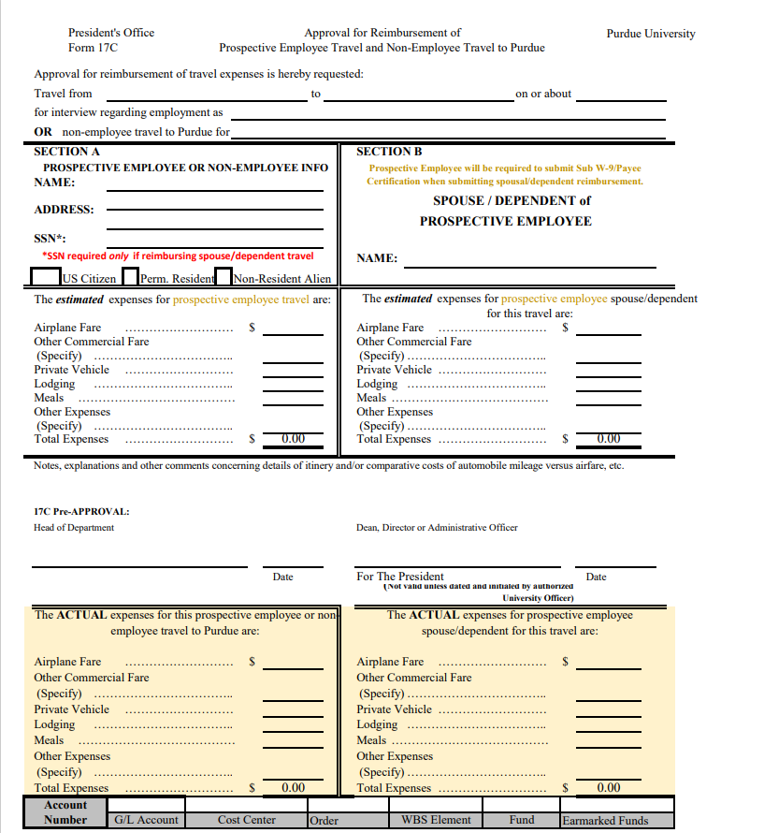
Prospective Employee Reimbursement
Prospective Employees visiting the campus to interview for a position may be reimbursed for some of the trip's associated expenses. Prior approval to reimburse these expenses is obtained by processing Form 17C, “Approval for Reimbursement of Expenses for Prospective Employee Interview Trips.”
A Social Security Number is needed if the spouse or other dependent accompanies the prospective employee. Any payments made to reimburse the expenses for the spouse or dependent are taxable.
If the vendor is requesting a check payment, then no other documentation is required. A Payee Certificate IS NOT required for a Prospective employee.
If a vendor is requesting a direct deposit, the vendor fills out the Sub W9.
Notice the “ACTUAL” expense area has been added to the form.
Form 17 C

Slide 35
Example
EXAMPLE
Enter Company Code (PUR or ARI) | PUR
Reference Related Semester/Year | SPRING 2022
Date of Form Submission | 3/22/2022
Brief Description | Vet Hospital Customer refund
Vendor Type (from list to the left) | 3
Request Type (from list below) | 1
Held Check(s)? Yes or No | Yes
Held Check(s) Contact | Terry Staff 494-4444
The One-Time Vendor Spreadsheet is requested by AP and is sent to the department to complete and return in the original Excel format. The responsibility falls within the department for obtaining and storing the necessary backup documentation. * For Direct Deposit, we need a Substitute W-9 ONLY.

Slide 36
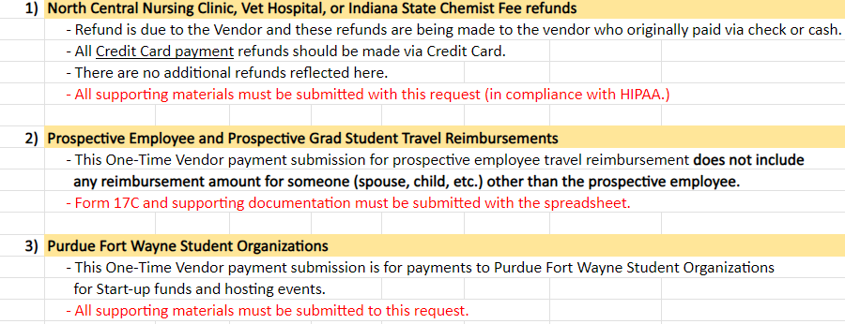
Request Types

Slide 37
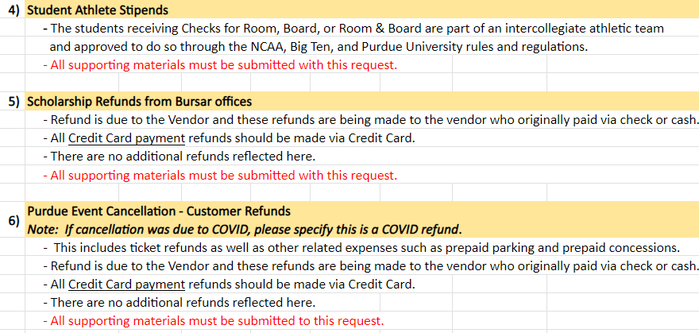
Request Types

Slide 38
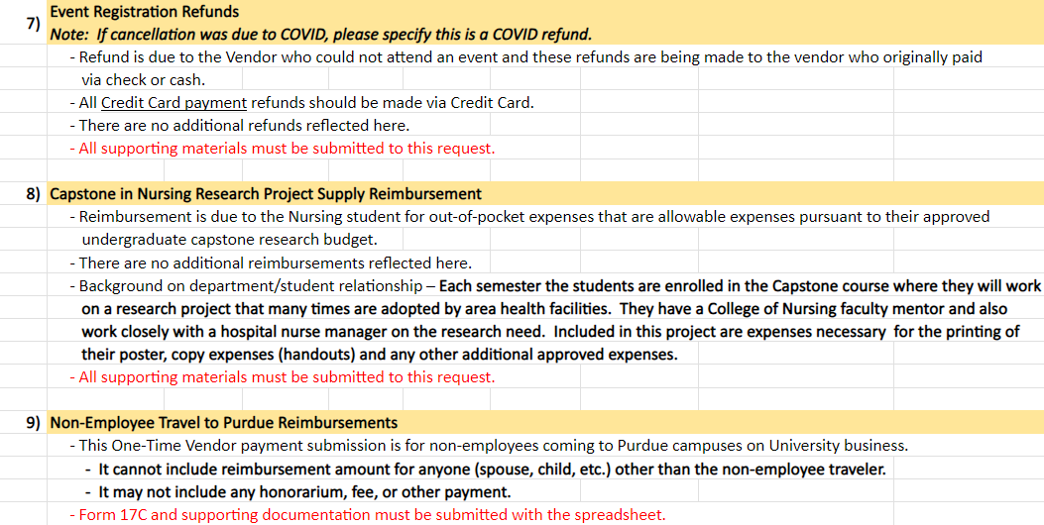
Request Types

Slide 39
Section Four – “Other ” Payments
Non-Resident Alien Payments
“Other ” Payments Training
Prizes and Awards
Non-Employee / Employee Reimbursements
Cash Advances

Slide 40
Non-Resident Alien Payments
Non-residents must complete a Glacier packet for payment to be received. For a non-resident to access the Glacier software, a link is sent, via email, by a Glacier administrator.
Each payment request must have a Tax Summary Report attached and all the pertinent documents as listed on the Summary (lower right corner). (
All international employees must have a Glacier account and must receive an access email link from a payroll or employment center staff person to create an account.
Please contact Jane Coleman, colema33@purdue.edu with any Glacier related questions.
Glacier Software Link
PLEASE NOTE: For a Prospective Employee Non-Resident Alien which is considered a ONE-TIME VENDOR by Accounts Payable, a Glacier packet is not required.

Slide 41
Tax Summary Report
This is an example of the Tax Summary Report; the highlighted areas are what will be required by the vendor to provide. Any questions need to be directed to
Jane Coleman at colema33@purdue.edu.

Slide 42
“Other” Payments Training
Alcoholic Beverages for University guests and the staff or faculty who host them at University functions MUST go through PRF and not through Accounts Payable.
Table Sponsorship – Example: Sponsoring a table for 10 to attend a dinner function…..this may be questioned by Accounts Payable to see if it will most likely go through PRF. Please check with your Business Manager before submitting your Docusign.
Foreign Vendors – Depending upon the trade agreements with the foreign country and tariffs in place, if your department uses a foreign country for software purchases, software licensing, or services/work done in the US, the vendor should be prepared to pay as much as a 30% tax upfront. (It could be a lesser amount; it may be not at all! It depends on the country and the trade agreement in place) The vendor could receive as much as 30% less than the amount on their invoice. If the software is being used in the United States or the vendor is working in the US, you may need to obtain Glacier forms for this foreign vendor and work with your Business Manager PRIOR to submitting your payment through Docusign. In doing so, this will allow you to determine, with the help of the TAX Dept in WL, whether-or-not there will be a tax and if so, how much money needs to be withheld upfront, and then you are able to consult with your vendor PRIOR to the sale in order to allow everyone to be aware of how much the vendor will receive and if you want to proceed with the transaction. Please remember that Purdue is obligated by federal law to withhold that tax upfront. You and your vendor need to preplan for these types of scenarios.
Please be aware that using a P-card to try to avoid the Foreign Vendor Tax scenario will not work. The same rules apply to using your own credit card.
Contact: Jane Coleman at colema33@purdue.edu for all foreign vendor questions and concerns. She is the expert and can assist with all foreign vendor advice and protocol.

Slide 43
Prizes and Awards
Non-employee individuals who receive an award or prize and are U.S. citizens, Resident Aliens or Permanent Residents, payment is made via the DIV-DocuSign Process and a Payee Certification Form would be required. If it is a new vendor/payee, then all pertinent forms are required.
If non-employee international individuals receive a prize or award, payment would be made via the DocuSign process and Glacier documentation would have to be attached.
The Tax Department will determine the tax coding.
HONORARIUMS for EMPLOYEES RELATED TO WORKSHOPS
If the EMPLOYEE is performing the duties related to instruction or participating in instructing the workshop, etc., this payment would be paid through PAYROLL. If the EMPLOYEE was one of the teachers/instructors invited to attend and receive the instruction, this payment would pay out through ACCOUNTS PAYABLE.

Slide 44
Non-Employee Reimbursements
Employee Reimbursements
If a non-employee is being reimbursed, original receipts (if possible) should be submitted. A Payee Certification Form will need to be attached and a clear explanation of the business purpose for this expense should be provided. (If this Payee is not currently in the AP system, all pertinent paperwork will be required.)
If the non-employee is international, a Payee Certification Form would need to be provided along with the appropriate Glacier documentation. Original receipts (if possible) should be provided. If foreign currency is used, a currency conversion chart must be attached. For mileage, a route map displaying miles traveled must be attached. (If the Payee is not currently in the AP system, all pertinent paperwork will be required.
Please remember to attach the contracts, etc., so that the TAX Dept in WL can view the legitimacy of the expense and not question whether it is a maverick spending situation.
Please DO NOT attach photos, blank pages, unrelated documents, and AD copies to your Docusigns! These unnecessary documents take up too much space on the “drive”. If your department needs to see them in order to approve the expense, please make this arrangement prior to going through Docusign, if possible.
Employee expense reimbursements do not require a Payee Certification Form. They do require original receipts (if possible).
If an original receipt is not possible, a Certification for a Missing Receipt should be completed. Missing Receipts
A PNW business purpose needs to be clearly stated that explains the reason for the expenditure.
If business travel expenses are being reimbursed, CONCUR should be utilized.
This includes Virtual Registrations as well as in-person, mileage, etc…(This includes regular employees, grad student employees and active under-grad student employees.
Concur-Employees and Departments can contact West Lafayette Travel if they need assistance creating a travel expense report. purduetravel@purdue.edu
Please remember to list all attendee/participant names and the business purpose for the dinner receipt reimbursements. (Example: Chairperson takes candidate and three additional faculty out to dinner for business purpose.)
Please also remember the importance of anonymity on behalf of our students per FERPA regulations. As is the case with Restricted data, we also hold our students’ privacy to these same high standards. Please do not identify an attendee/participant as a student.
This same anonymity standard should be in effect for DIVS containing personal medical testing information for employees due to HIPPA regulations.
Please make sure that you have indicated on your DIV in the PERNER area, the PERNER number and/or indicated on the DIV in the Description area that the individual is an EMPLOYEE.
Notes:
Speak about proper documentation, adding blank pages, or ads. The w9 only need that pages, not all 12 pages.

Slide 45
CASH ADVANCE
Contact the Travel Department in West Lafayette. Cash Advances Regulations
Employees must go through Concur for Cash Advances.

Slide 46
SECTION FIVE CHARTS

Slide 47
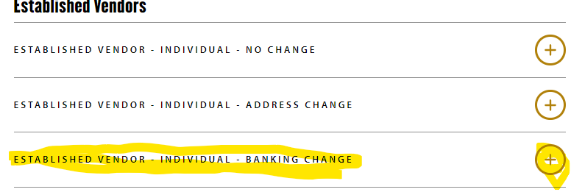
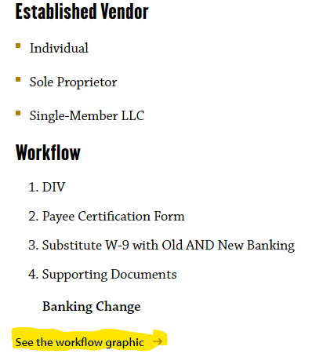
Chart Flow

Slide 48
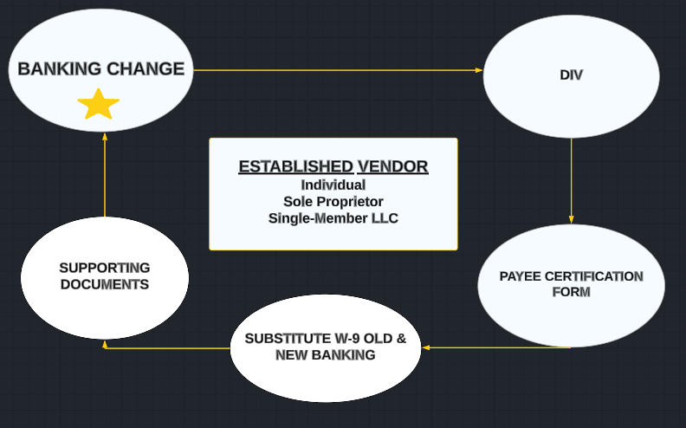
Chart 1

Slide 49
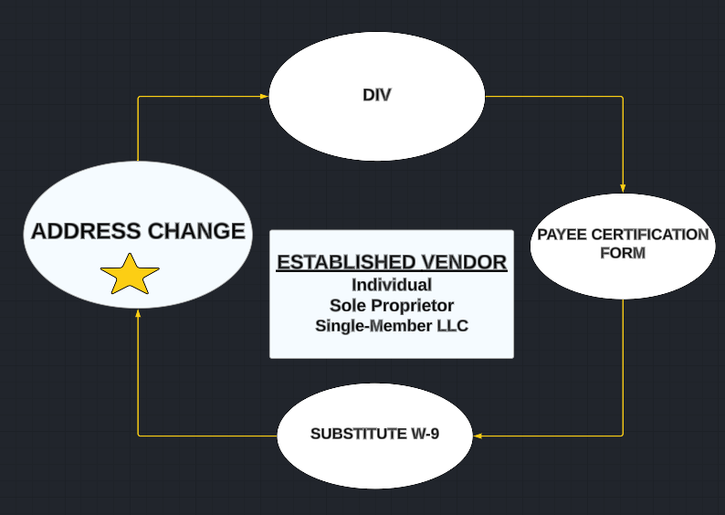
Chart 2

Slide 50
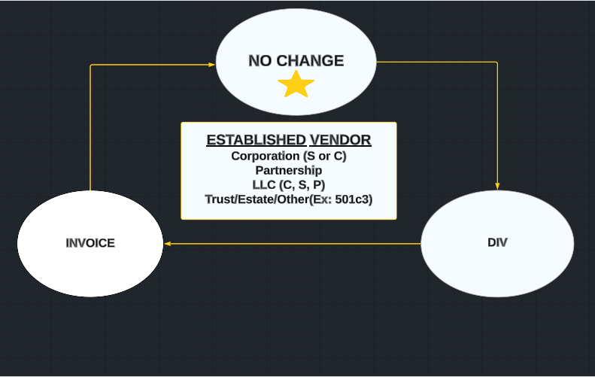
Chart 3

Slide 51
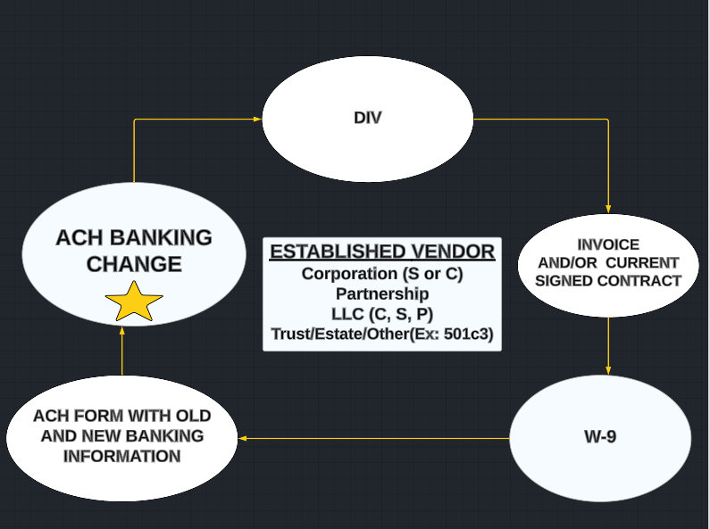
Chart 4

Slide 52
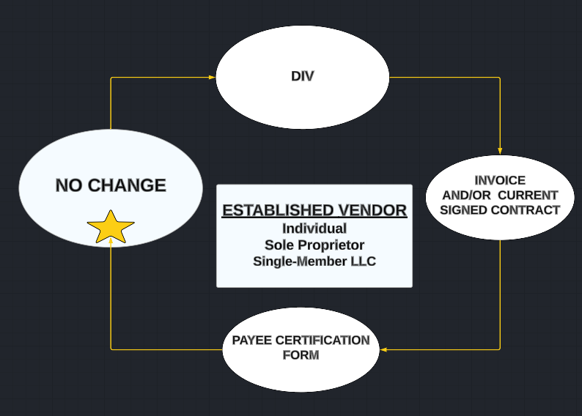
Chart 5

Slide 53
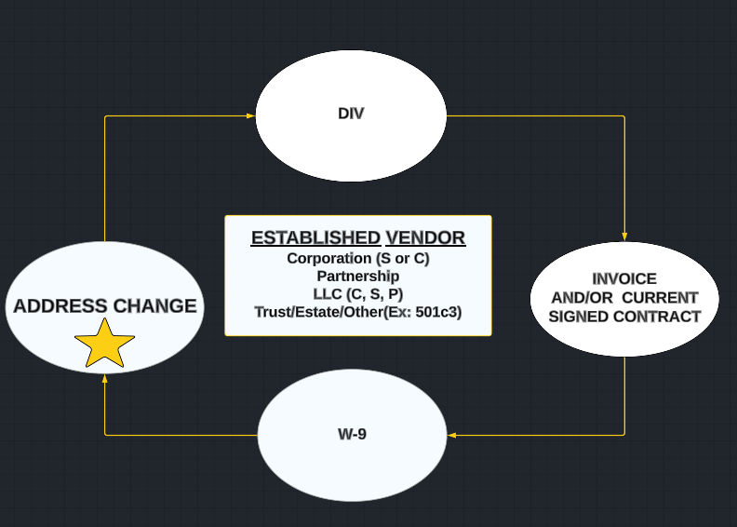
Chart 6

Slide 54
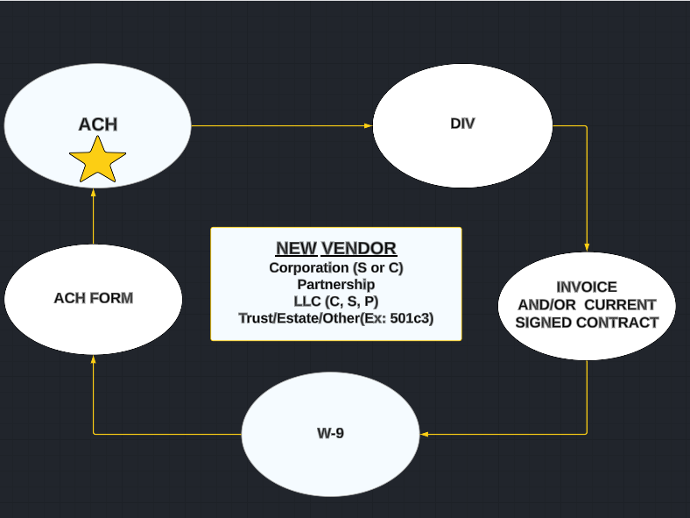
Chart 7

Slide 55
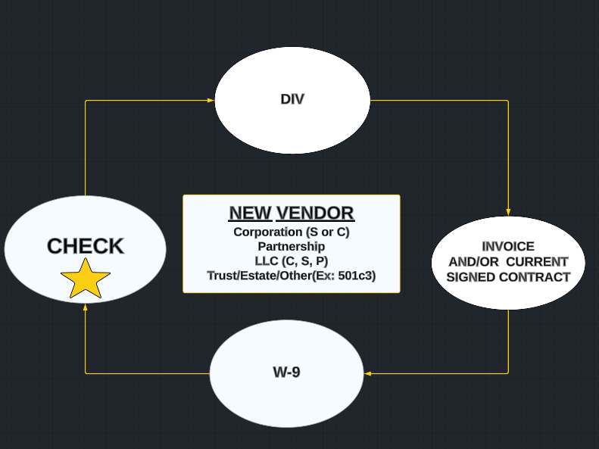
Chart 8

Slide 56
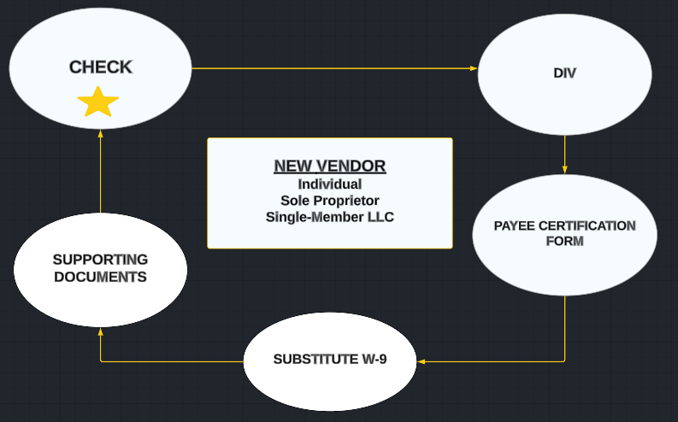
Chart 9

Slide 57
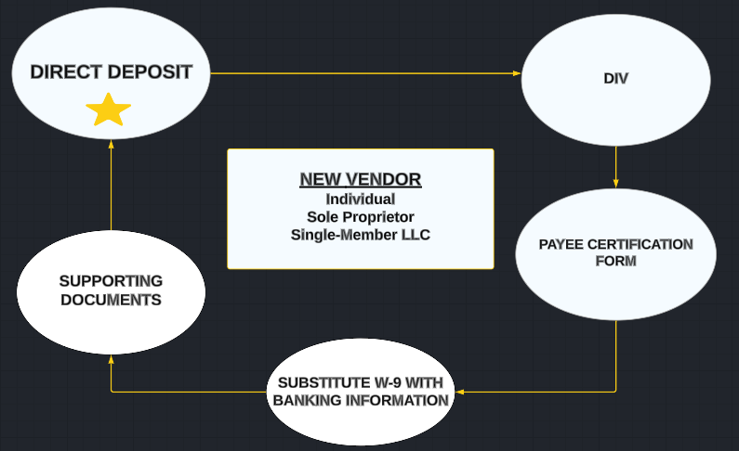
Chart 10

Slide 58
NAVIGATING THE PNW ACCOUNTS PAYABLE WEBSITE!

Slide 59
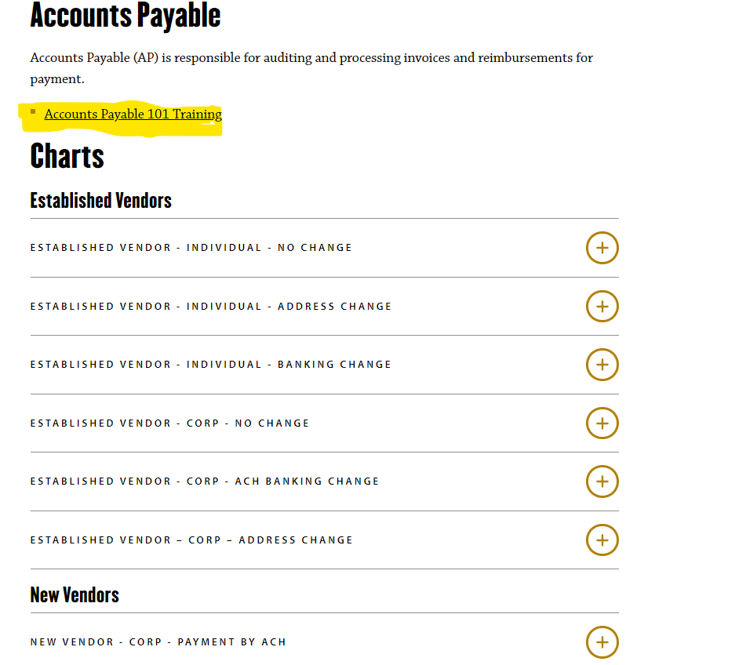

Slide 60
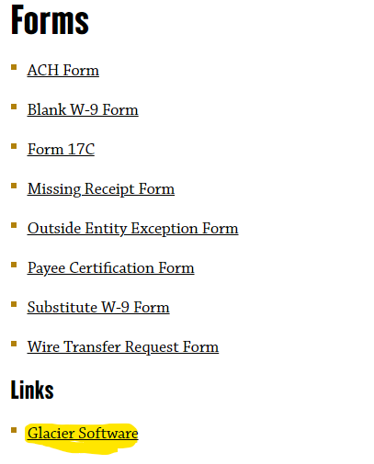
Accounts Payable

Slide 61
THINGS TO REMEMBER:
All inquiries related to P-Cards should be directed to your specific Account Coordinator who is located within the Managerial Accounting Department.
Accounts Payable is located within the Financial Accounting Department.
Accounts Payable will schedule a one-on-one training session for you if you are unable to attend a semester training workshop. Please reach out to us at: pnwpayables@pnw.edu
Reminder: Please always refer to the webpage for the most recent Accounts Payable Forms!
Please Remember: Entering outdated forms into Docusign will require you to REMOVE your Docusign.
Accounting & Budget Services
THANK YOU FOR JOINING US TODAY!

