Slide 1
Capital Asset Management and Inventory Training
Property Accounting Staff
Senior Accountant – Jessica Dean
Property Inspector Hammond – Shawn Marks
Property Inspector Westville/Gabis – Jennifer Stevens

Slide 2
Agenda
Departmental Responsibilities
Capital Assets
Capital Asset Tagging
Capital Asset Maintenance – DocuSign Process
Physical Inventory
Resources

Slide 3
Departmental Responsibilities
Financial Accounting
The department of Financial Accounting is responsible for the accounting controls and reporting of all moveable capital assets owned or maintained by Purdue Northwest.
The Property Accounting Team consists of three members: senior accountant and two property inspectors.
University Departments
The head of each department is responsible for all assets procured by his or her department. The responsibility includes protection against abuse, theft, movement, disposal, and unauthorized use.

Slide 4
Capital Assets
Definition
Capital Equipment is any tangible item that meets each of the following three criteria:
  Cost is $5,000 or greater.
  Expected to have a useful life in excess of one year.
  Will not lose its identity through use.
Software licenses greater than $500,000 are also considered Capital Equipment.

Slide 5

Capital Asset Tagging – Option 1
Option 1: Property Inspector Tags Assets
The Property Accounting Team receives gold inventory tags from West Lafayette for all new capital assets. A copy of the purchase order is attached to help identify the new asset/s.
As tags are received, property inspectors will reach out to departments to schedule a date and time to tag the new capital asset. The property inspectors will need access to the new asset and the following information if applicable: asset location, model number, serial number, manufacturer, and asset contact.
New capital assets should be tagged within 30 days of receipt from West Lafayette.

Slide 6
Capital Asset Tagging – Option 2
Option 2: Department Contact Tags Asset
Due to the location or availability of a new asset, it may be more convenient for the department contact to tag the new item. This is determined on a case-by-case basis.
Property inspector will notify the department contact that we are in receipt of a new asset tag.
Property inspector sends the gold inventory tag, a copy of the purchase order, and instruction cover sheet to the department contact via inter-campus mail.
Department contact tags assets, fills out the stamped area on the purchase order and sends completed form back to the property inspector.
Capital Asset should be tagged, and paperwork returned to property inspector within 10 business days.

Slide 7
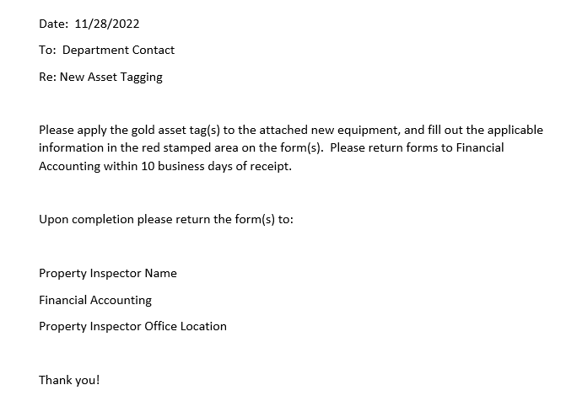
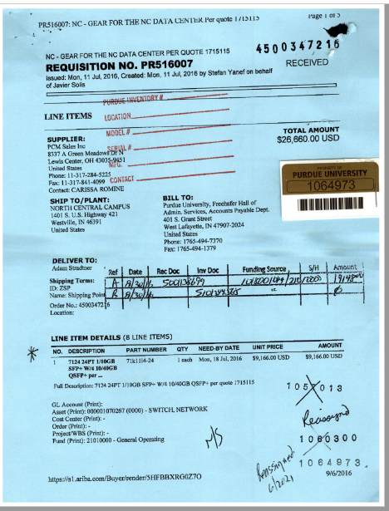
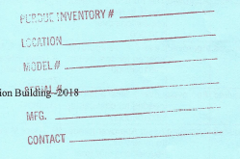
Capital Asset Tagging – Option 2
Instruction Cover Sheet Example
Purchase Order & New Asset Tag Example

Slide 8
Capital Asset Maintenance
After a new asset is tagged, any changes to the originally submitted information must be sent to the Property Accounting Team. Common asset changes include:
Cannibalize/Disposal
To take salvageable parts from a disabled machine in order to use them in another piece of equipment or dispose of the equipment.
Change in Location
When Equipment changes physical location, the department is responsible for notifying the Property Accounting Team. Any changes to the following information requires an update:
  Change in building location
  Change in room location
  Change in asset contact name

Slide 9
Capital Asset Maintenance
Property Off Campus
The Property Accounting Team must be notified if any Purdue owned or maintained assets are taken off campus.
The purpose of removal must be for university business and not for personal use.
Stolen
Any stolen equipment should first be reported to the PNW police department. If the theft was not on campus, notify local law enforcement.
A police report number is required to remove as asset from inventory due to theft.

Slide 10
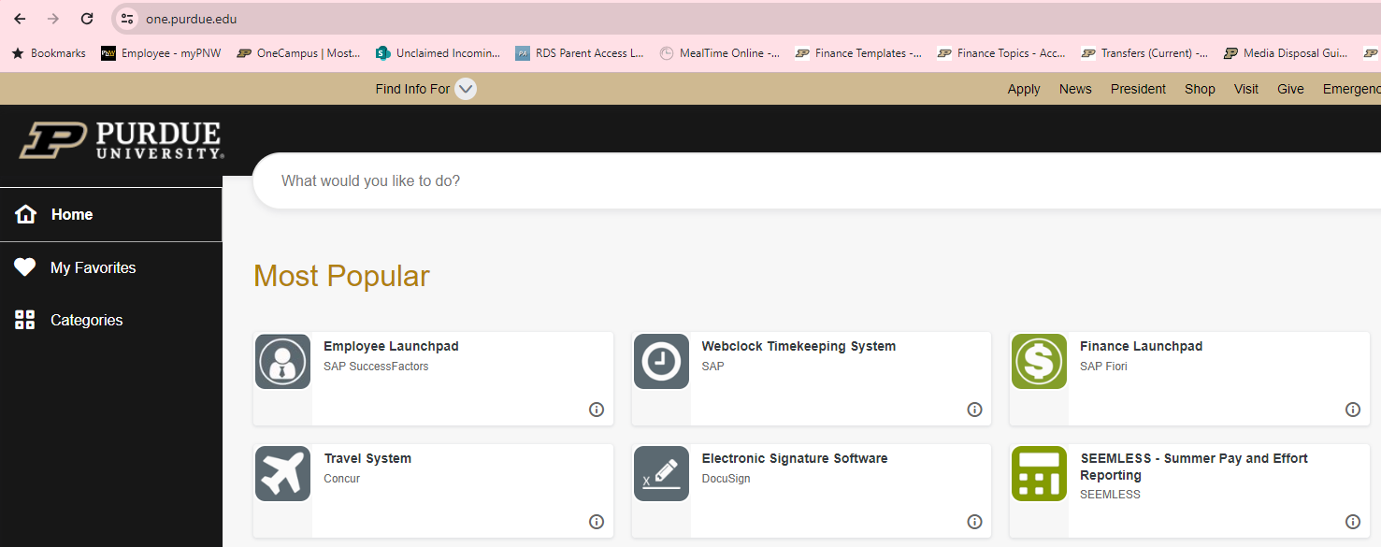
Property Maintenance DocuSign Process
A new process has been created in DocuSign so departments can easily submit asset status changes directly to Property Accounting staff for processing.
Log in to DocuSign through the One Campus Portal.

Slide 11
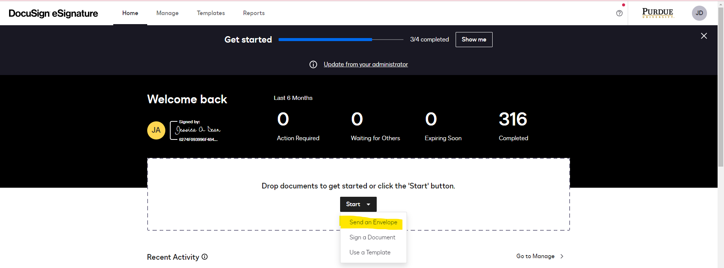
Property Maintenance DocuSign Process
Click on Start and choose Send an Envelope.

Slide 12
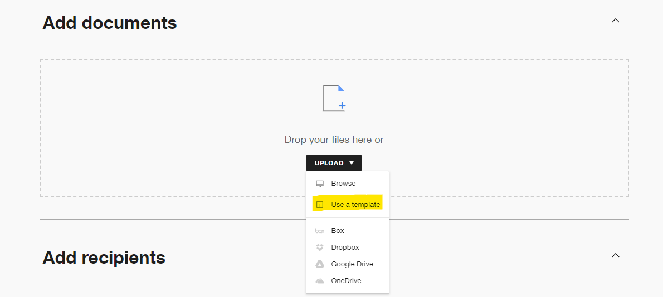
Property Maintenance DocuSign Process – Asset Disposal
Click on Upload and choose Use a Template.

Slide 13
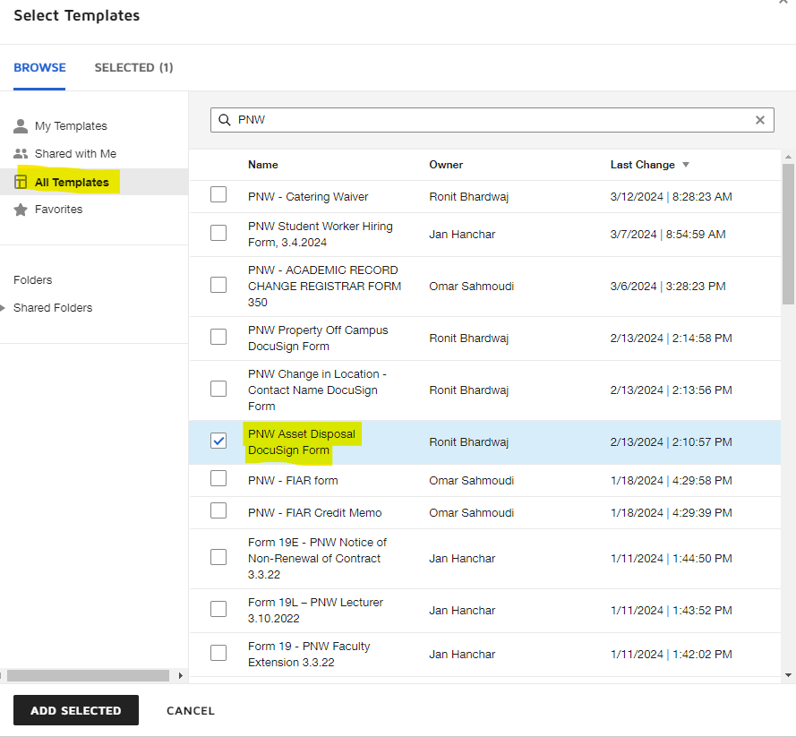
Property Maintenance DocuSign Process – Asset Disposal
Select All Templates and type PNW in the search bar.
Choose PNW Asset Disposal DocuSign Form.
Click Add Selected

Slide 14
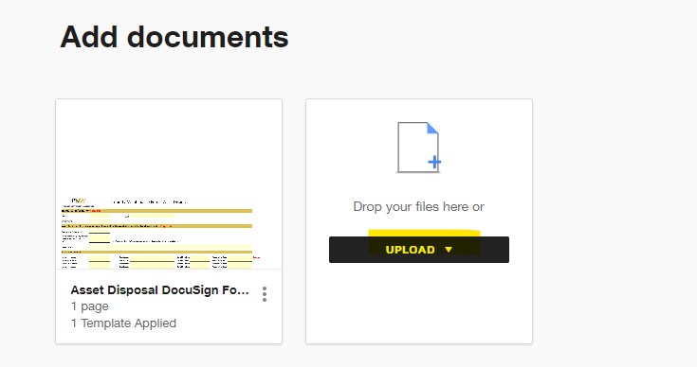
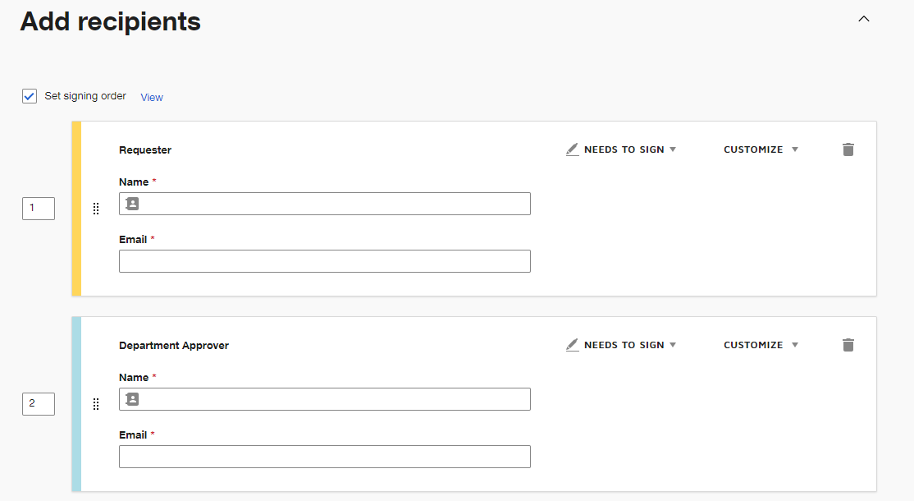
Property Maintenance DocuSign Process – Asset Disposal
Attach any support you have for the Asset Disposal Request by clicking Upload.
Add recipients to workflow. The Requester’s name and email is assigned to the Requestor fields, and a department head/Dean’s name and email is assigned to Department Approver fields. Click Next.

Slide 15
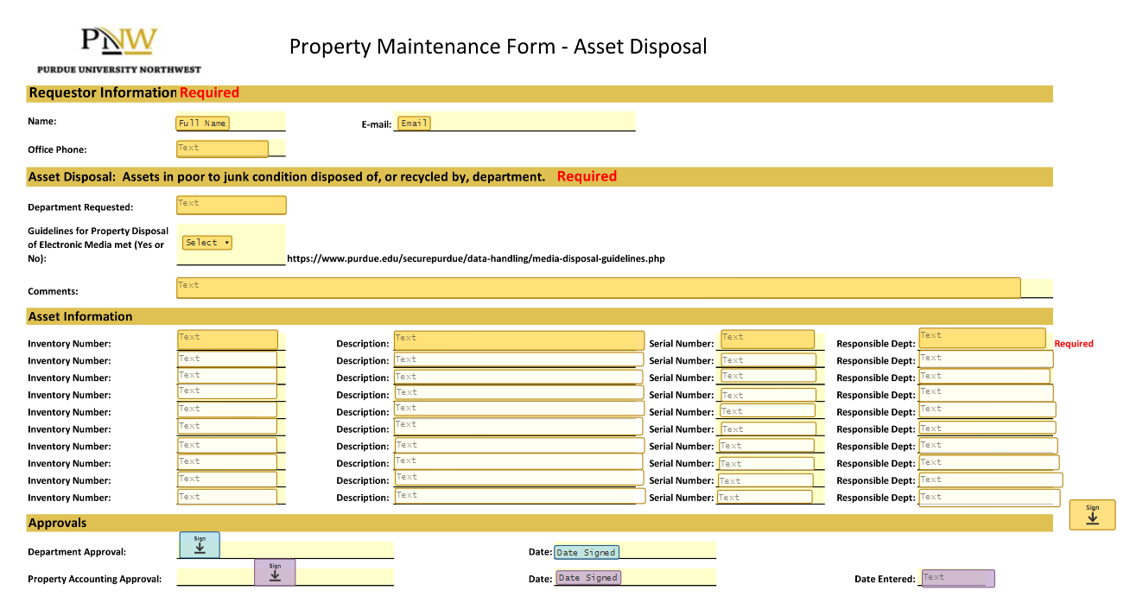
Property Maintenance DocuSign Process – Asset Disposal

Slide 16
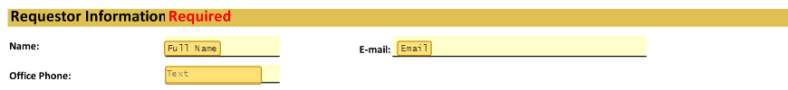
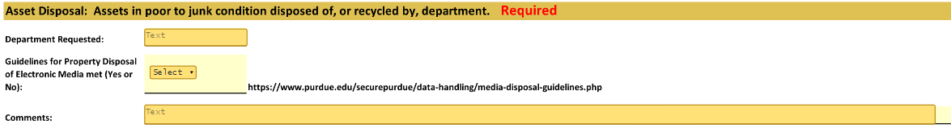
Property Maintenance DocuSign Process – Asset Disposal
Enter requestor information in first required section.
Enter Department Requested, choose Yes or No for meeting the Guidelines for Property of Electronic Media, and enter any relevant comments regarding the listed assets in the second required section.

Slide 17
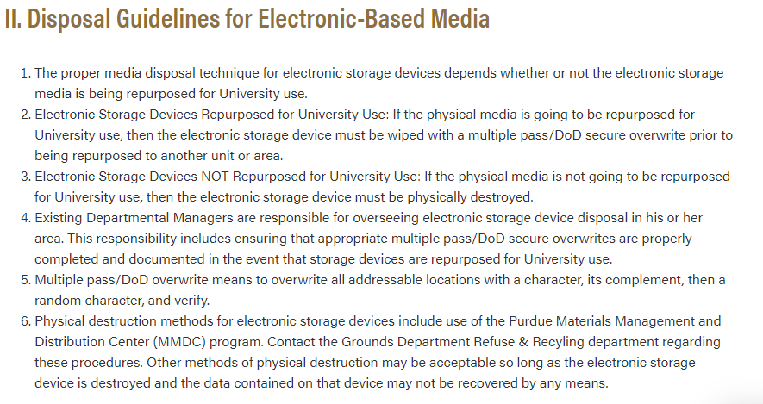
Guidelines for Property Disposal of Electronic Media
https://www.purdue.edu/securepurdue/data-handling/media-disposal-guidelines.php

Slide 18
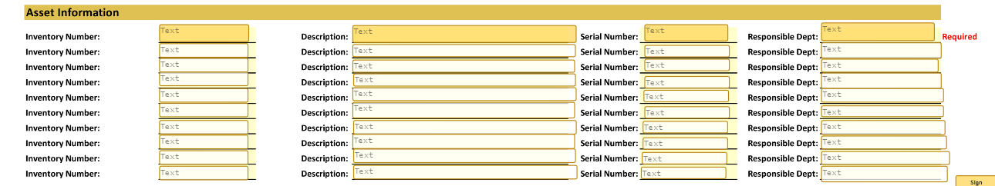
Property Maintenance DocuSign Process – Asset Disposal
Enter the Inventory Number (found on gold asset tag), Description, Serial Number (enter N/A if the asset does not have a serial number), and the Responsible Department in the third section. Only one line is required, but up to 10 assets can be entered on the same form.
Click send to start the approval workflow.

Slide 19
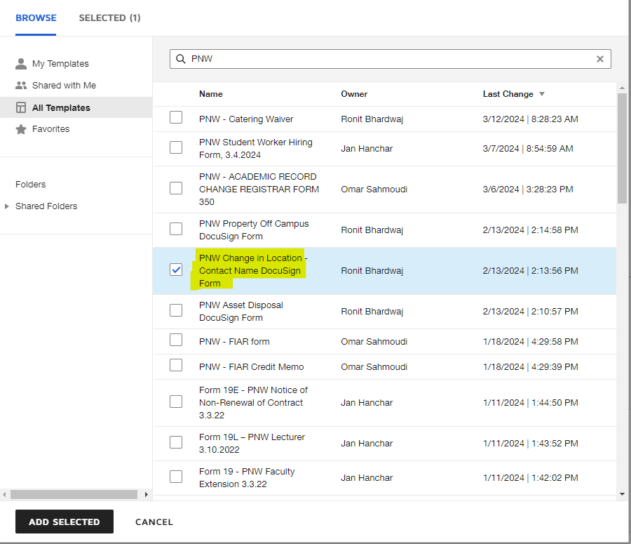
Property Maintenance DocuSign Process – Change in Location/Contact
Select All Templates and type PNW in the search bar.
Choose PNW Change in Location – Contact Name DocuSign Form.
Click Add Selected

Slide 20
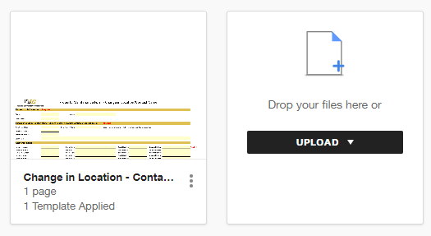
Property Maintenance DocuSign Process – Change in Location/Contact
Attach any support you have for the Change in Location/Contact Request by clicking Upload.
Add recipients to workflow. The Requester’s name and email is assigned to the Requestor fields, and a department head/Dean’s name and email is assigned to Department Approver fields. Click Next.

Slide 21
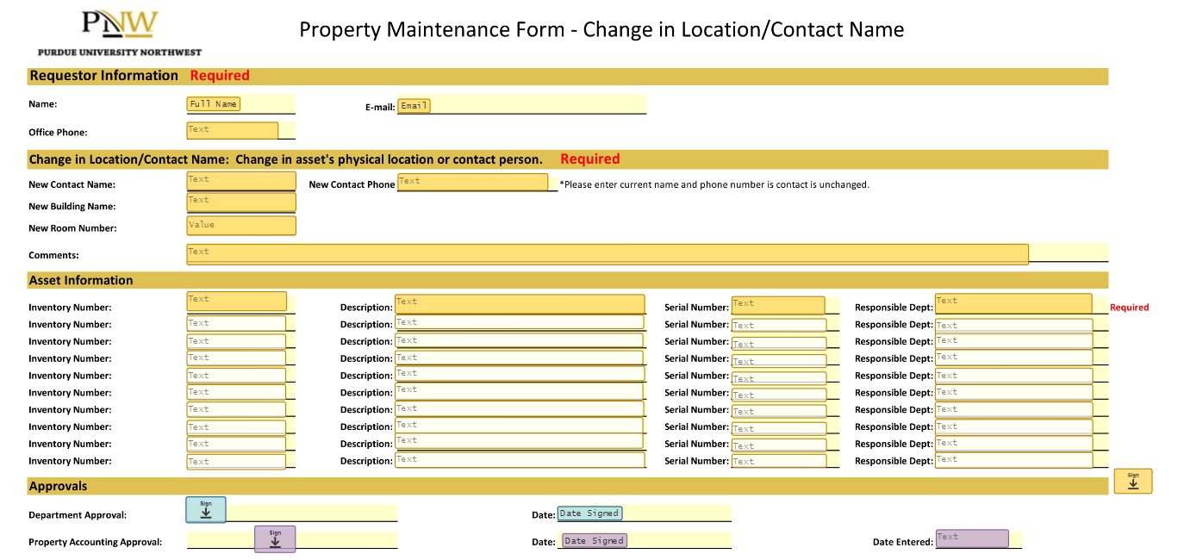
Property Maintenance DocuSign Process – Change in Location/Contact

Slide 22
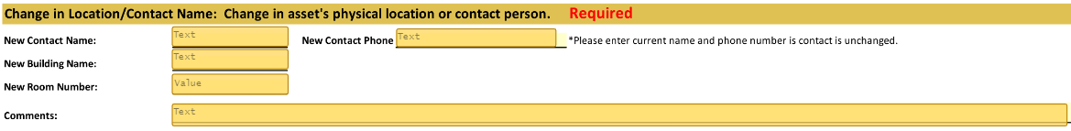
New Property Maintenance DocuSign Process – Change in Location/Contact
Enter requestor information in first required section.
Guidelines for Property of Electronic Media, and enter any relevant comments regarding the listed assets in the second required section.
Enter New Contact Name, New Contact Phone, New Building Name, New Room Number, and any comments regarding the listed assets in the second required section.
Please enter current name and phone number if the contact is unchanged.

Slide 23
Property Maintenance DocuSign Process – Change in Location/Contact
Enter the Inventory Number (found on gold asset tag), Description, Serial Number (enter N/A if the asset does not have a serial number), and the Responsible Department in the third section. Only one line is required, but up to 10 assets can be entered on the same form.
Click send to start the approval workflow.

Slide 24
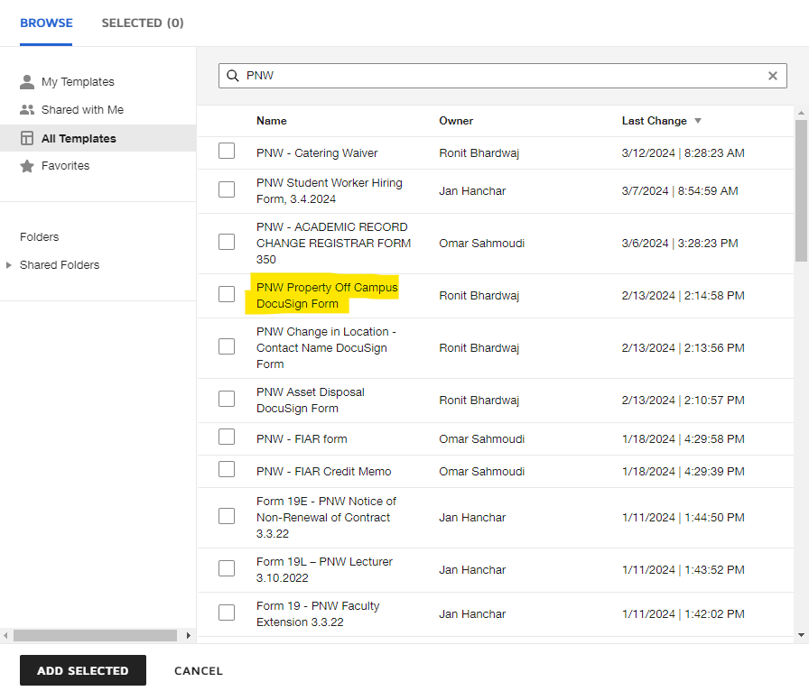
Property Maintenance DocuSign Process – Property Off Campus
Select All Templates and type PNW in the search bar.
Choose PNW Property Off Campus DocuSign Form.
Click Add Selected

Slide 25
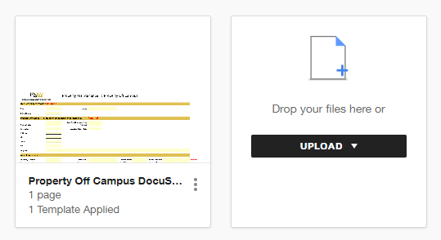
Property Maintenance DocuSign Process – Property Off Campus
Attach any support you have for the Property Off Campus Request by clicking Upload.
Add recipients to workflow. The Requester’s name and email is assigned to the Requestor fields, and a department head/Dean’s name and email is assigned to Department Approver fields. Click Next.

Slide 26
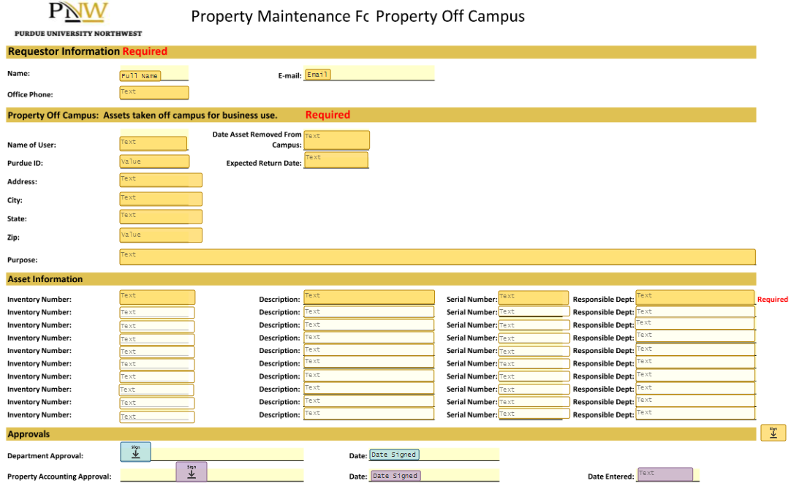
Property Maintenance DocuSign Process – Property Off Campus

Slide 27
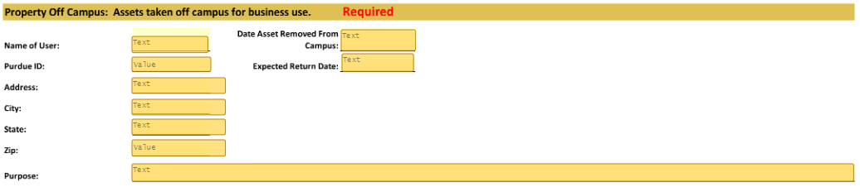
Property Maintenance DocuSign Process – Property Off Campus
Enter requestor information in first required section.
Enter Name of User, Purdue ID of User, Address, City, State, Zip Code, Date Asset Removed From Campus, Expected Return Date, and the Purpose for removing the asset from campus in the second required section.

Slide 28
Property Maintenance DocuSign Process – Property Off Campus
Enter the Inventory Number (found on gold asset tag), Description, Serial Number (enter N/A if the asset does not have a serial number), and the Responsible Department in the third section. Only one line is required, but up to 10 assets can be entered on the same form.
Click send to start the approval workflow.

Slide 29
Capital Asset Maintenance
Please email propmgmt@pnw.edu with questions regarding property maintenance and the DocuSign process.

Slide 30
Questions?

Slide 31
Physical Inventory
A physical inventory of all Purdue owned and maintained capital assets occurs every other year. The physical inventory includes all capital assets located on the Hammond campus, Westville campus, Gabis Arboretum, and any other location where PNW business is conducted.
FY 26 is not physical inventory year. The next inventory cycle will begin in Fall 2026 for FY 27.
Property Inspectors
  Hammond Campus – Shawn Marks
  Westville Campus & Gabis Arboretum – Jennifer Stevens

Slide 32
Physical Inventory Process
Beginning in Fall of the new inventory cycle, property inspectors will begin to distribute asset lists to department contacts.
Department contacts are to work with faculty and staff to review asset lists and submit any status changes to the property inspectors within 5 business days.
Updated asset lists will be used to determine status and location of capital assets during physical inventory.

Slide 33
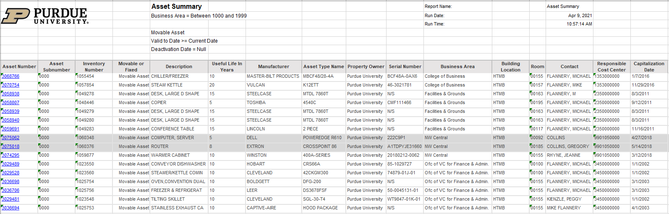
Physical Inventory Process
Asset List Example

Slide 34
Physical Inventory Process – First Pass
Property inspectors will coordinate with department contacts to schedule a convenient time to scan asset inventory tags. This is referred to as the first pass.
Items not found during the first pass will require additional attention.
The first pass will take place beginning in October through December of the new inventory cycle.

Slide 35
Physical Inventory Process – Second Pass
Property inspectors will send department contacts a list of the assets not found during the first pass.
Department contact will review and work with faculty and staff to locate the unfound capital assets.
Once the capital assets are found, property inspectors will schedule a convenient time to scan remaining asset inventory tags.
The second pass will take place beginning in January through February of the new inventory cycle.

Slide 36
Physical Inventory Process – Final Pass
Within 10 business days of completing the second pass, property inspectors will email department contacts a list of assets that remain not found.
Departments are to reply within 5 business days to:
  Provide the location of the unfound assets
  Provide an explanation describing why the department is no longer in possession of the asset. Please include any available supporting documentation.
If a response is not received within 5 business days, an escalation email will be sent. This email will include the Dean and/or Department Head.
Once all assets are accounted for, property inspectors will submit the necessary forms to West Lafayette.

Slide 37
Questions?

Slide 38
Resources
Training materials and other information:
https://www.pnw.edu/business-services/accounting-and-budget-services/
Email questions to:
propmgmt@pnw.edu

