Slide 1

WELCOME TO accounts payable
TRAINING
*Please silence your microphones
*Please make sure your audio is set appropriately to accommodate headphone or speaker accordingly
1
Notes:
REMIND AUDIENCE: THIS IS NOT BEING RECORDED! THERE WILL BE A NEW LINK TO THIS UPDATED POWER POINT ON THE WEBSITE LATER THIS WEEK!

Slide 2
Mission, Goal & Vision
Our Mission is to provide guidance, support, training, and resources to assist Purdue Northwest staff with processing invoices.
Our Goal is to perform our due diligence in providing timely responses to inquiries, keying invoices as provided to us, and setting up/changing vendors.
Our Vision is to maintain data integrity, compliance, and financial stewardship for Purdue Northwest

Slide 3
Agenda
New & Review – Let’s Get Started!
Pg. 1 – WELCOME!
Pg. 2 – Mission, Goal & Vision
Pg. 3– AGENDA
Pg. 4 - SECTION ONE – EXPECTATIONS & RESPONSIBILITIES
Pg. 5 – Programs and Procedures
Pg. 6– Return address for VOIDED checks
Pg. 7.8 – Department Responsibilities when placing an order
Pg. 9,10 Payment Responsibilities
Pg. 11 Remittance Address
Pg. 12 Importance of Processes
Pg. 13, 14 Cyber Security
Pg. 15, 16 Payment Works Portal
Pg. 17 – Utilities
Pg. 18- SECTION TWO – FORMS & MORE
Pg. 19– zEMP Records
Pg. 20– DIV Instructions
Pg. 21– Held Check
Pg. 22– Credit Memo
Pg. 23–Payee Certification Form
Pg. 24-28-- Power Form Instructions
Pg. 29 –Wire Transfer Form
Pg. 30– SECTION THREE – ONE-TIME VENDOR
Pg. 31– Form 17C
Pg. 32 –One-Time Vendor Documentation
Pg. 33 – Substitute W-9
Pg. 34, 35 – One-Time Vendor Excel Spreadsheet/Request Types
Pg. 36 – SECTION FOUR – “OTHER “ PAYMENTS
Pg. 37 –Non-Resident Alien Payment
Pg. 38– Glacier Tax Summary Report
Pg. 39 – “Other” Payments
Pg. 40– Prizes and Awards
Pg. 41 – Non-Employee / Employee Reimbursements
Pg. 42 – SECTION FIVE - CHARTS
Pgs. 43, 44– Individual and Corporation Charts
Pgs. 45 - 47– Accounts Payable Website / Email Address, Etc.

Slide 4
Section One-Expectations & Responsibilities
Programs and Procedures
Return Checks/VOIDED
Provide Standard Expectations
Identify Potential Errors
Minimize Fraud
Payment Responsibilities
Changes!!!!!!!!!!!!

Slide 5
Familiarize yourself with the following programs and procedures
DocuSign – Docusign has many features for payment processes and necessary forms and functions. Please familiarize yourself with navigating Docusign, especially the area of DIV entry, removal, etc. Reminder: Do not send documents to Accounts Payable for review before submission into DocuSign.
Filelocker – Email is not an encrypted secure method of sharing a vendor’s personal information. Tax Documents containing names accompanied by addresses, social security numbers (considered RESTRICTED data), bank account numbers, etc. should NOT be sent through your PNW email account to anyone including Accounts Payable.
Purdue IT Services –This link will provide you with useful information for all of Purdue’s popular services.
Microsoft Teams – This is AP’s most efficient and effective tool of choice for training. You should familiarize yourself with this program to enable future training and assistance.
Payee Certification Power Form– This form is done through our website and is not trackable until it appears back in your queue. Please familiarize yourself with this process. Please note the process:
Initiator (Department Rep. ) Consultant (Vendor) Supervisor (Department Head ) Initiator (Department Rep. )
Notes:
In order to perform your responsibilities efficiently and effectively, please familiarize yourself with the following:

Slide 6
Address
RETURN/VOIDED/CREDITS
SEND CHECKS TO:
The address listed on the left of the screen.
Make sure that the account and GL number are indicated on a post-it note when sending, so that the check can be returned to the correct account.
___________________________________________________
*Question: What should I do if my vendor says they didn’t receive a check?
*Answer: – Check the Due Date on the invoice to see if the payment is overdue. Then, send an email to PNWpayables@pnw.edu with the VENDOR’S NAME,INVOICE NUMBER, copy of the DOCUSIGN HEADER from the originator, and AMOUNT. We will then let you know if your vendor should have received the check by now or if they should be expecting it soon.
If we determine the check to be overdue, we will initiate a stop/payment/rewrite process on the vendor’s behalf.
Purdue University
Accounts Payable
2550 Northwestern Avenue, Suite 1100
West Lafayette, IN 47906
United States

Slide 7
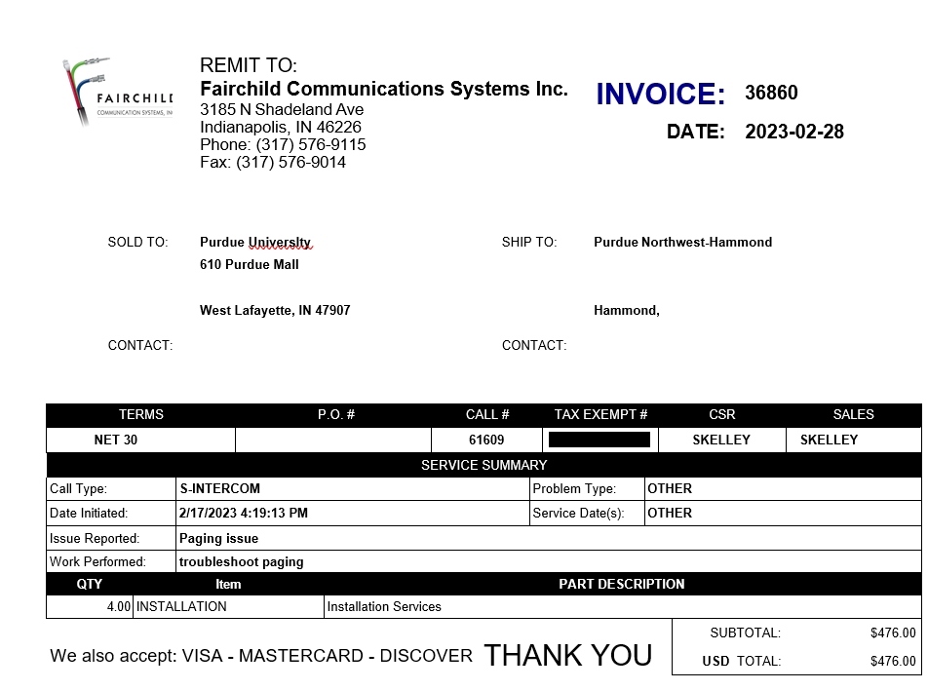
Accountability – Ensure Vendor Knows Where to Send Non-PO Invoices
How departments can help avoid delays in
processing invoices:
Provide the vendor with the following important information when placing your order:
Your Department Name
Contact Person Name (Who placed the order?, Who should receive the invoice?)
Contact Address (PNW address, Your Building/Room location)
Contact Phone Number (Your Phone Number, not the number for AP)
If you have placed your order through ARIBA and it has an ARIBA PO # 45XXXXXXXX on the invoice and Procurement has informed you to pay it through AP instead, the reason for the exception must be indicated on the DIV prior to sending it through the approval process. This allows AP to know it is not a double payment.

Slide 8
Payment Responsibilities
Due Diligence – Invoice/Contract: Ensure Documentation will Support the Payment
Supporting Documentation must be sufficient to answer the following questions:
  Who is the payment for? Vendor Name?
  What is the payment for? Brief explanation of expense?
  When is the payment due? Actual Due Date? Terms of Payment?
  Where is the payment going? Remittance Address?
  Why/How is Purdue responsible for this payment?
The current due invoice amount MUST match the DIV check amount.
Must Substantiate an Audit Review
Purdue Does Not Make Payments to Third-Party Vendors.
The invoice must be addressed to Purdue and have Purdue as the entity responsible for payment.
Examples of supporting documentation when required:
Agreements
Approvals
Contracts
Emails
Invoices
PC Form
Notes:
When you call and ask will this get through the system, think about it like this, if internal audit randomly pulls your Docusign in 9 months to review, will the information included allow them to understand and substantiate without questioning anything? They won’t be speaking to you in person like I am right now. Will you remember in 9 months without perfect documentation?

Slide 9
Payment Responsibilities – Cont.
Due Diligence – is it an actual Invoice?
Examine documents closely and look for key words:
Quote, Estimate, Pro-forma Invoice - Projection of Costs for Ordering Purposes
Order Detail, Summary, Acknowledgement - Confirmation of Order/Service
    May not reflect accurate total
    May not include correct payment terms or remittance instructions
Statements - Observation of Outstanding Invoices (example on next slide)
    May not reflect recent payments
    May not include details of purchase/service
    May not include correct payment terms or remittance instructions

Slide 10
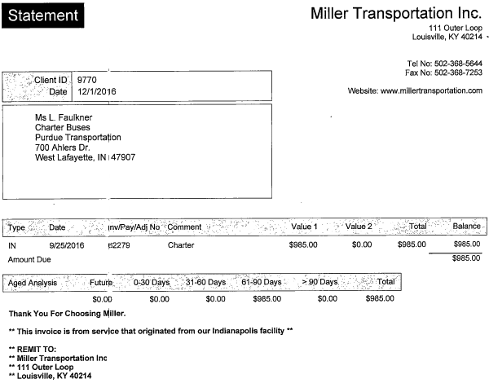
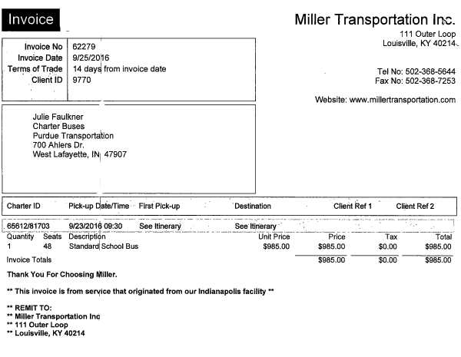
Payment Responsibilities - Invoice
Due Diligence - Is it an actual Invoice? Did the company charge tax?

Slide 11
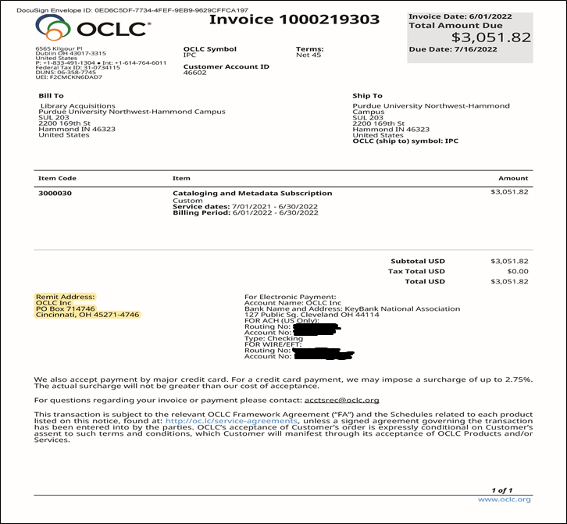
REMITTANCE ADDRESS
Please make sure you are using the correct remittance address on your DIV.
This is important for AP to process your payment. Even if it is a direct deposit, the remittance address must match what is in our system.
The Vendor Payment Works Portal enables the vendor to change this information upon invitation from AP staff; however, the department needs to notify the vendor that PNW AP will send an invitation to them to change/update their information in the Payment Works Portal.

Slide 12
Importance of Processes
Provide Standard Expectations - Requirements for Keying a Payment
  AP always must key the invoice number exactly as it appears on the invoice.
  The invoice/reference number may not exceed 15-characters.
  An invoice may not be submitted without a unique identifier.
    Allows Purdue Northwest staff to retrieve or research information
    Assists Vendors in applying payments correctly per state/unit/etc.
    Prevents duplicate payments
    (If missing, use standard & unique value to identify the payment)
  Invoice Date - Always key the date the invoice was created by the vendor
  The current due invoice amount MUST match the DIV check amount.
    It is used by Vendors to apply payments correctly
    Missing Date: Use Date of Order/Service
    Accuracy of invoice date prevents early/late payments
    Using the correct invoice date can prevent duplicate payments

Slide 13
Be Aware of Common Cyber Threats
Phishing
  Pretends to be a trustworthy source to acquire sensitive information
  Victims may be subject to malware or identify theft
  Defense:
    Hover over questionable links to reveal the true destination;
    Beware of cloned websites (watch for https);
    Report suspicious email to abuse@purdue.edu
Spoofing an Email Account or Website
  Making the source look like a reputable source
  Cybercriminal uses tools that mask the source/sender; relies on our lack of attention!
  Defense: carefully read incoming emails for the proper email address; hover over sender's name to see underlying address; contact sender directly if email or phone number is questionable.
  Artificial Intelligence (AI) – Artificial Intelligence is a set of technologies that allow computers to perform tasks that typically require human intelligence. AI systems can learn, reason, and solve problems.

Slide 14
Data Security
Why Should I Care About How Data Is Handled?
Often, we become desensitized to the data that we handle in our everyday job. However, somewhere someone is handling your information, whether it be your SSN (Social Security number), your bank account information or other private information. Handle someone else’s data how you’d like your data handled.
Why are we doing this?
Reinforce our procedures
Protect Purdue resources
Protect Purdue’s reputation
Protect Purdue and YOU!
PROTECT OUR VENDORS!
We still see bank account numbers and information on vendor invoices everyday and we must be mindful of where this information is stored once it reaches our hands.

Slide 15
PURDUE PARTNERS WITH PAYMENT WORKS PORTAL
VENDOR RESPONSIBILITIES
DEPARTMENT RESPONSIBILITIES
Vendor receives an email invitation to complete their own portal.
Vendor completes their own personal banking information via the portal and submits (eliminating the need for ACH forms)
Vendor completes own personal address and tax information via the portal (eliminating the need for W-9 and Sub W-9 forms), exception: one-time vendor/direct deposit will still require a Sub W-9.
Vendor refers to their own portal to check payment status and payment history.
Vendor is responsible for updating any changes to their bank account information and address directly in their dashboard within the Payment Works Portal.
Docusign process has not changed
Department will submit DIV (only NEW version of DIV will be accepted) includes vendor’s email and name
Individual/single-member LLC/Sole proprietor will still require a payee certification form
Department is still the vendor contact! The department is still responsible for informing the vendor that Accounts Payable will send an invitation for them to complete their own vendor portal.
One-time vendor process has not changed.
Practices and procedures are still in place except for the vendors responsibilities of becoming stewards of their own personal data in the Payment Works portal.
Employee vendors are NOT in the Payment Works Portal. All existing practices and procedures for employee payments remain the same.
The Vendor Contact Name and Vendor Contact Email Address on the new DIV template needs to be the individual who has authority to complete the Vendor’s banking and tax information.

Slide 16
Examples of invitation(s) sent to the vendor to complete the Vendor Works portal
Purdue has partnered with Payment Works to securely update and maintain our vendors' payment information. To proceed with payment processing, please register with Payment Works so your payment information is always up to date. Thank you.
Purdue received invoice#____________ with information that doesn't match our current records. To proceed with payment, please update your vendor record with Purdue University through Payment Works to ensure your information is up to date for payments. Thank you.

Slide 17
UTILITIES
We are requesting that everyone be consistent when LABELING UTILITIES in DOCUSIGN. Please LABEL them as UTILITIES in the heading and NOT as alternatives such as Waste or Recycle or Phone, etc.
Our staff is trained to identify UTILITIES as a PRIORITY DOCUSIGN, and every attempt is made to ensure that these are paid in a very timely manner.
Reminder: If your invoice does not impact campus operations or safety, it is not considered a utility.

Slide 18
Section Two – Forms & More
ZEMP Employees Updates
DIV
Held Check
Credit Memo
Payee Certification Form
Substitute W-9 - One-Time Vendor {EFT Banking}
Wire Transfer Form

Slide 19
Important Key Factors For Updating zEMP Vendors
zEMP Org Records – EMPLOYEE – Changes made in Success Factors DO NOT update in SAP. These records are for Concur payments. When an employee changes their banking in SuccessFactors, it does not change in SAP for reimbursement purposes when being paid through the DIV process. It does update in CONCUR. Therefore, when a reimbursement is made through the DIV process to an employee and they have made a banking change, PNW Accounts Payable does not have access to this information, and the reimbursement will continue to go to the old bank account unless PNW AP is informed of this change prior to the reimbursement and makes a banking change request to the employee vendor record in SAP. However, if the employee chooses to be reimbursed through CONCUR, the updated banking information should automatically carry over from SuccessFactors to the CONCUR system. An email from the employee, including contact information, should be sent to pnwpayables@pnw.edu, instructing them that a banking change has taken place along with the date of the change and their name as it appears in SuccessFactors. This will allow us to verify the PUID and request this change be made in SAP.
**Please keep in mind: Employees are not Payment Works vendors! All practices and procedures for employee payments remain the same.

Slide 20
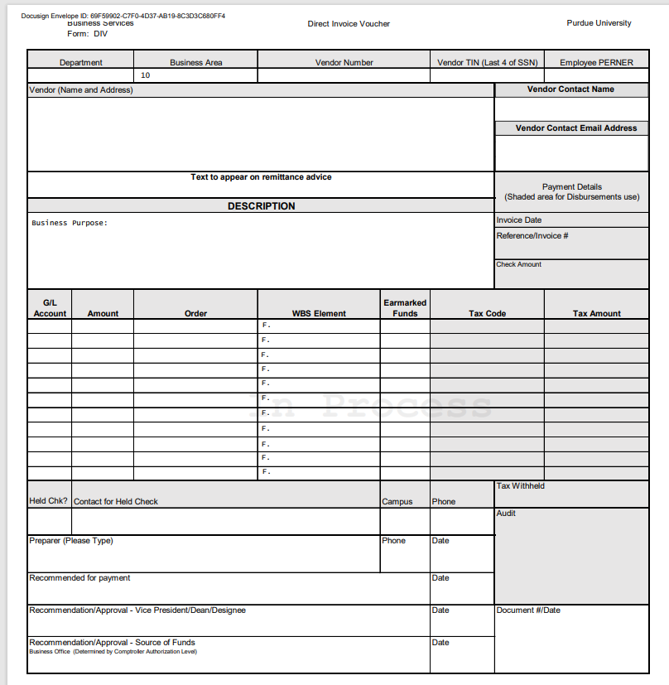
Instructions for DIV
*Vendor- Type the name of the company and the remit address per the invoice
Vendor- Contact Name and Contact Email Address on the DIV template needs to be the individual who has the authority to complete the Vendor’s banking and tax information.
*Text to appear on remittance is optional- This is where you would include any account number or invoice number that you wish to be written in the note section of the check.
*Invoice date- Date listed on the Invoice or date of purchase if it is a receipt
Reference/Invoice #- The invoice number listed on the invoice when applicable, or your own identifier accompanied with the following: REIMB09282020JD(reimbursement) SRVC09282020JD(Service), STIP092820JD (Stipend) 15-character space maximum ONLY
Check amount-The current due invoice amount MUST match the DIV check amount. Ensure the amount listed here is accurate and includes the proper decimal placement. Example- $00.00
Description- Write a brief description of what services were provided or what items were purchased
GL- Business Office ( Account Coordinator ) will assign the appropriate GL number
Amount- the amount of the charge. If the charges need to be paid by different accounts, then you will need to enter separate lines. Ensure the amount listed here is accurate and includes the proper decimal placement. Example-$00.00
Order- This is where you include the account number(s) you wish to use. Example: 320000XXXX
WBS Element- This is used when your desired account number begins with F.XXXXXXXX.XX.XXX
Employee PERNER: This is the user ID number listed in SuccessFactors.
Docusign link for further instructions :
DocuSign Template Training

Slide 21
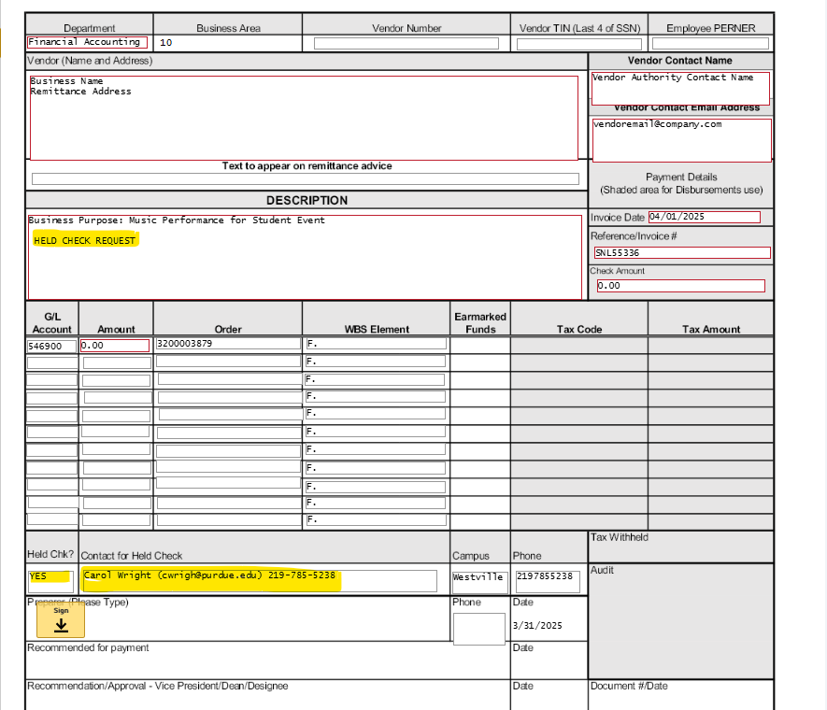
Held Check
EXAMPLE: Held Check Information
This information is necessary for West Lafayette to contact you to obtain information regarding your “send to” location preference. Please DO NOT include your location information in this space.

Slide 22
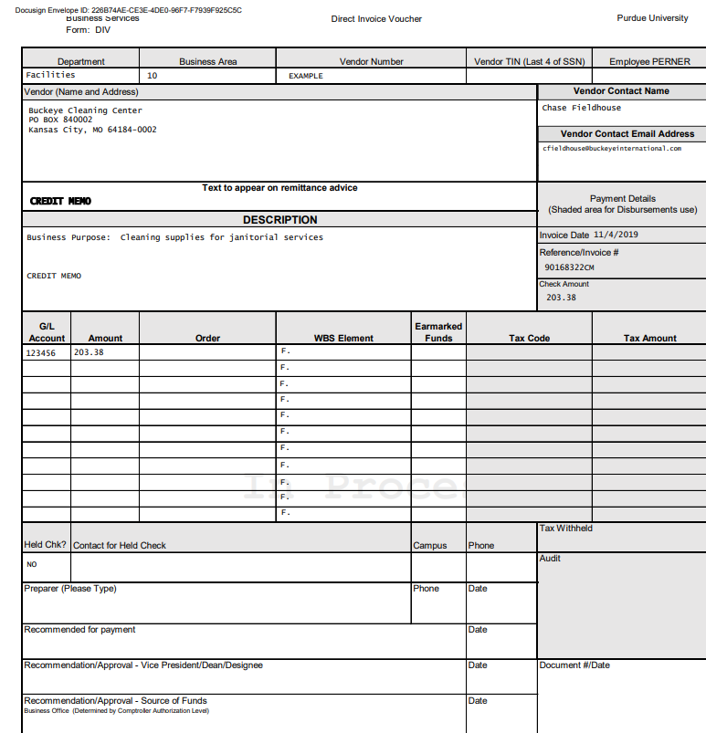
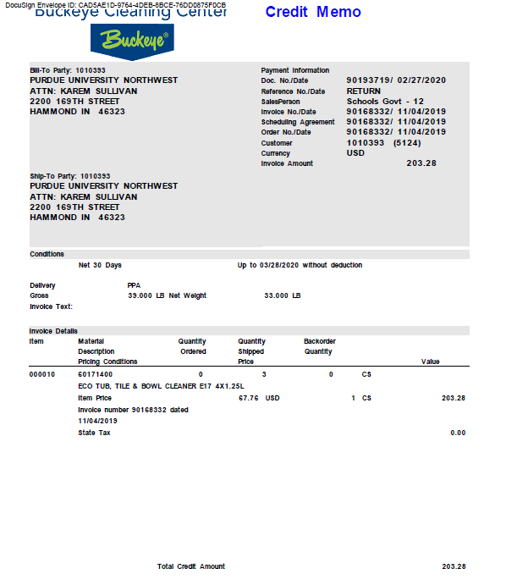
Example of a Credit Memo DIV
Example of a Credit Memo DIV
This is entered on a regular DIV Form.
This must be attached in your DocuSign for processing. Notice that the DIV indicates Credit Memo, The invoice also indicates at the top that it is a Credit Memo, and the credit amount is listed at the bottom.

Slide 23
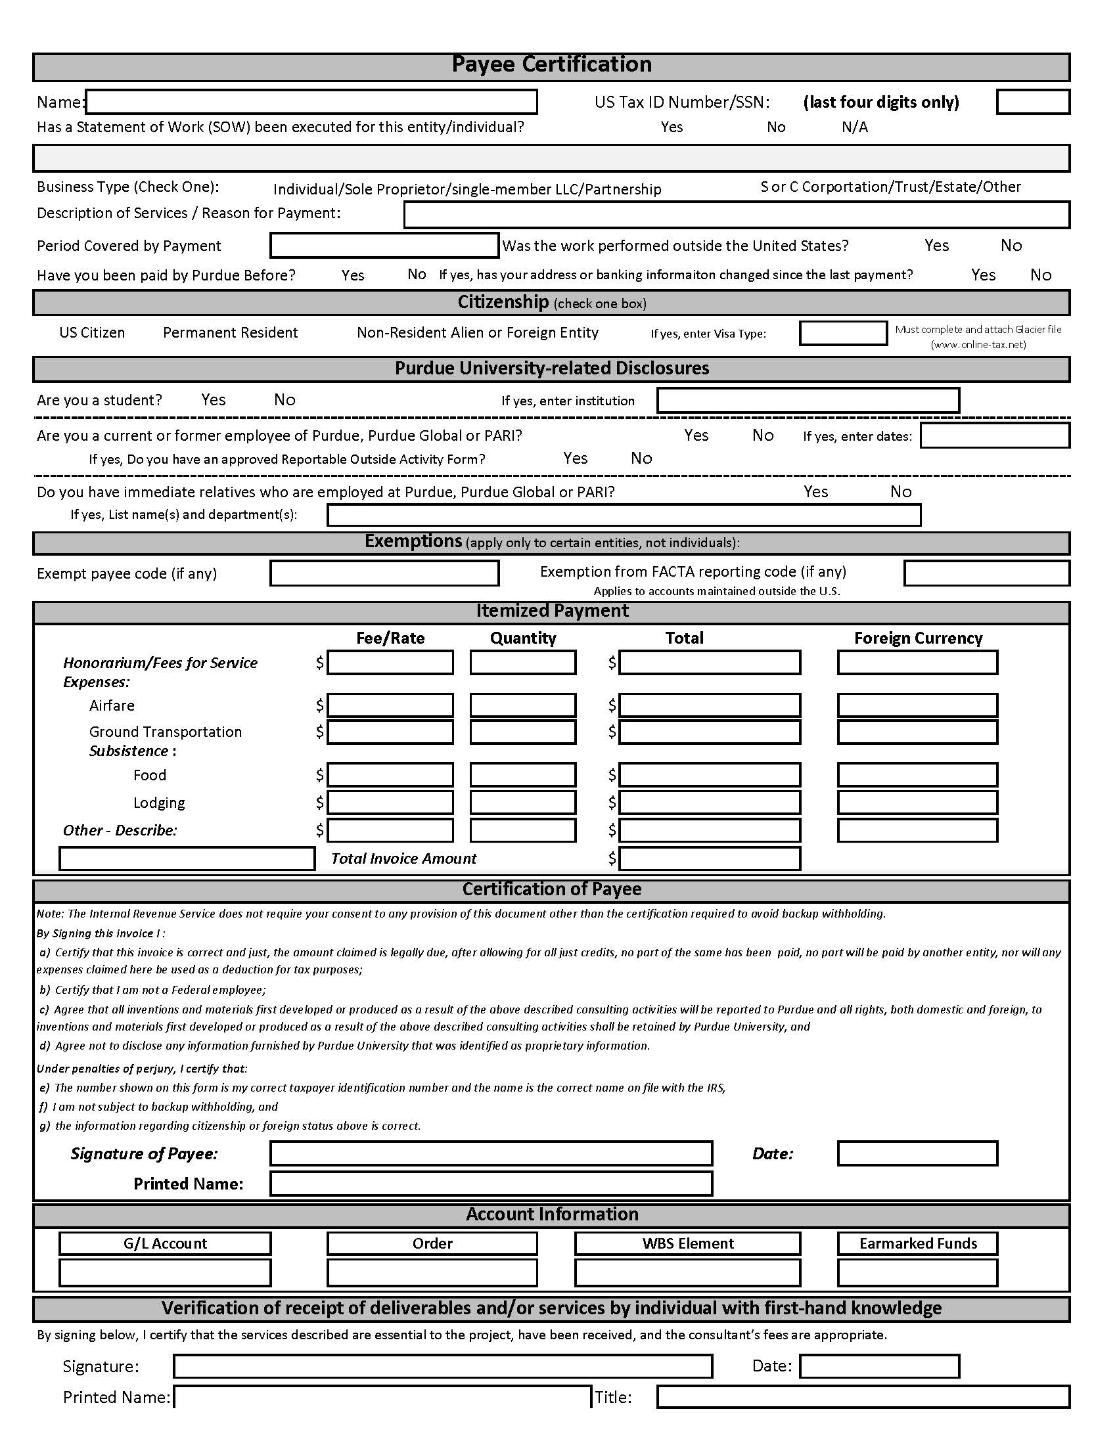
PAYEE CERTIFICATION POWER FORM
This form needs to be completed for sole proprietors, single-member LLCs, and individuals who are NOT Employees/Grad Assistants and have not been identified as one-time vendors by the AP Department.
A copy of the Professional Services Agreement needs to be attached to the DIV being processed through DocuSign if the Statement of Work has been executed for the entity/individual.
If VISA Type is F1, a Glacier packet should be included.
The information provided by the Payee is used to confirm that all information is updated in the Tax Department in the SAP accounting system prior to processing payment.
The GL will be placed on the Payee Certification Form by the Account Coordinator – DO NOT complete this area! Consult your Account Coordinator on how to add a text box for them to complete this information.
When NOT using the Power Form Process, the Payee Certification Form is to either be handwritten in one color and format or all typed.
https://PowerForm Payee Certification.docusign.net

Slide 24
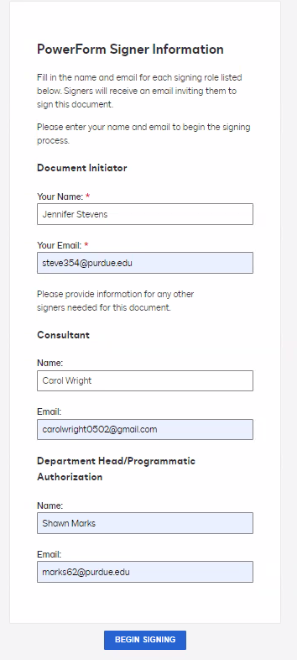
Power Form Format
Power Form Process
The document begins with you@purdue.edu. It advances to your vendor aka consultant. It then advances to the approver usually a supervisor departmenthead@purdue.edu. It then comes back to you@purdue.edu. Everyone must be aware of their role in the process for it to be successful.

Slide 25
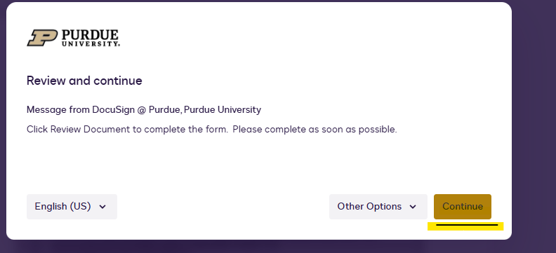
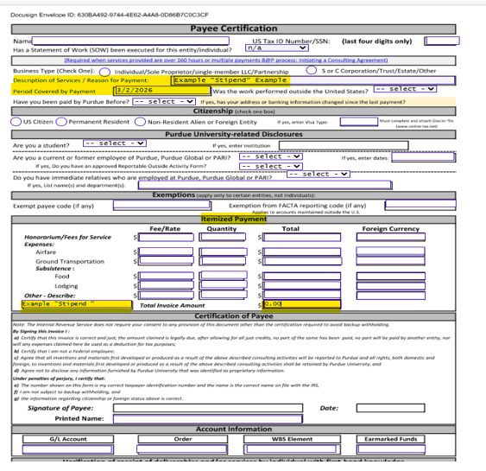
Initiator Form Flow ( Department Representative )

Slide 26
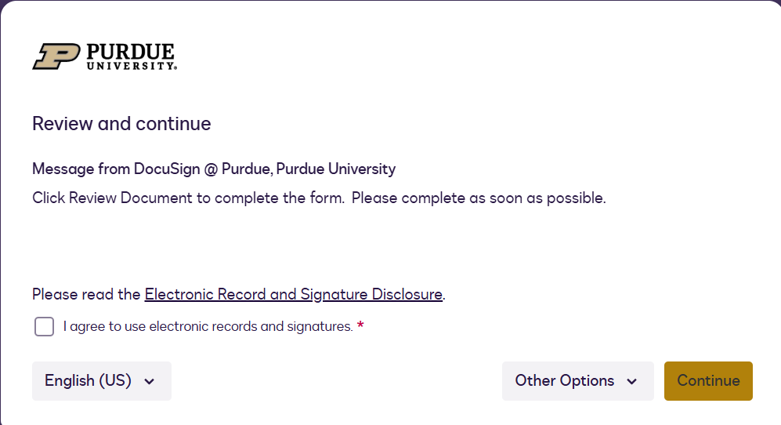
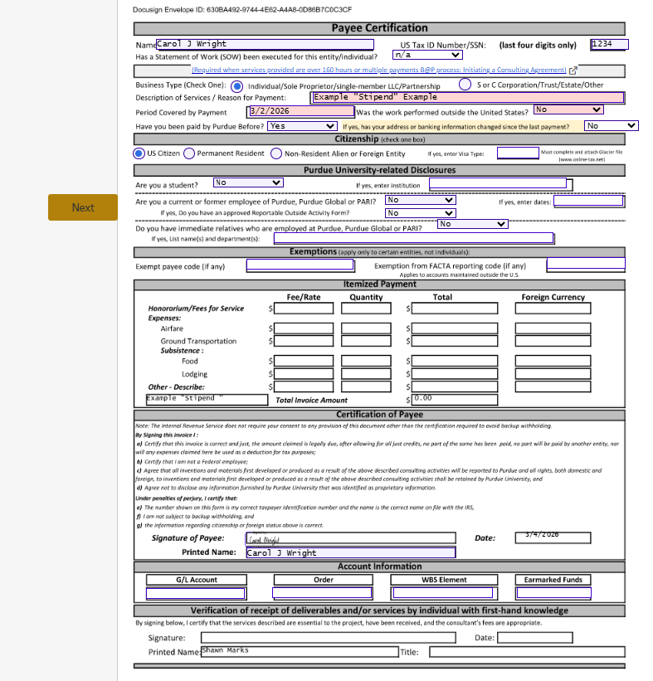
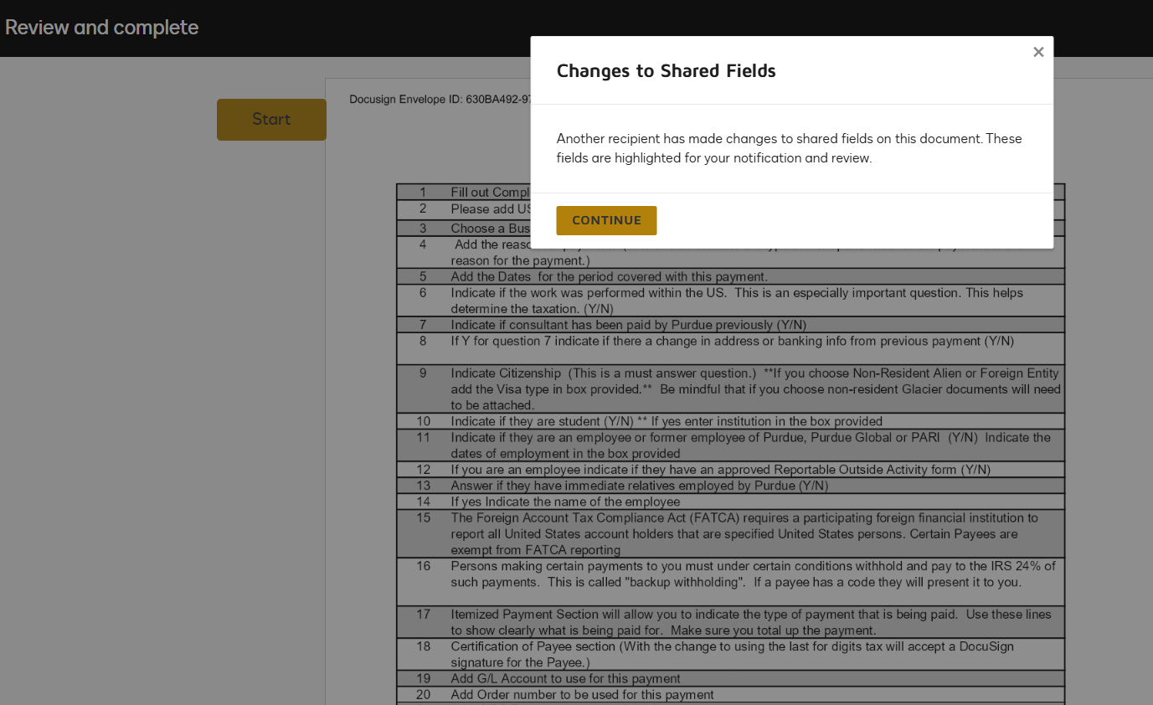
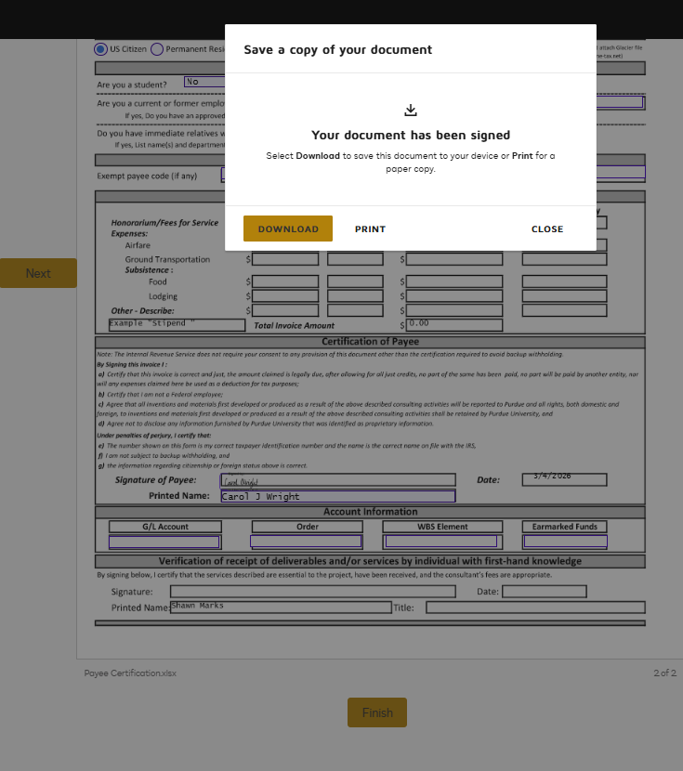
The Consultant / Vendor view
This is what the consultant/ vendor would receive; they would then complete their areas on the payee cert. form. The consultant/ vendor clicks finish, and then it is complete.

Slide 27
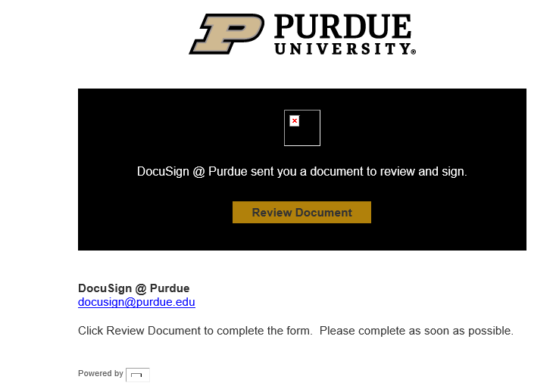
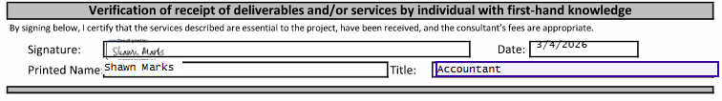
The Final Approver (Department Head / Supervisor )
Your department head will receive this email to review the document and sign the payee certificate. Once completed, it will then be rerouted back to you.

Slide 28
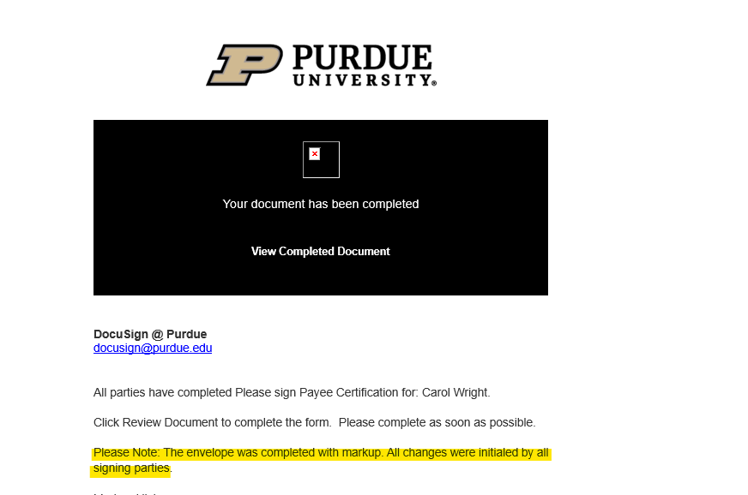
Final view of the Power Form
You will receive the email below stating that the document has been completed.

Slide 29
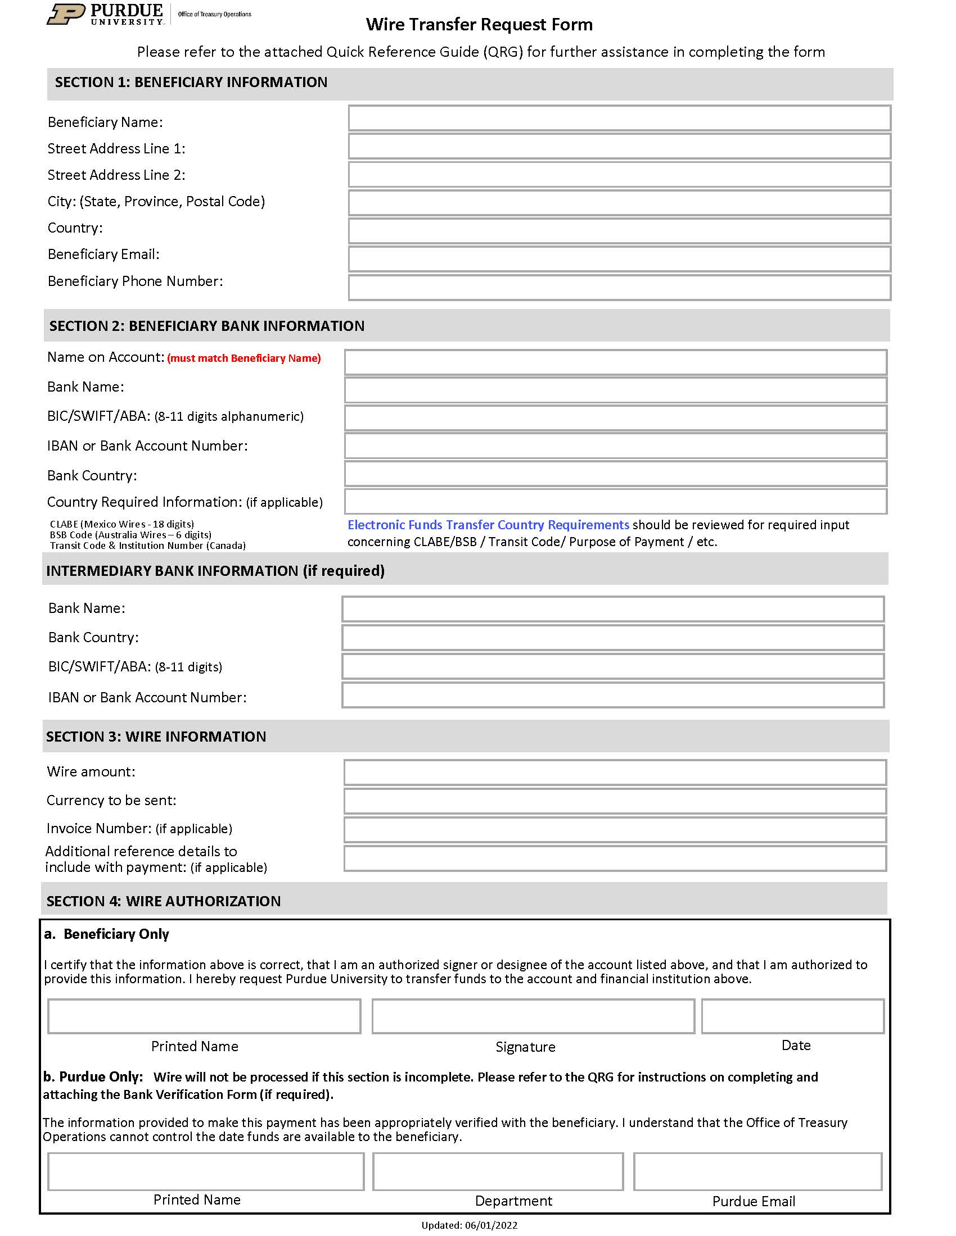
Wire Transfer Form
This form is used when funds are being sent from one account to the other with the bank being the “liaison” instead of the ACH.
A Wire Transfer Request Form and supporting documentation need to be attached with each payment request.
All International payments must be made via wire transfer if non-domestic banking.
Reminder that if setting up the vendor as a new Foreign Vendor, AP will need the W-8BEN-E or W-BEN, depending on the vendor type.
Section 1 & 2 (Beneficiary Name & Name on Account MUST Match)
If you are required to attach a conversion chart, the dates must match the trip or invoice dates.
Foreign Software purchases, licensing, and services performed within the US, may be subject to a 30% tax withholding upfront required by the IRS.
Please contact your Business Manager with any questions pertaining to the Wire Transfer Process.
Wire Transfer Request Form

Slide 30
Section Three - One-Time Vendor
Form 17C
One –Time Vendor Documentation
Substitute W-9 (EFT Banking Choice)
One-Time Vendor Excel Spreadsheet

Slide 31
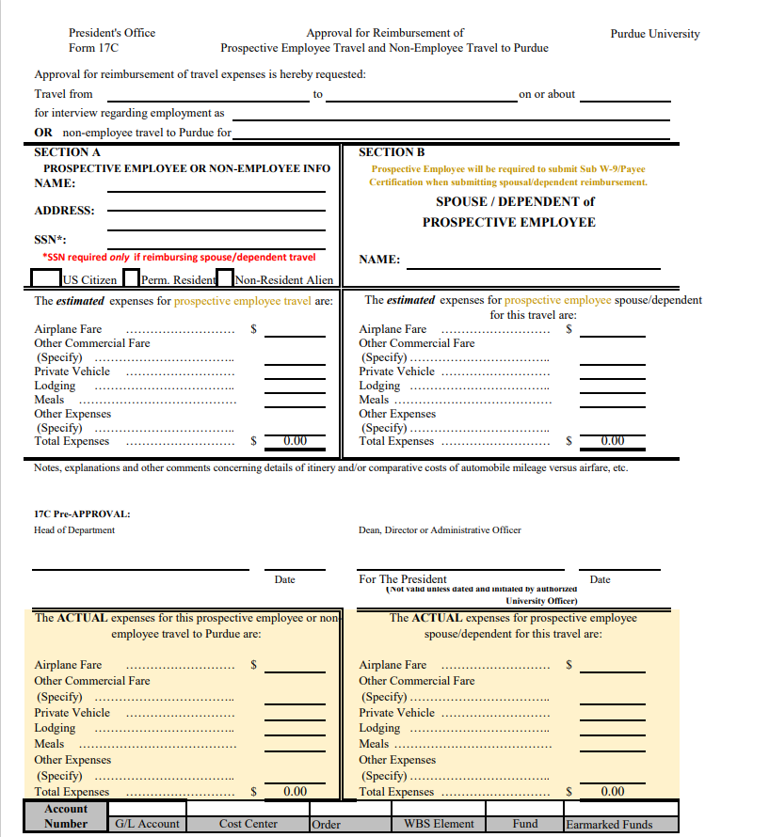
Prospective Employee Reimbursement/Form 17C
Prospective Employees visiting the campus to interview for a position may be reimbursed for some of the trip's associated expenses. Prior approval to reimburse these expenses is obtained by processing Form 17C, “Approval for Reimbursement of Expenses for Prospective Employee Interview Trips.”
The Department must email PNW Accounts Payable the vendor’s name and address before submitting the DocuSign and Form 17C to ensure that the prospective employee is a one-time vendor.
A Social Security Number is needed if the spouse or other dependent accompanies the prospective employee. Any payments made to reimburse the expenses for the spouse or dependent are taxable.
If the vendor is requesting a check payment, then no other documentation is required. A Payee Certificate IS NOT required for a Prospective employee.
If a vendor is requesting a direct deposit (EFT), the vendor fills out the Sub W9.
Notice the “ACTUAL” expense area has been added to the form.
Form 17 C

Slide 32
One-Time Vendor Documentation
Documentation for Check Payment
Documentation for Direct Deposit (EFT)
DIV
Form 17 C
Supporting Documentation
DIV
Form 17C
Substitute W-9
Supporting Documentation
**Prior to submitting a one-time vendor request, contact PNW AP to confirm if the vendor is a true one-time vendor.**

Slide 33
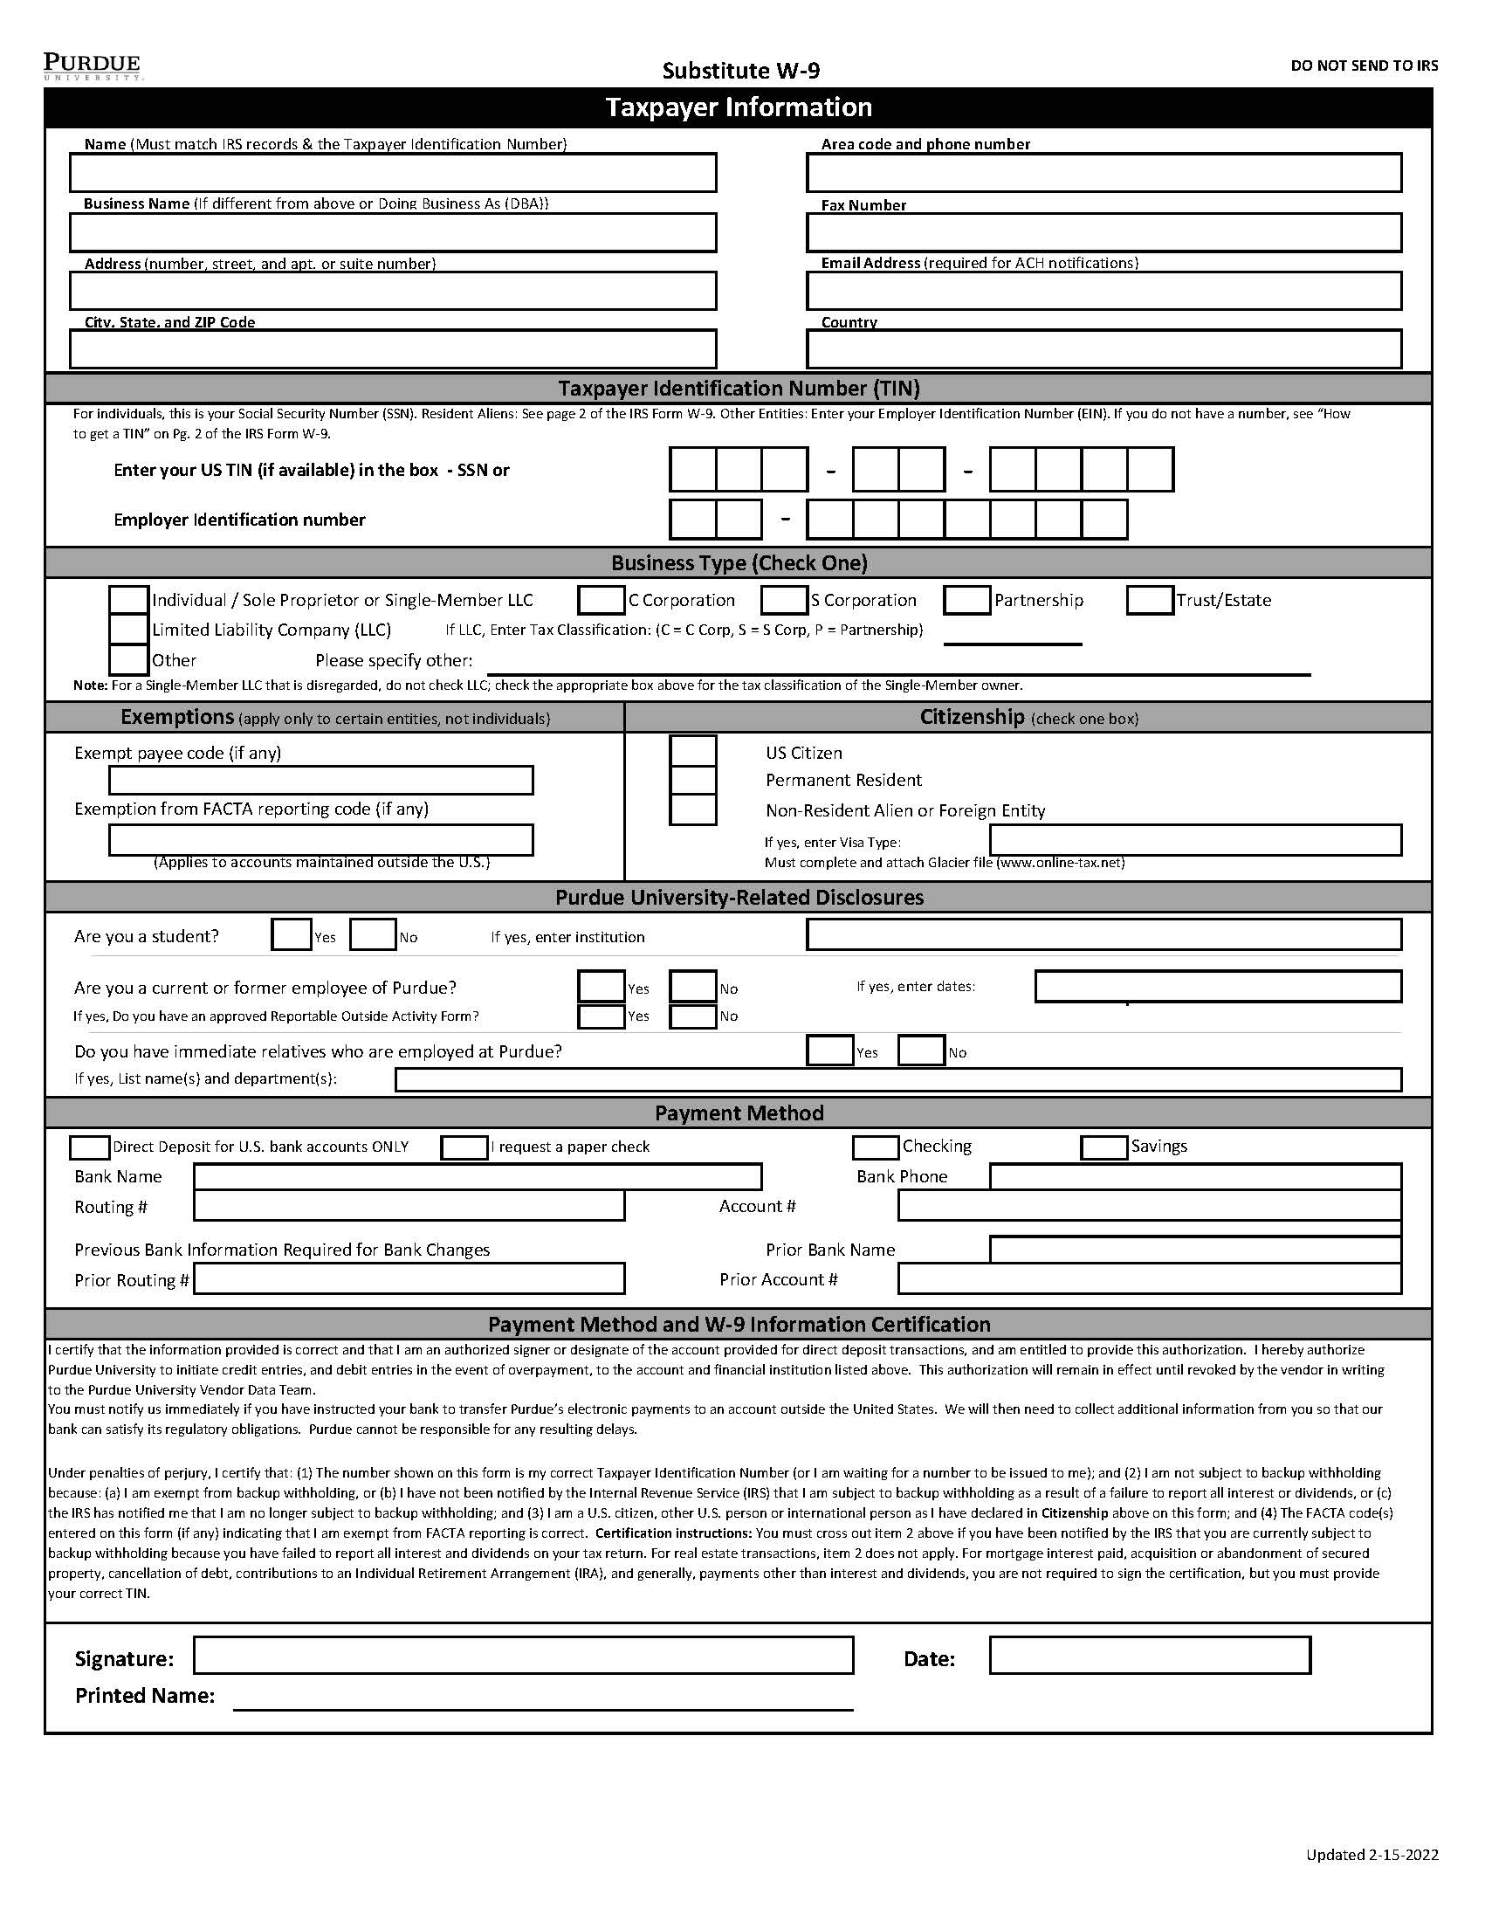

Substitute W-9
This form is necessary for a One-Time vendor requesting direct deposit as payment. This form is to be completed exclusively by the vendor.
The Vendor needs to complete the following :
Taxpayer Information
Taxpayer Identification Number
Business Type
Citizenship
Purdue University –Related Disclosures
Payment is made via direct deposit, with the vendor selecting either checking or savings account. The vendor must provide the bank name and phone number, routing number (9-digit number ), and account number.
Signature Area **
No areas on the form may be left blank, and the form may not be altered.
**Authenticated electronic signatures are acceptable on Purdue’s Sub W-9. An authenticated signature is created through electronic software that is encrypted and is specific to the designated signer.
It is imperative to remember that restricted data cannot be sent via email. We should not initiate a Purdue DocuSign to collect this restricted information. All staff must remain compliant with Purdue’s data-handling requirements, ensuring restricted data is safely shared among peers utilizing the Filelocker alternative.
Example: Carol J Wright - This is NOT an authenticated electronic signature !!!!!
This IS an authenticated electronic signature !!!!! -
Substitute W-9

Slide 34
Example
EXAMPLE
Enter Company Code (PUR or ARI) | PUR
Reference Related Semester/Year | SPRING 2022
Date of Form Submission | 3/22/2022
Brief Description | Vet Hospital Customer refund
Vendor Type (from list to the left) | 3
Request Type (from list below) | 1
Held Check(s)? Yes or No | Yes
Held Check(s) Contact | Terry Staff 494-4444
The One-Time Vendor Spreadsheet will be sent to the Department from PNW AP ONLY if your vendor is determined to be a true One-Time Vendor. The Department will then complete and return the spreadsheet back to the PNW AP requestor in the original Excel format. The responsibility falls within the department for obtaining and storing the necessary backup documentation. * For Direct Deposit, a Substitute W-9 is also required and will need to be sent to the PNW AP requestor via Filelocker .

Slide 35
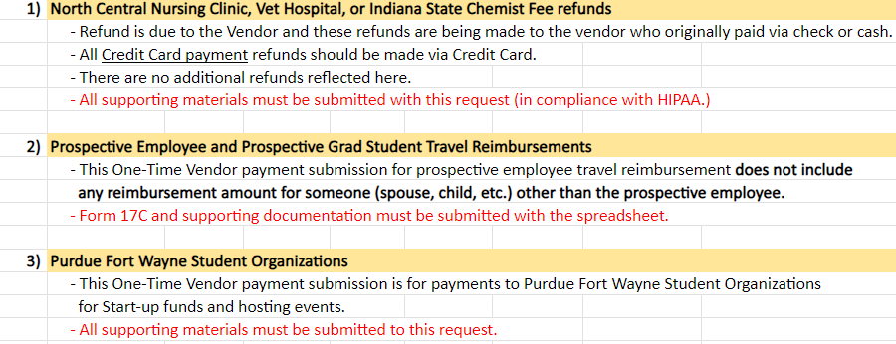
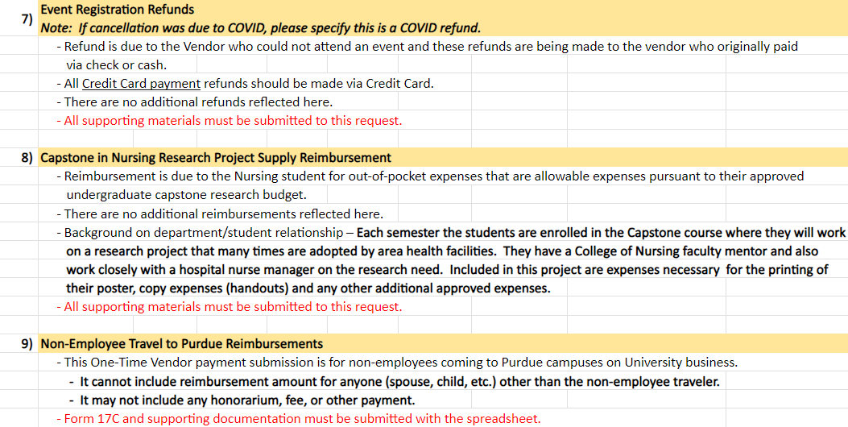
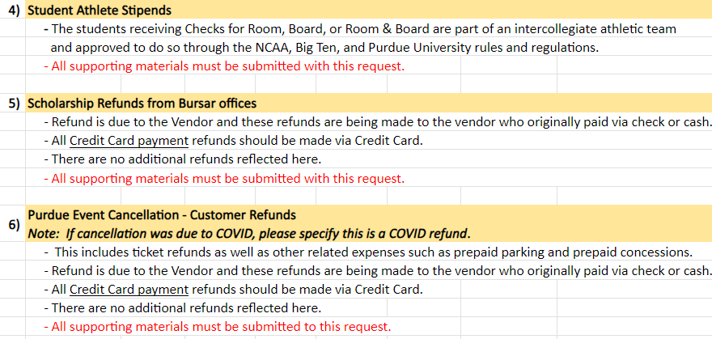
Request Types

Slide 36
Section Four – “Other ” Payments
Non-Resident Alien Payments
“Other ” Payments Training
Prizes and Awards
Non-Employee / Employee Reimbursements
Cash Advances

Slide 37
Non-Resident Alien Payments
Non-residents must complete a Glacier packet for payment to be received. For a non-resident to access the Glacier software, a link is sent, via email, by a Glacier administrator.
Each payment request must have a Tax Summary Report attached and all the pertinent documents as listed on the Summary in the lower section. (See slide 38)(((see
All international employees must have a Glacier account and must receive an access email link from a payroll or employment center staff person to create an account.
Please contact Jane Coleman, colema33@purdue.edu with any Glacier related questions.
Glacier Software Link
PLEASE NOTE: For a Prospective Employee Non-Resident Alien which is considered a ONE-TIME VENDOR by Accounts Payable, a Glacier packet is not required.

Slide 38
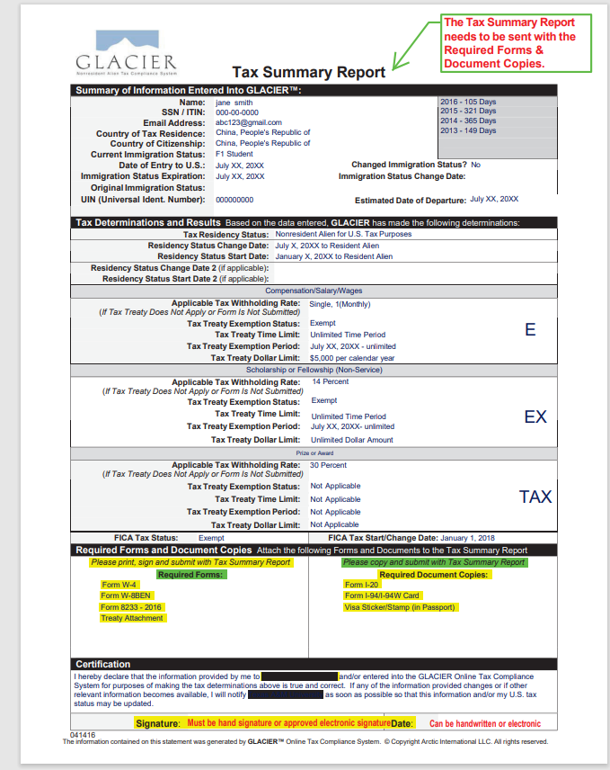
Tax Summary Report
This is an example of the Tax Summary Report; the highlighted areas are what will be required by the vendor to provide. Any questions need to be directed to your Glacier Administrator.
Jane Coleman at colema33@purdue.edu.

Slide 39
“Other” Payments Training
Alcoholic Beverages for University guests and the staff or faculty who host them at University functions MUST go through PRF and not through Accounts Payable.
Employees must go through Concur for Cash Advances. https://www.purdue.edu/procurement/travel/regulations/cash-advances.php
Table Sponsorship – Example: Sponsoring a table for 10 to attend a dinner function…..this may be questioned by Accounts Payable to see if it will most likely go through PRF. Please check with your Business Manager before submitting your Docusign.
Foreign Vendors – If your department uses a foreign country for software purchases, software licensing, or services/work done in the US, the vendor should be prepared to pay as much as a 30% tax upfront. Please work with your Business Manager PRIOR to submitting your payment through Docusign to determine, with the help of the TAX Dept in WL, whether-or-not there will be a tax, and if so, how much money needs to be withheld upfront. You are then able to consult with your vendor PRIOR to the sale in order to allow everyone to be aware of how much the vendor will receive, and if you want to proceed with the transaction. Please remember that Purdue is obligated by federal law to withhold that tax upfront. You and your vendor need to preplan for these types of scenarios.
Please be aware that using a P-card to try to avoid the Foreign Vendor Tax scenario will not work. The same rules apply to using your own credit card.
Contact: Jane Coleman at colema33@purdue.edu for all foreign vendor questions and concerns. She is the expert and can assist with all foreign vendor advice and protocol.

Slide 40
Prizes and Awards
For non-employee individuals who receive an award or prize and are U.S. citizens, Resident Aliens, or Permanent Residents, payment is made via the DIV-DocuSign Process, and a Payee Certification Form would be required. If it is a new vendor/payee, the Payment Works links will be emailed to the vendor.
If non-employee international individuals receive a prize or award, payment would be made via the DocuSign process, and Glacier documentation would have to be attached.
The Tax Department will determine the tax coding.
HONORARIUMS for EMPLOYEES RELATED TO WORKSHOPS
If the EMPLOYEE is performing the duties related to instruction or participating in instructing the workshop, etc., this payment would be paid through PAYROLL. If the EMPLOYEE was one of the teachers/instructors invited to attend and receive the instruction, this payment would pay out through ACCOUNTS PAYABLE.

Slide 41
Reimbursements
Non-Employee Reimbursements
Employee Reimbursements
Employee expense reimbursements do not require a Payee Certification Form. (Except when the employee is performing a service not related to their current job with Purdue.)
Original receipts are required. If an original receipt is not possible, a Certification for a Missing Receipt should be completed. Missing Receipts
A PNW business purpose needs to be clearly stated that explains the reason for the expenditure.
If business travel expenses are being reimbursed, CONCUR should be utilized.
This includes Virtual Registrations as well as in-person, mileage, etc…(This includes regular employees, grad student employees and active under-grad student employees.
Concur-Employees and Departments can contact West Lafayette Travel if they need assistance creating a travel expense report. purduetravel@purdue.edu
Please remember to list all attendee/participant names and the business purpose for the dinner receipt reimbursements. (Example: Chairperson takes candidate and three additional faculty out to dinner for business purpose.)
Please also remember the importance of anonymity on behalf of our students per FERPA regulations. As is the case with Restricted data, we also hold our students’ privacy to these same high standards. Please do not identify an attendee/participant as a student.
This same anonymity standard should be in effect for DIVS containing personal medical testing information for employees due to HIPPA regulations.
Please make sure that you have indicated on your DIV within the Description area that the individual is an EMPLOYEE.
Future employees who have accepted a job offer may receive reimbursement through the DocuSign process if the payment is issued more than 30 days before their hire date. An offer letter must be attached. If it is less than 30 days before the employee’s hire date, the allowance/reimbursement is paid through Payroll.
Please contact Human Resources for further details – PRIOR to submitting your DIV.
If a non-employee is being reimbursed, original receipts (if possible) should be submitted. A Payee Certification Form will need to be attached, and a clear explanation of the business purpose for this expense should be provided. (If this Payee is not currently in the AP system, the Payee will be sent the Payment Works Link.)
If the non-employee is international, a Payee Certification Form would need to be provided along with the appropriate Glacier documentation. Original receipts (if possible) should be provided. If foreign currency is used, a currency conversion chart must be attached. For mileage, a route map displaying miles traveled must be attached. (If the Payee is not currently in the AP system, the Payee will be sent the Payment Works link.) Please remember to attach the contracts, etc., so that the TAX Dept in WL can view the legitimacy of the expense and not question whether it is a maverick spending situation.
Please DO NOT attach photos, blank pages, unrelated documents, and AD copies to your Docusigns! These unnecessary documents take up too much space in our secure BOX folder. If your department needs to see them to approve the expense, please make this arrangement prior to going through Docusign, if possible.
Notes:
Speak about proper documentation, adding blank pages, or ads. The w9 only need that pages, not all 12 pages.

Slide 42
SECTION - FIVE CHARTS
PLEASE NOTE:
DUE TO THE IMPLEMENTATION OF THE VENDOR “PAYMENT WORKS” PORTAL, THE VENDOR IS RESPONSIBLE FOR THEIR OWN DATA.

Slide 43
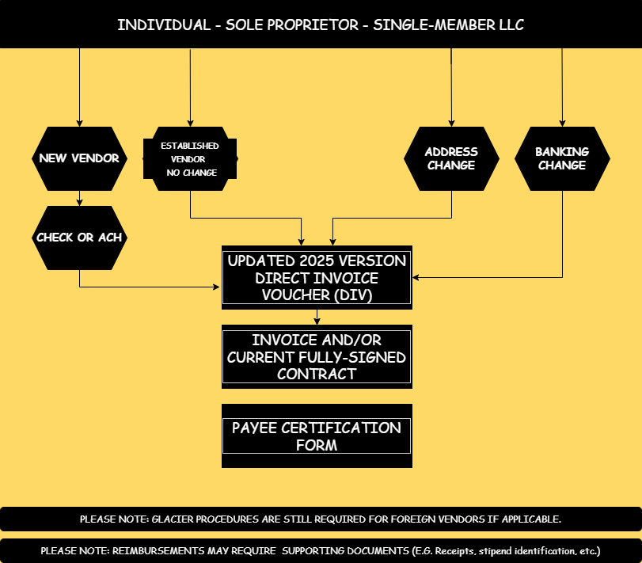
Chart 1

Slide 44
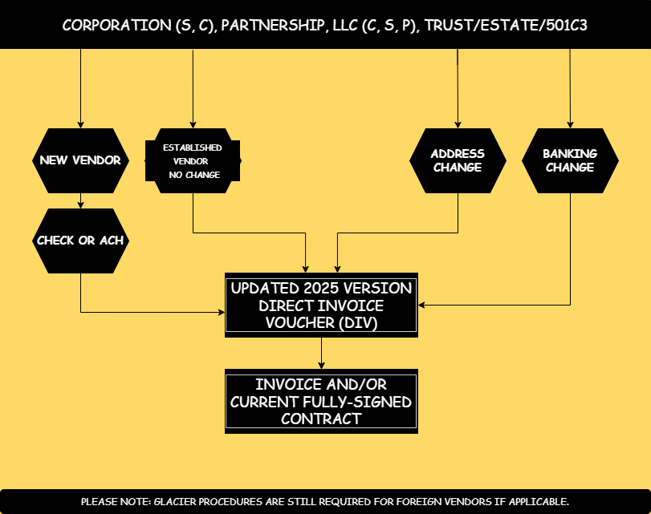
Chart 2

Slide 45
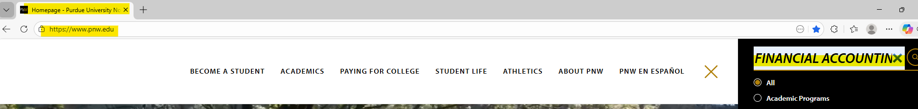
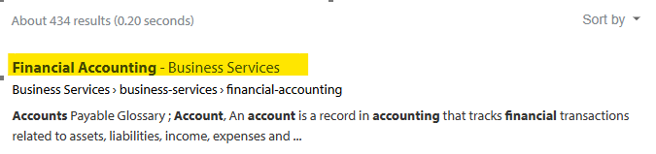
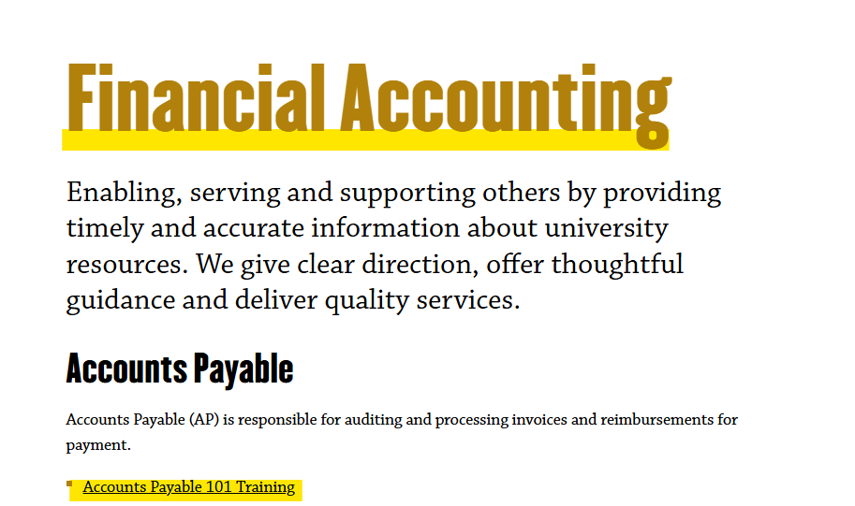
NAVIGATING THE PNW ACCOUNTS PAYABLE WEBSITE!
Financial Accounting - Business Services - Purdue University Northwest

Slide 46
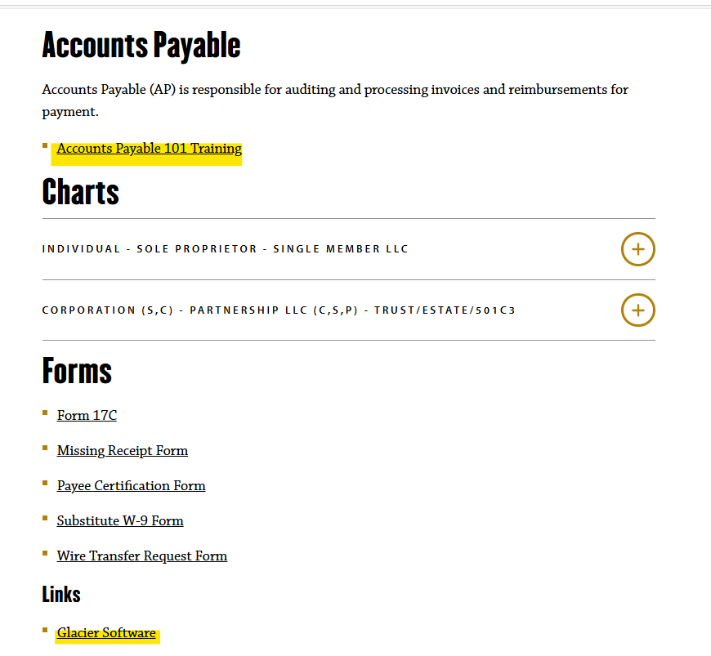
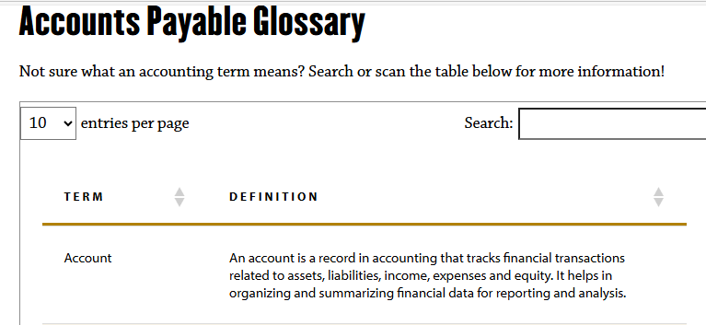
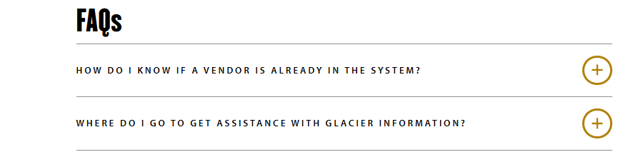
Accounts Payable

Slide 47
Things to Remember
All inquiries related to P-Cards should be directed to your specific Account Coordinator, who is located within the Managerial Accounting Department.
Accounts Payable is located within the Financial Accounting Department.
Accounts Payable offers semester trainings as well as quarterly “topic-specific” half-hour mini-sessions.
Our next mini-session will highlight the Payment Works Vendor Portal. Keep an eye on your email for upcoming announcements and be sure to join us for guidance on navigating the process.
Have AP inquiries? Please reach out to us at: pnwpayables@pnw.edu
Reminder: Please always refer to the webpage for the most recent Accounts Payable Forms!
Financial Accounting
Please remember: Entering outdated forms into DocuSign will require you to REMOVE your DocuSign.
THANK YOU FOR JOINING US TODAY!

