Slide 1
Graduate Student Orientation
2025-2026

Slide 2
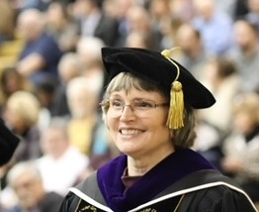
Welcome to PNW!
Joy L. Colwell
Director of Graduate Studies
Professor of Organizational Leadership and Supervision

Slide 3
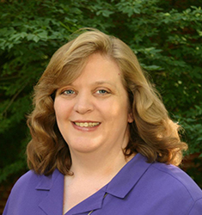
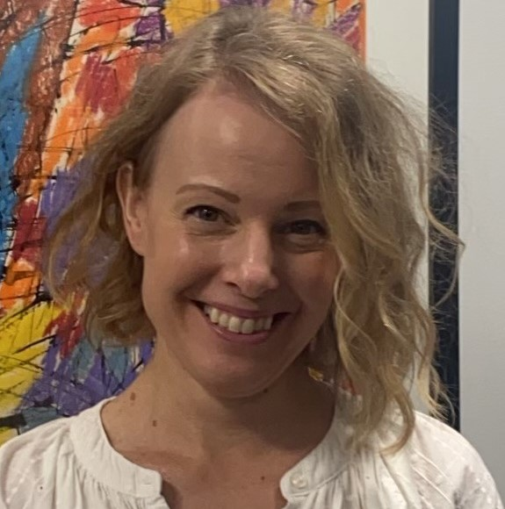
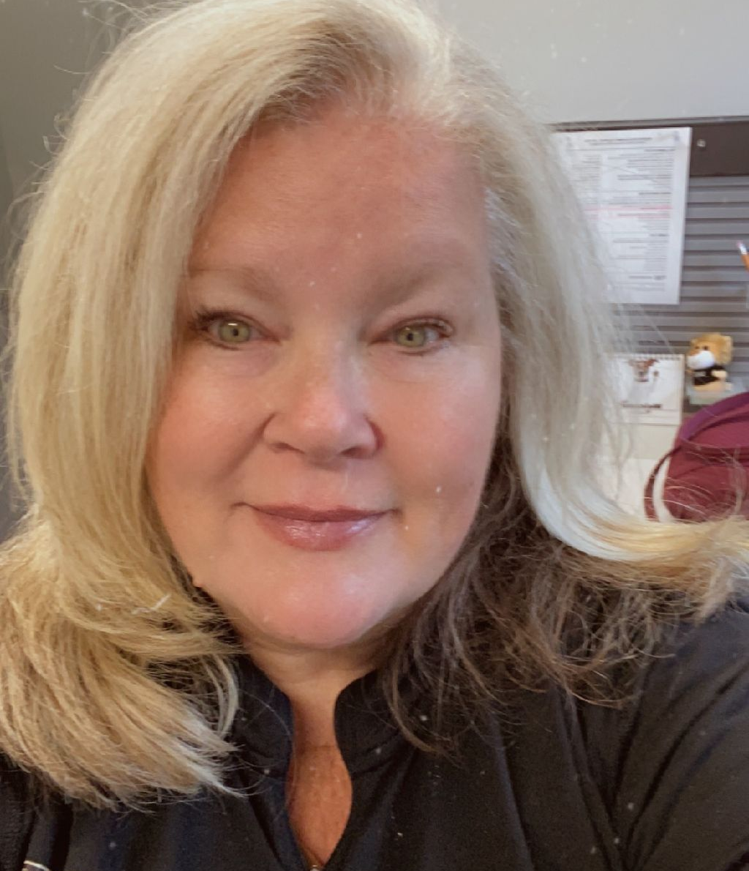
Graduate Studies Office Meet our Team
Margaret (Peggy) Greer
Associate Director of Graduate
Admissions and Records
Janet Huber
Grad Student Support Specialist
Michelle McAllister
Grad Student Support Specialist

Slide 4
PNW and Purdue University
Purdue University Northwest (PNW) is part of the Purdue University Graduate School
PNW follows the rules and policies of the Purdue University Graduate School
Resources for PNW students can be found on the Graduate Studies website.
https://www.pnw.edu/graduate-studies/
Resources can also be found on the Purdue University – West Lafayette Graduate School website.
https://www.purdue.edu/gradschool/
Some information from Purdue University - West Lafayette is relevant to PNW such as graduate deadlines, academic performance requirements, thesis requirements, etc.

Slide 5
Graduate Studies Office
The Graduate Studies Office is located in 212 Lawshe Hall.
Contact us at (219) 989-2257 or grad@pnw.edu
The office is open Monday through Friday, and you can drop in between 9am to 4:00pm. If you need to visit at a different time, please call us in advance.
Visit our office to submit required documents noted in your admission letter, such as official transcripts, diploma, etc.
Some forms can be submitted directly to grad@pnw.edu, such as Graduate Staff Fee Remission forms.
Our staff is also available to assist students with questions virtually or in-person. Please contact the Graduate Studies Office for an appointment.

Slide 6
Graduate Student Late Fee
Important info to know----
Graduate students may be charged a $150 Graduate Late Fee for missing certain deadlines.
For more information, please visit the Bursar webpage or call (219) 989-2560 (bursar@pnw.edu).

Slide 7
Courses and Advising
Your academic advisor in your program of study can assist you with advising and registration. Your advisor will work with you on selecting the correct courses that are on your plan of study.
You can find the name of your academic advisor on the second page of your admission letter.
You can self register through the myPNW portal. Make sure the courses that you register for count towards your degree/plan of study.

Slide 8
Health Insurance
PNW is pleased to offer health insurance options to all students through UnitedHealthcare Student Resources, administered by Academic HealthPlans, Inc. (AHP). For more information, please visit https://www.pnw.edu/dean-of-students/student-resources/student-health-insurance/
All international graduate students who are registered for classes, regardless of credit hours, visa status, or insurance policy type, are required to enroll in the University-sponsored medical insurance plan or to obtain an approved waiver or coverage by the enrollment/waiver deadline. For more information and to enroll, please visit https://pnw.myahpcare.com/
For more information regarding waivers, please visit https://pnw.myahpcare.com/waiver?_ga=2.118796555.347164460.1626710908-1234353313.1619466947
Open Enrollment for health insurance coverage during the 2025-2026 academic year is July 1, 2025 (8:00am ET) to September 5, 2025 (5:00pm ET or 4PM local time).
Failure to provide proof of health insurance will result in a hold being placed on your account and possibly being charged a $150 Graduate Late Fee.
Be sure to check your PNW email for more information regarding health insurance and deadline reminders.

Slide 9
Graduate Student Handbooks and Information
Check with your department for a program specific graduate student handbook.
Academic policies and procedures for the Office of Graduate Students and Post Doctoral Scholars can be found in the Purdue University catalog.
Purdue Academic Catalog
PNW Catalog
Student Resource Guide
Campus Policies

Slide 10
The Point
The Point is your one-stop student support and success center that offers a true peer-to-peer experience to make you feel welcome and confident as you begin graduate studies at PNW.
Students can ask questions, get connected to resources and learn more about being part of the Pride.
We believe some of the best community building happens at The Point.
For more information, please visit https://www.pnw.edu/admissions/undergraduate/admitted-students/the-point/

Slide 11
Student ID Cards/PrIDe Card
For instructions on how obtain your electronic ID, please visit https://www.pnw.edu/admissions/undergraduate/admitted-students/id-card/
Your PNW undergraduate ID is still valid if you become a graduate student.
Physical ID cards can be requested. Please submit your request for a physical ID card on the webpage above.
Please contact The Point (formerly New Student Orientation) at (219) 989-4160 with any questions.

Slide 12
Student Login
Newly admitted graduate students should have received an admissions email from the Office of Graduate Students and Post Doctoral Scholars, welcoming you to the Purdue system.
You also received a second email from PNW with information about usernames and authentication (Purdue Login)two factor procedures.
You’ll use your PNW username and password to access a range of digital services. Learn more about creating and changing your accounts by visiting https://www.pnw.edu/information-services/services/accounts-and-passwords/

Slide 13
BoilerKey
A two-factor authentication system, Purdue Login significantly improves the security of protected computer systems and accounts by requiring two forms of verification before access is granted.
For more information, please visit https://www.pnw.edu/information-technology/services/purdue-login/

Slide 14
Student Email
Every PNW student is provided with a Gmail account.
As part of the Google Apps for Education, email address are set to your PNW account username@pnw.edu.
All official University information will be sent to this account.
Check for messages frequently.
For more information about your student account, please visit https://www.pnw.edu/information-services/services/gmail-google-drive/

Slide 15
Graduate Staff Appointments
A graduate staff appointment offers a tuition remission (reduction in tuition) and a monthly stipend (paycheck).
Staff may work as teaching assistants, research assistants or graduate professionals doing other work on campus.
Positions are very competitive, since there are more applicants than positions available.
Check with your program to see if there are any positions available. You can also check with other departments on campus.

Slide 16
Graduate Staff Appointments
A fee remission form must be turned in every semester that you are employed. Please turn your completed form in to Lawshe 212.
For more information regarding graduate staff appointments, please visit https://www.pnw.edu/graduate-studies/opportunities-for-support/graduate-employment/
Please contact the Graduate Studies Office at (219) 989-2257 or grad@pnw.edu with any questions.
Graduate Staff Remission Form (pnw.edu) Form link

Slide 17
Plan of Study
Graduate education is controlled by a Plan of Study or degree requirements which show the courses you will take to earn your degree, along with any other requirements for graduation.
The electronic Plan of Study (ePOS) system can be found through the myPNW portal.
Navigate to the Graduate Student Resources Page from the Dashboard.
Under “Pages”, select “Students” and then Graduate Student Resources. From that page, select “Graduate Plan of Study”
ePOS will be available to new graduate students after one semester of enrollment.
You can find instructions for ePOS on the Graduate Studies website (https://www.pnw.edu/graduate-studies/about-us/graduation-guide/)
Credit hours required for your program vary by degree program. The academic catalog will show the credit hours required for your particular degree program.
Thesis, non-thesis, coursework-based programs are available.

Slide 18
Academic Expectations
Graduate students are expected to maintain a “B” (3.0/4.0) cumulative graduate GPA.
Students must have a 3.0 average on their plan of study courses to graduate.
Some programs do not allow “C” grades on the plan of study. Please check with your academic advisor/program.
If you do have “C” grades, you will need to offset those with “A” work to maintain a cumulative 3.0 GPA on your plan of study, if “C” grades are allowed by your graduate program.

Slide 19
Library Resources
It is strongly recommended that you learn about the resources that are available to you at the library for your graduate level studies in your discipline.
Many sources are available online, or through Interlibrary Loan.
For more information about our Library, please visit https://www.pnw.edu/library/

Slide 20
Writing Resources
Purdue University West Lafayette Writing Lab.
PNW Writing Center - Find support for any writing task from trained peer tutors, including workshops, group sessions and electronic sessions (over email).
Citation Management or Reference Management Software (e.g. EndNote, Zotero, Mendeley), either free or purchased, may be helpful to you in your studies, especially in a thesis or research based program.
Investigate the usefulness of the software and start using early in your studies.

Slide 21
Student Software
Software may be available at an educational discount.
Some software titles are available at Purdue University West Lafayette through ITAP
Software List
Services for Students

Slide 22
Technical Support and Customer Service
Need technical assistance? PNW’s Customer Service Center is ready to help.
Office hours are Monday through Friday, 8:00 am to 4:30 pm, Saturday
Contact Customer Service at (219) 989-2888 or csc@pnw.edu.
Customer Service Website
Information Services Website

Slide 23
Good luck with your future studies and thank you for choosing to study at PNW! Grad Studies staff are here to help!

