Slide 1

Graduate Studies Orientation
2026-2027

Slide 2
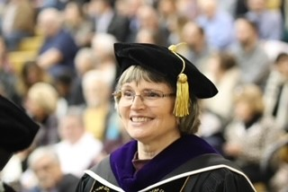
Graduate Studies Staff
Joy L. Colwell, J.D.
Director of Graduate Studies
Professor of Organizational Leadership and Supervision

Slide 3

Graduate Studies Staff (Faculty Fellow)
Christopher K. Belous, Ph.D.
Graduate Studies Faculty Fellow
Director of Couple & Family Therapy Graduate Programs and Services

Slide 4
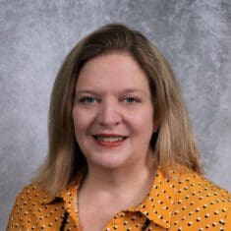
Graduate Studies Staff (Associate Director)
Margaret (Peggy) Greer
Associate Director of Graduate Admissions and Records
Designated School Official

Slide 5
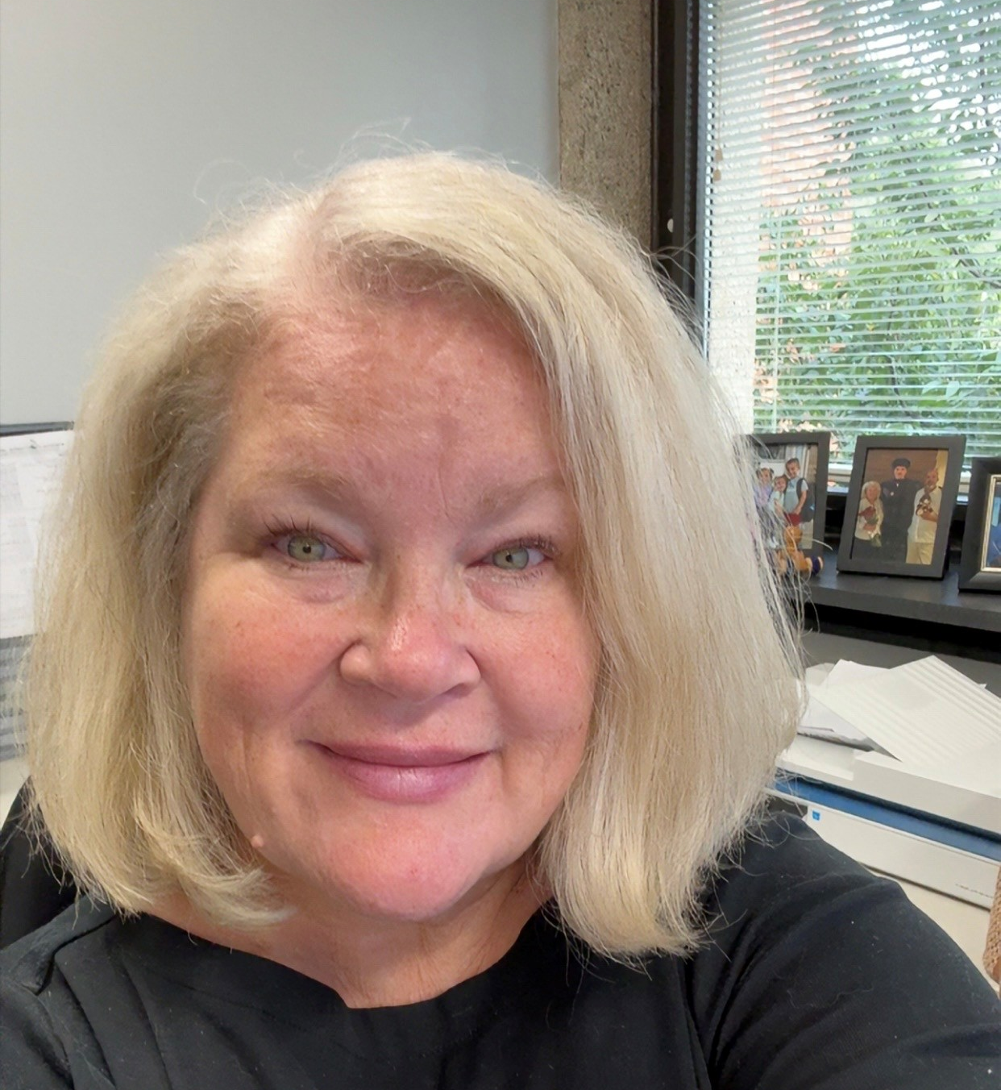
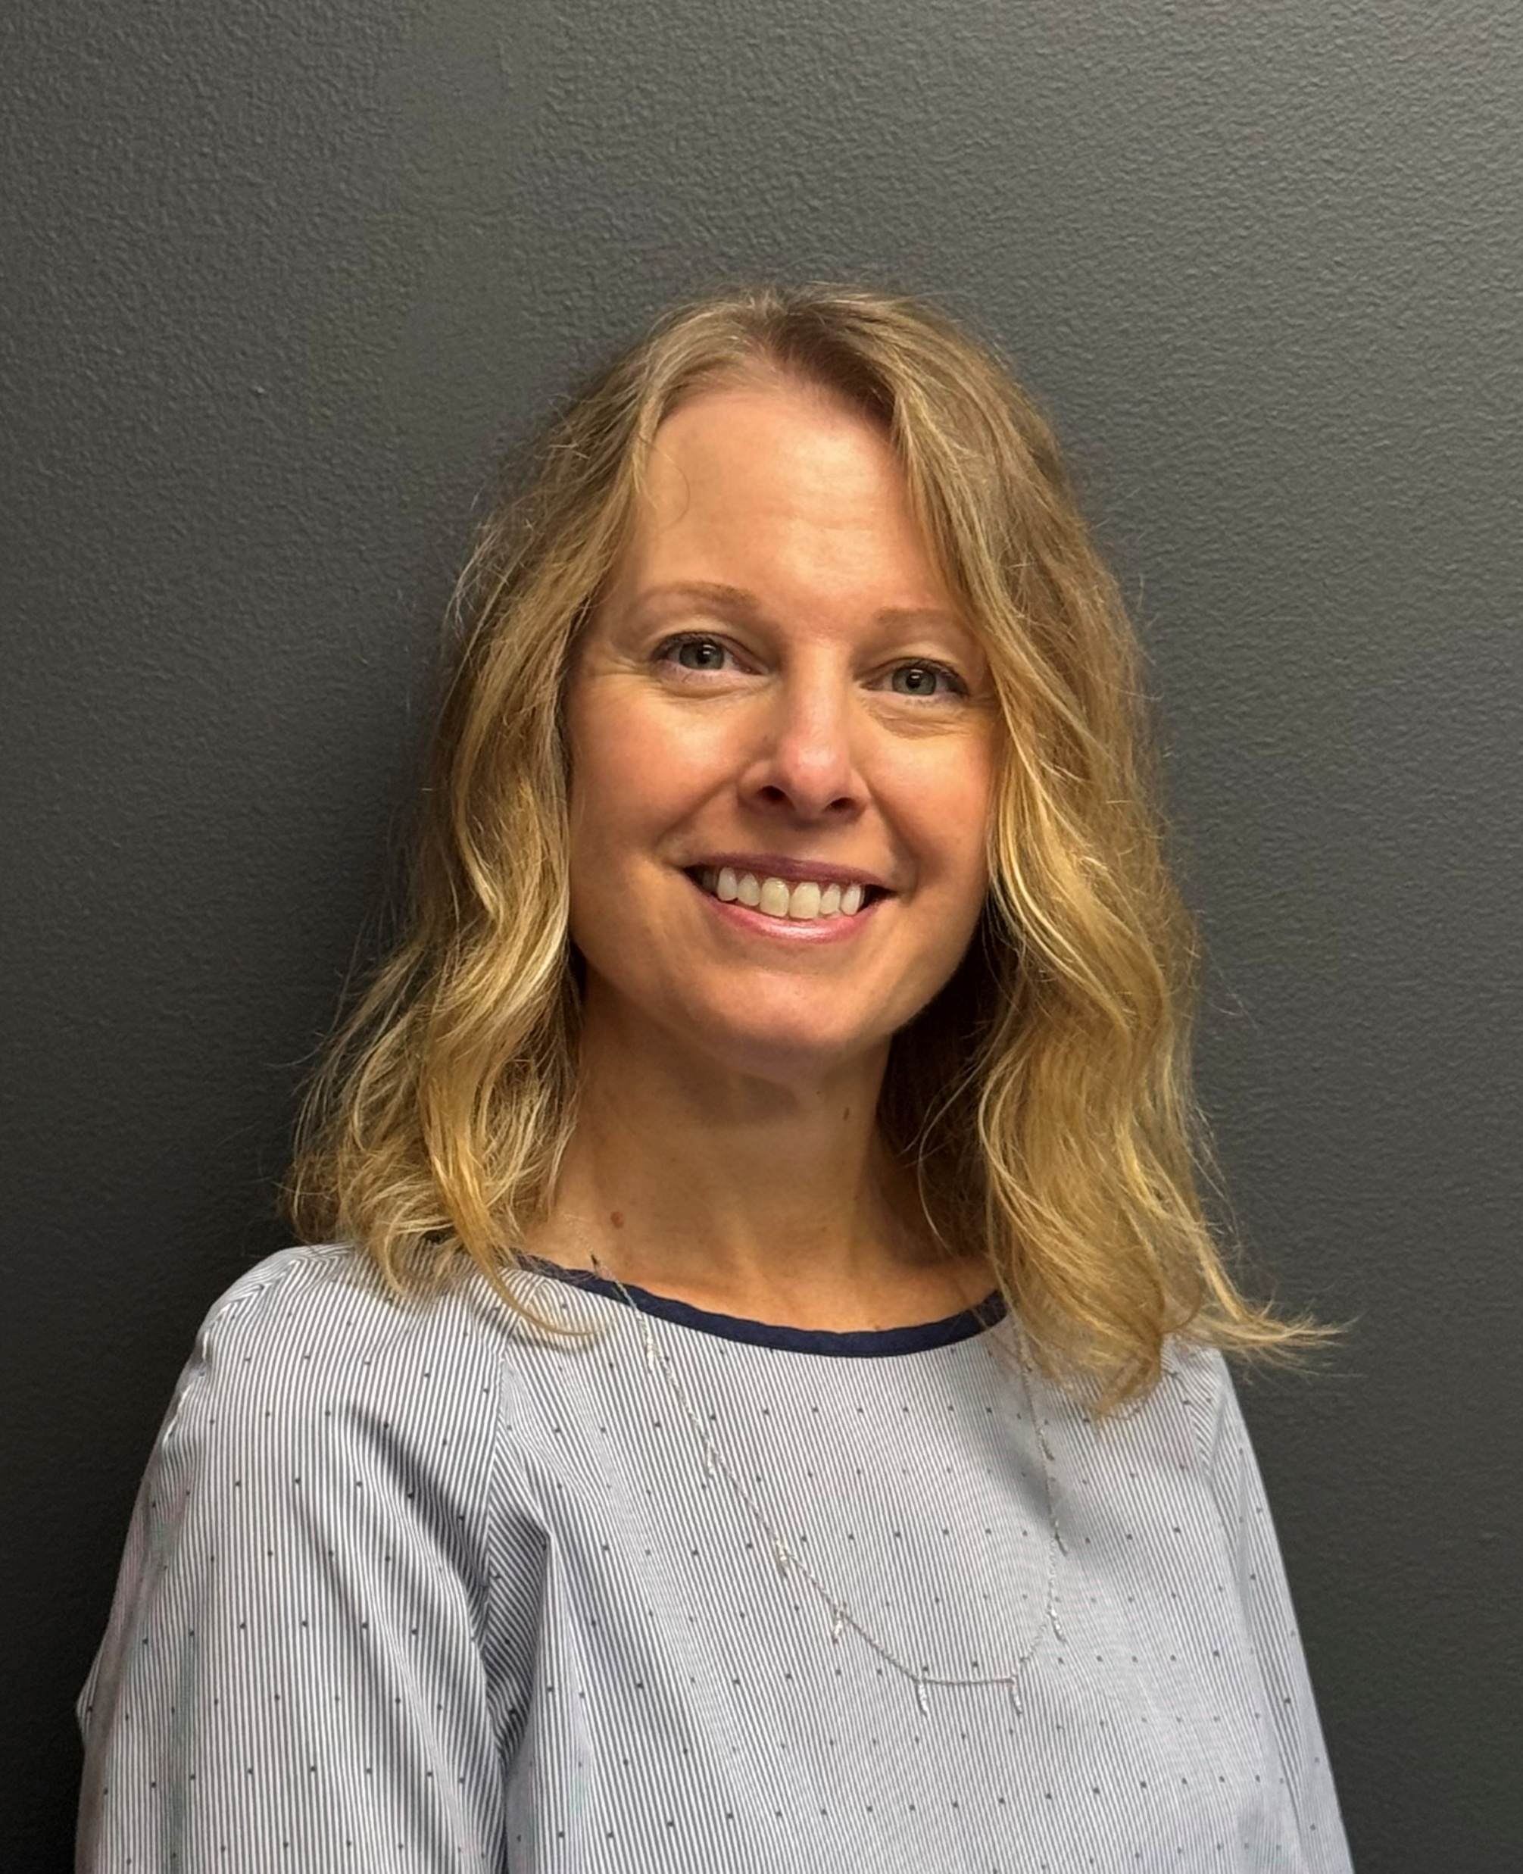
Graduate Studies Staff (Support Specialists)
Janet Huber
Student Support Specialist
Michelle McAllister
Student Support Specialist

Slide 6
PNW and Purdue University
Purdue University Northwest (PNW) is part of the Purdue University Office of the Vice Provost for Graduate Students and Postdoctoral Scholars (OGSPS)
PNW graduate programs follow the rules and policies of the Purdue University OGSPS.
Resources for PNW grad students can be found on the Graduate Studies website.
  https://www.pnw.edu/graduate-studies/
Resources can also be found on the Purdue University – West Lafayette Graduate School website.
  https://www.purdue.edu/gradschool/
  Some information from Purdue University - West Lafayette is relevant to PNW such as graduate deadlines, academic performance requirements, thesis requirements, etc.

Slide 7
Graduate Studies Office
The Graduate Studies Office is located at Lawshe Hall, Room 212
Contact us at (219) 989-2257 or at grad@pnw.edu
The office is open Monday through Friday, 9:00am to 4:00pm. If you need to visit at a different time, please call us in advance.
Visit our office to submit required documents noted in your admission letter, such as official transcripts, diploma, etc.
Some forms can be submitted directly to grad@pnw.edu, such as Graduate Staff Fee Remission forms, or you can drop them off.
Our team is also available to assist students with questions virtually or in-person.

Slide 8
Courses and Advising
Your academic advisor in your program of study can assist you with advising and registration. Your advisor will work with you on selecting the correct courses that are on your plan of study.
You can find the name of your academic advisor on the second page of your admission letter. You can also contact the Graduate Studies Office and we can give you their contact information.
You can self-register through the myPNW portal. Make sure the courses that you register for count towards your graduate degree/plan of study.

Slide 9
Health Insurance
PNW is pleased to offer health insurance options to all students through UnitedHealthcare Student Resources, administered by Academic HealthPlans, Inc. (AHP). For more information, please visit Student Health Insurance - Dean of Students - Purdue University Northwest
All international graduate students who are registered for classes, regardless of credit hours, visa status, or insurance policy type, are required to enroll in the University-sponsored medical insurance plan or to obtain an approved waiver or coverage by the enrollment/waiver deadline. For more information and to enroll, please visit https://pnw.myahpcare.com/.
For more information regarding waivers, please visit International Graduate Students - Graduate Studies - Purdue University Northwest
Open Enrollment for health insurance coverage during the 2026-2027 academic year is July 1, 2026 (8:00am ET) to September 8, 2026 (5:00pm ET or 4PM PNW time). Spring semester enrollment is 12/01/26 to 02/02/27.
Failure to provide proof of health insurance will result in a hold being placed on your account and possibly being charged a $150 Graduate Late Fee.
Be sure to check your PNW email for more information regarding health insurance and deadline reminders.

Slide 10
Graduate Student Late Fee
Important info to know----
Graduate students may be charged a $150 Graduate Late Fee for missing certain deadlines.
For more information, please visit the Bursar webpage or call (219) 989-2560 (bursar@pnw.edu).

Slide 11
Graduate Student Handbooks and Information
Check with your department for a program specific graduate student handbook.
Academic policies and procedures for the Office of the Vice Provost for Graduate Students and Post Doctoral Scholars (OGSPS) can be found in the Purdue University catalog.
Policies and Procedures for Administering Graduate Student Programs - Purdue University
Purdue University Northwest Academic Catalog
Student Handbook - Dean of Students - Purdue University Northwest
Policies - Dean of Students - Purdue University Northwest

Slide 12
The Point
The Point is your one-stop student support and success center for both graduate and undergraduate students at PNW.
For more information, please visit The Point - Purdue University Northwest.

Slide 13
Student ID Cards/PrIDe Card
For instructions on how obtain your electronic ID, please visit
PrIDe Card - Student ID - Purdue University Northwest
Your PNW undergraduate ID is still valid if you become a graduate student.
Physical ID cards can be requested. Please submit your request for a physical ID card on the webpage above.
Please contact The Point at (219) 989-4160 with any questions.

Slide 14
Student Login
Newly admitted graduate students should have received an admissions email from the Office of the Vice Provost for Graduate Students and Post Doctoral Scholars (OGSPS), welcoming you to the Purdue system.
You also received a second email from PNW with information about usernames and authentication (Purdue Login)two factor procedures.
You’ll use your username and password to access a range of digital services. Learn more about creating and changing your accounts by visiting Purdue Login - Information Technology - Purdue University Northwest.

Slide 15
Two Factor Authentication (MFA)
A two-factor authentication system, Purdue Login significantly improves the security of protected computer systems and accounts by requiring two forms of verification before access is granted.
Microsoft Multi-Factor Authentication (MFA) is the smartphone application that prompts you to confirm you are signing into Purdue Login.

Slide 16
Student Email
Every PNW student is provided with an Outlook account.
All official University information will be sent to this account.
Check for messages frequently.
For more information about your student account, please visit https://www.pnw.edu/information-technology/services/exchange/ or
For Students - Information Technology - Purdue University Northwest

Slide 17
Graduate Staff Appointments
A graduate staff appointment offers a tuition remission (reduction in tuition) and a monthly stipend (paycheck).
Staff may work as teaching assistants, research assistants or graduate professionals doing other work on campus.
Positions are very competitive, since there are more applicants than positions available.
Check with your program to see if there are any positions available. You can also check with other departments on campus.

Slide 18
Graduate Staff Appointments (Continued)
A Graduate Staff Fee Remission Form must be submitted each semester that you are employed. Please submit your completed form to Lawshe Hall, Room 212.
For additional information about graduate staff appointments, please visit https://www.pnw.edu/graduate-studies/opportunities-for-support/graduate-employment/
If you have any questions, please contact the Graduate Studies Office at (219) 989-2257 or grad@pnw.edu.
Graduate Staff Remission Form (pnw.edu) Form link

Slide 19
Plan of Study
Graduate education is controlled by a Plan of Study or degree requirements which list the courses you will take to earn your degree, along with any other requirements for graduation.
The electronic Plan of Study (ePOS) system can be found through the myPNW portal.
  Navigate to the Graduate Student Resources Page from the Dashboard.
  Under “Pages”, select “Students” and then Graduate Student Resources. From that page, select “Graduate Plan of Study”
ePOS will be available to new graduate students after one semester of enrollment.
You can find instructions for ePOS on the Graduate Studies website (https://www.pnw.edu/graduate-studies/about-us/graduation-guide/)
Credit hours required for your program vary by degree program. The academic catalog will show the credit hours required for your particular degree program.
Thesis, non-thesis, coursework-based programs are available.

Slide 20
Academic Expectations
Graduate students are expected to maintain a “B” (3.0/4.0) cumulative graduate GPA.
Students must have a 3.0 average on their plan of study courses to graduate.
Some programs do not allow “C” grades on the plan of study. Please check with your academic advisor/program.
If you do have “C” grades, you will need to offset those with “A” work to maintain a cumulative 3.0 GPA on your plan of study, if “C” grades are allowed by your graduate program.

Slide 21
Library Resources
It is strongly recommended that you learn about the resources that are available to you at the library for your graduate level studies in your discipline.
Many sources are available online, or through Interlibrary Loan.
For more information about our Library, please visit https://www.pnw.edu/library/

Slide 22
Writing Resources
Purdue University West Lafayette Writing Lab.
PNW Writing Center - Find support for any writing task from trained peer tutors, including workshops, group sessions and electronic sessions (over email).
Citation Management or Reference Management Software (e.g. EndNote, Zotero, Mendeley, etc.), either free or purchased, may be helpful to you in your studies, especially in a thesis or research-based program.
Investigate the usefulness of the software and start using early in your studies.

Slide 23
Student Software
Software may be available at an educational discount.
Purdue University IT Student Software
Some software may be available for your classes through the PNW Bookstore.

Slide 24
Technical Support and
Customer Service
Need technical assistance? The Customer Service Center is ready to help.
(219) 989-2888
csc@pnw.edu
Hours of Operation:
CSC is closed on all campus holidays and when the campus is closed for other reasons.
Customer Service Center - Information Technology - Purdue University Northwest
Phone
Monday to Friday: 7:30am to 4:30pm
Saturday: 10:00am to 5:00pm
Zoom
Monday to Friday: 7:30am to 4:30pm
Saturday: 10:00am to 5:00pm
Join the Virtual Help Desk
Walk-in (Powers 216)
Monday to Friday: 7:30am to 4:30pm

Slide 25
Thank you for choosing Purdue University Northwest!

